Slide 1

Volunteerism Engagement
and Lifecycle:
Strategies for Today's Volunteer Landscape
Town of Olds, October 6, 2026
Notes:
GD

Slide 2
Housekeeping
and welcome!
Notes:
GD
Housekeeping – this workshop will take about 3 hours with facilitated discussion and presentation content. As we are a small group, please feel free to ask questions as we go through the presentation.
Also mention that this presentation will cover a lot of different topics, so get ready to take notes.

Slide 3
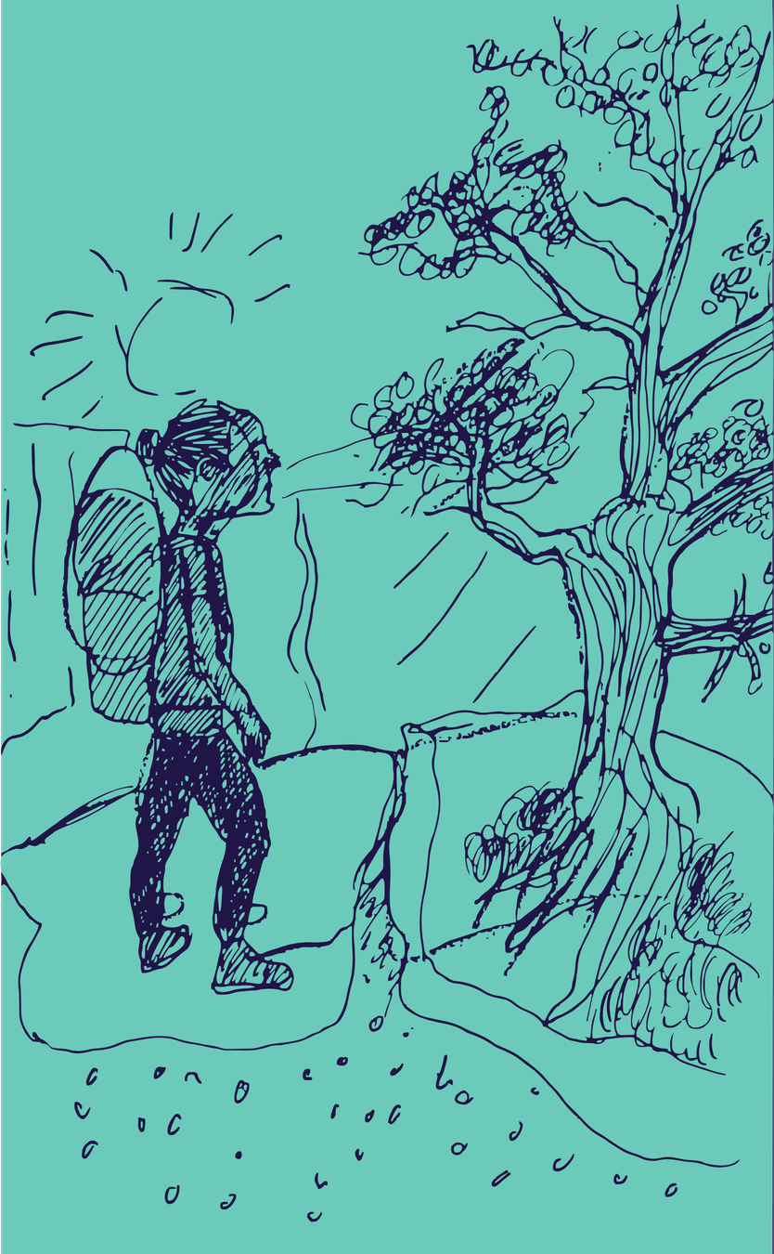
Land Affirmation
Notes:
EN
Volunteer Alberta’s main office is situated on Treaty 6 Territory, specifically, amiskwaciwâskahikan (ᐊᒥᐢᑲᐧᒋᐋᐧᐢᑲᐦᐃᑲᐣ) as it is referred to by the Plains Cree peoples among other Indigenous names, and the homeland of the Métis Nation. Our staff, board, and our work reach across Treaties 4, 6, 7, 8, and 10, and we affirm that the land we call Alberta is the traditional and ancestral territory, as well as present-day homes of many Nations, including the Blackfoot Confederacy – Kainai, Piikani, and Siksika – the Cree, Dene, Saulteaux, Nakota Sioux, Stoney Nakoda, the Tsuu T’ina Nation, and the Métis People of Alberta, which includes the Métis Settlements and the 21 districts of the Métis Nation of Alberta. Since time immemorial, First Nations, Inuit, and Métis peoples have cared for these lands, and they continue to do so today. Volunteer Alberta identifies and affirms the historical and current relationships of these Nations to the land as an act of Reconciliation and with the awareness that acknowledging, recognizing, or affirming these facts is a small step and not enough.
Volunteer Alberta is committed to reflecting on, critiquing, and changing our ways of knowing, being, and doing in order to start supporting and concretely contributing to Reconciliation and Indigenous Resurgence in ways we have not yet done.

Slide 4

Volunteer
Alberta
Presenter:
Graeme Dearden
We are a diverse and inclusive member association strengthening and creating pathways for volunteerism and civic engagement in Alberta.
Resident big-haired nonprofit and co-op dork.
Works as VA’s Manager of
Learning and Inquiry
Notes:
GD

Slide 5

Volunteer
Alberta
Presenter:
Erin Navarro
We are a diverse and inclusive member association strengthening and creating pathways for volunteerism and civic engagement in Alberta.
Master volunteer coordinator and lover of corgis.
Works as VA’s Senior Coordinator,
Learning and Resources
Notes:
EN

Slide 6
Agenda for Today
  History of Volunteerism and Trends
  Managing Volunteers: Prehiring
    Risk and Policy
    Recruitment
  Managing Volunteers: Hiring
    Applications
    Interviews
    Background and Reference Checks
  Managing Volunteers: Post-hiring
    Onboarding
    Retention
Notes:
GD

Slide 7

Agreements for Today
  Let’s act in ways that nurture trust
  Let’s be curious
  Let’s actively listen and be open
  Let’s be ourselves
  Let’s be careful of our own judgements
  Let’s acknowledge and appreciate
  Let’s take care of ourselves and each other
  Let’s seek connections and build community
  Let’s have FUN!
Notes:
EN

Slide 8
Volunteering Predates
Nonprofit Organizations
Volunteering seems to be a characteristic of our species, with informal (unorganized) volunteering probably going back to our origins 150,000–200,000 years ago.
Research suggests that informal volunteering is partially instinctive (an aspect of behavior genetics) among human beings, not learned behavior present only in some cultures.
Notes:
GD
-Volunteerism has a long history
-Today, we often picture formal roles: organizations, applications, background checks
-We think of nonprofits and charities supporting social services
-These formal volunteer roles emerged in the mid‑1800s
-But informal volunteering goes back much further
-Helping others may be central to what it means to be human
-Research shows informal volunteering exists across all cultures
-It appears to be a human instinct, not a learned or culture‑specific behavior

Slide 9
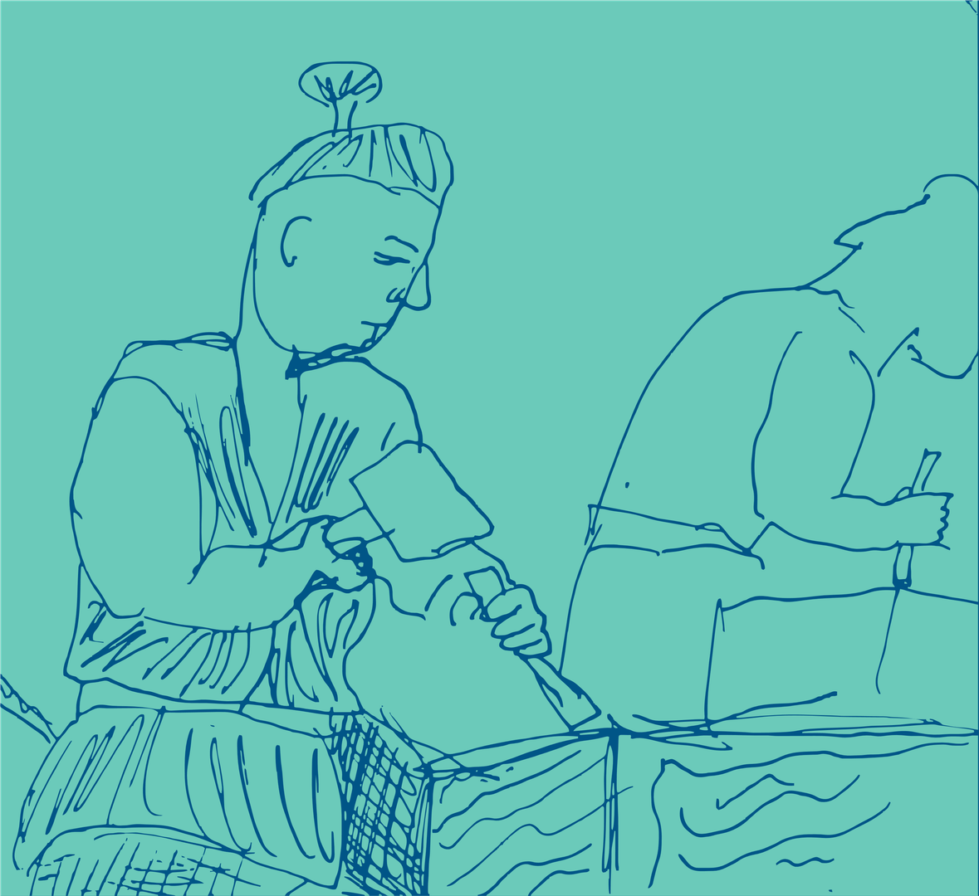
History of
Volunteerism
China 123 BCE - The Tsu, the Hui, and the She, all voluntary associations that provided a range of services for members including education, farm work, elderly care, burials, and temple maintenance.
Notes:
GD
-Looking all the way back to 123 BCE, there is evidence in China of voluntary associations that helped in every day life.
-The tsu had many of it's associations developed through ancestral and cultural ties
-The tsu served partly as a means of ancestor worship, but also as a source of mutual aid, providing a range of services, including education, care of the elderly, and burial assistance, to its members.

Slide 10

History of
Volunteerism
Medieval Europe: Fraternities and guilds, for men, provided a space for shared identity and belonging, and helped one build trust and community ties outside of kinship bonds. Beguines, were intentional communities of religious women who cared for the poor, the ill, and others on the margins.
Notes:
GD
-Medieval Europe: Fraternities and guilds (for men) fostered identity, trust, and community beyond kinship
-Created a strong social economy of self‑help and mutual aid
-Activities included church fundraising, maintaining communal spaces, and aiding neighbors in distress
-Early example of volunteering as self‑development, not pure selflessness
-Beguines: Intentional communities of religious women
-Cared for the poor, sick, and marginalized
-Offered women meaningful work outside marriage
-Provided companionship, mutual aid, medical care, and support in hard times
-Despite persecution, communities survived the Reformation
-Over 1,700 béguines in Belgium by the mid‑1820s

Slide 11

History of
Volunteerism
Membership: The defining factor of these associations is that membership was elective, not compulsory... These groups were built on an ethos of reciprocity and mutuality, as opposed to one-way, self-sacrificial giving.
Notes:
GD
-The defining factor of these associations is that membership was elective, not compulsory. There is some evidence of formal associations among hunter-gatherer societies, but it is generally accepted that they became more prevalent within more settled, horticultural societies. These groups were built on an ethos of reciprocity and mutuality, as opposed to one-way, self-sacrificial giving.

Slide 12

Formal volunteerism is a relatively new concept!
Notes:
GD
-“Volunteer” comes from Hebrew nadav — to willingly give; linked to generosity, nobility, and altruism
-Term gained popularity in 1755 during the American Revolutionary War
-Civilians volunteered by fundraising, boycotting British goods, and supporting soldiers
-Volunteerism shifted from faith-based duty to an expression of patriotism
-In Canada, early volunteerism was tied to Roman Catholic Church charities
-By the 1800s, volunteerism expanded to formal philanthropy and social reform organizations
-Major organizations emerged: YMCA, Red Cross, Salvation Army, United Way
-During the U.S. Civil War (1861–65), women became central to charity, culture, and reform
-Tension arose between church-based aid and “scientific philanthropy” focused on efficiency
-Example: U.S. Sanitary Commission (professionalized, public health–focused) vs. Christian Commission (evangelical, volunteer-driven, individual aid)

Slide 13
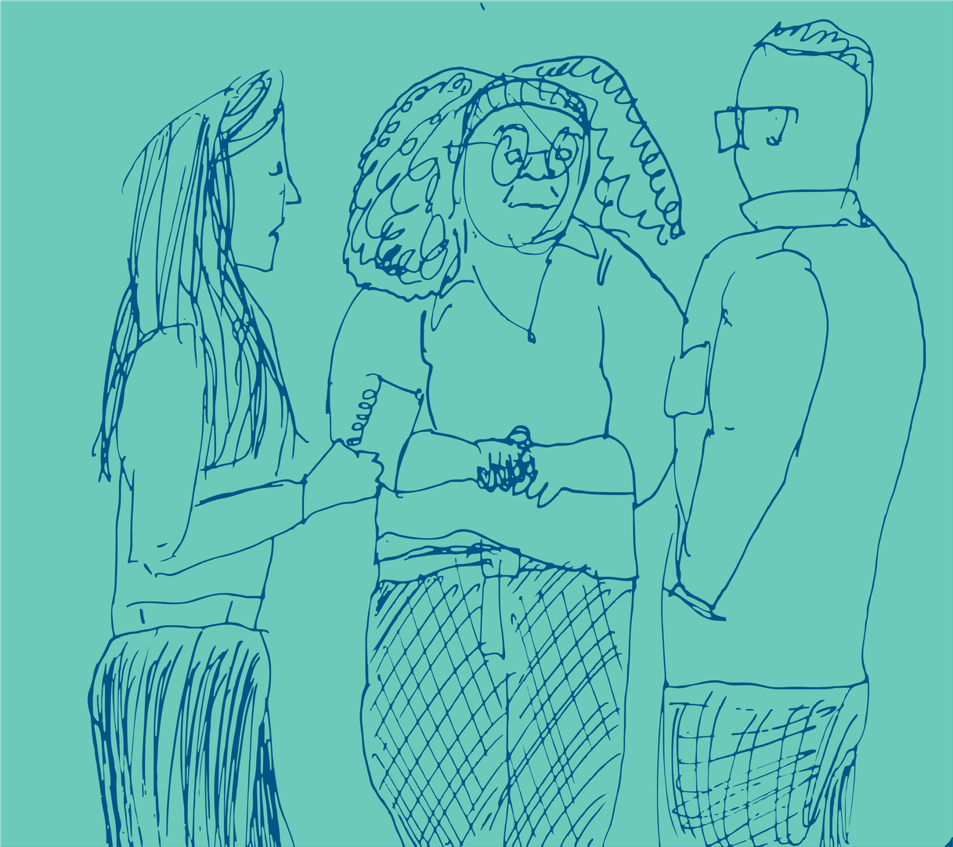
History of
Volunteerism
Volunteering as a job: Increasingly throughout the 20th Century, volunteer work and paid work began to compete for attention. Framed as a job, formal volunteering embraced the logic of scientific management, centering professionalization, hierarchical oversight, and risk mitigation.
Notes:
GD
-Through the 1920s to the 1970s, professionalization and government programs reduced reliance on volunteers.
-Volunteerism during this time evolved through activism, volunteer programs, and more business-like nonprofits.
-Volunteerism in the 20th century is seen socially and legally as akin to employment.
-This led to treating volunteerism with the kind of scrutiny that jobs are subject to
-It has become increasingly important to protect organizations that engage volunteers from liability.
-Additionally, scientific management practices meant to optimize productivity in the workplace started to be applied to community work, framing community support as something that is measurable

Slide 14
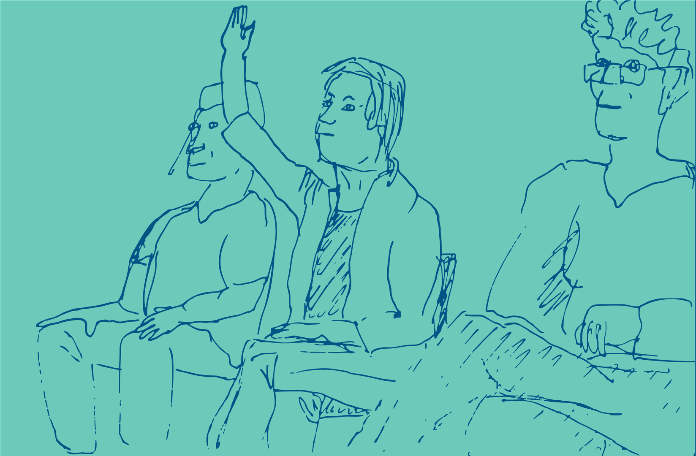
History of
Volunteerism
Volunteering today: to volunteer, it is standard practice to apply to a posting, submit references, undergo a police check, attend training, and subscribe to a standard set of health and safety protocols.
Notes:
GD
-This has resulted in a landscape of volunteerism that puts volunteers through things like reference checks, police checks, and evaluation.
-We should be clear at this point, we don't say this with any judgment.
-Volunteerism takes many forms, from informal community care to highly structured programs.
-There is no single “right” way to engage volunteers; practices should reflect your mission and community.
-Understanding volunteerism’s history helps expand possibilities for how volunteers can contribute today.

Slide 15

Let’s chat!
What parts of volunteering in the 21st C do you like?
Dislike?
Why?
Notes:
GD
Discussion:
-10-15 people: think, pair, share
-15+ people: table discussions, share back with the room
20 mins to discuss. 10 mins to share back

Slide 16
Current Trends in
Volunteering
Notes:
GD
With some history out of the way, let's talk about current trends in volunteering.

Slide 17
Volunteer Engagement Trends in Alberta
Older Albertans contribute more time to their formal volunteering
More young people formally volunteer
Source: 2018 and 2023 Stats Canada Survey on Giving, Volunteering, and Participation
Notes:
GD
-Statistics Canada does a survey on giving, volunteering, and participation every five years
-This survey shows more young people overall are participating in formal volunteering, with youth aged 15-24 volunteering at a rate of 83.7% and Albertans aged 65-74 volunteering at a rate of 77.4%
-They volunteer less hours overall then older Albertans though. Youth aged 15-24 volunteer, on average, 98 hours a year while Albertans aged 65-74 volunteered 327 hours on average per year

Slide 18
Volunteer Engagement Trends in Alberta
Higher level of education indicates higher likelihood to formally volunteer
Survey data doesn’t record informal volunteerism levels
Source: 2018 and 2023 Stats Canada Survey on Giving, Volunteering, and Participation
Notes:
GD
-According to the Survey on Giving, Volunteering, and Participating, education level does have an impact on the likelihood to formally volunteer
-But that doesn't mean people who have less education aren't volunteering or contributing. They may just be contributing in other informal ways.
-That is the limitation of some of this data. It focuses on formal volunteerism, less on informal volunteerism.
-Formal roles are generally created by and for nonprofit organizations
-Informal volunteering happens between individuals and communities. It is things like shovelling snow for your neighbour or babysitting for a struggling family or assisting a newcomer with settling into their home
-I encourage you to think about how informal volunteering shapes our society just as formal volunteering does.
-While formal volunteering addresses community issues through organized systems, informal volunteering builds the social fabric that holds communities together. It creates networks of support that can increase resilience during crises, natural disasters, economic hardship, or social isolation.

Slide 19
How does informal volunteerism show up in your community? Why do people volunteer informally?
Notes:
GD
Questions for the audience.
5 mins

Slide 20
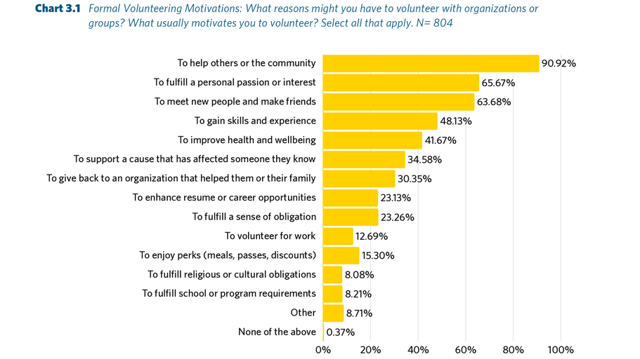
Source: Bringing Meaning to the Volunteer Experience: Insights on What Motivates, Sustains, and Challenges Volunteers,
Volunteer Alberta report
Notes:
GD
**Talk through some of the trends**
-Highlight recent Volunteer Alberta research based on a large national survey of volunteers and nonprofits
-Survey of 800+ volunteers shows the primary motivation is helping others
-If organizations can’t show how volunteer work helps the community, engagement will suffer
-Strong volunteer management requires personal engagement, recognition, and motivation
-Understanding individual motivations helps tailor better volunteer experiences
-Poor investment in volunteer engagement leads to low retention
-Key takeaway from the report: motivations range from personal fulfillment to social impact
-Matching roles to motivations keeps volunteers engaged; mismatches drive disengagement
-Best practice: ask questions, listen, check in regularly, and keep conversations open

Slide 21
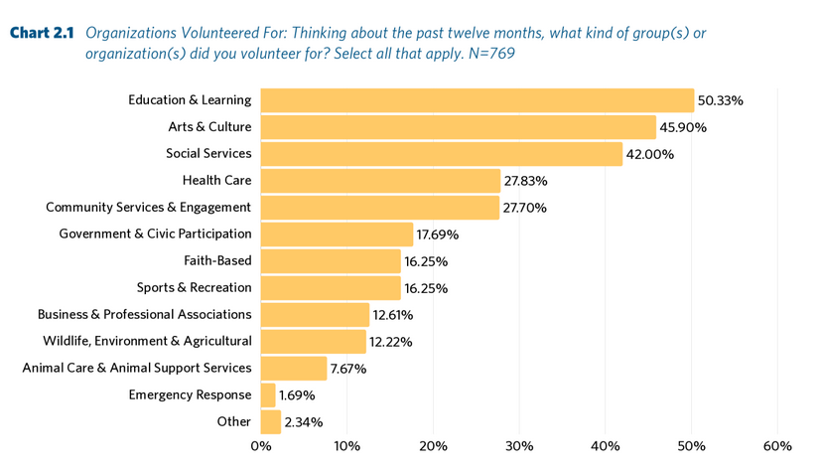
Source: Bringing Meaning to the Volunteer Experience: Insights on What Motivates, Sustains, and Challenges Volunteers,
Volunteer Alberta report
Notes:
GD
-This question often comes up in these presentations. What organizations are volunteers volunteering for?
-It's a pretty wide spread, but keep in mind the data from this survey does skew pretty heavily towards white female-identifying folks.
-But it gives a pretty good idea of where volunteers are spending their time.

Slide 22
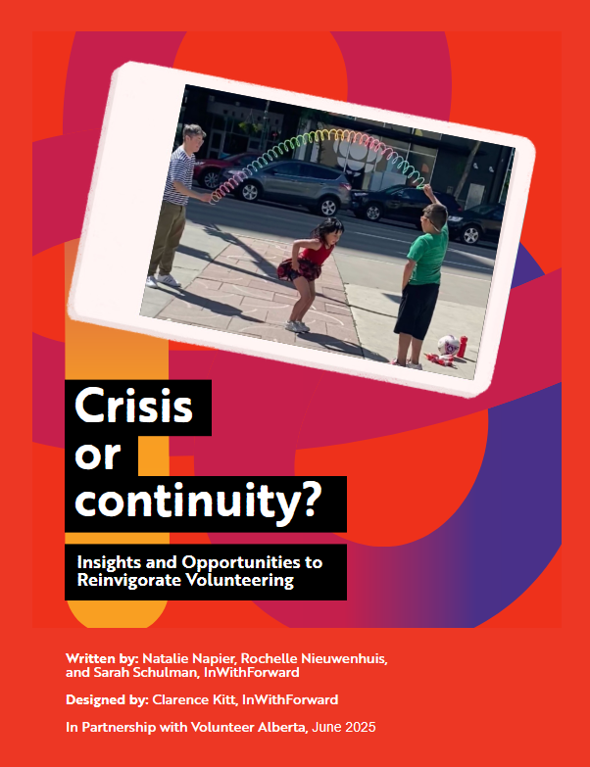
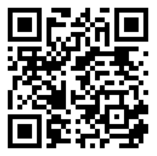
VA
Resource!
Notes:
GD
-VA did research between 2024-2025 with InWithForward into the what constrains, enlivens, and grows volunteerism in Alberta
-Using deep ethnographic research, we visited three communities: Lethbridge, Edmonton, and Fairview
-We wanted a mix of a large city, a mid-sized city, and a small municipality
-Used thick data to explore five actionable insights.
-The insights were:
-Personal growth is not an individual activity
-Endemic Social Awkwardness
-Stinking Thinking
-Joyful Commitment
-Roles you can bump into
**Talk through each insight a bit**

Slide 23
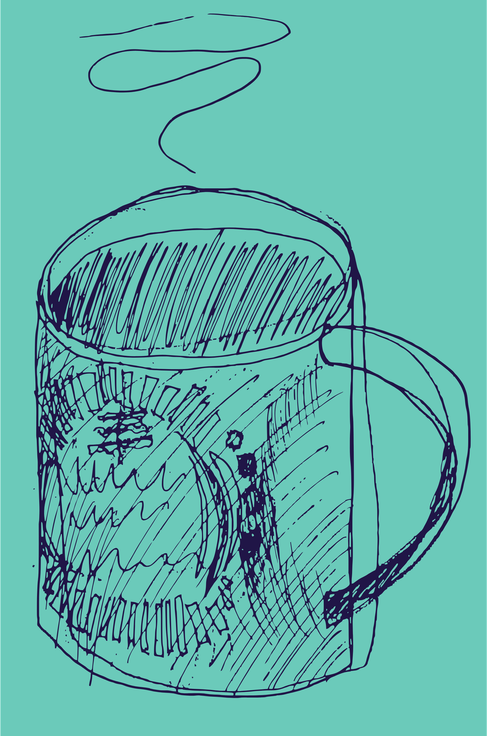
Big Learnings
  Volunteering has always existed
  Formal volunteer management is relatively new
  Volunteers engage for many different reasons
  Today's volunteer landscape is changing
  Orgs must adapt their approaches accordingly
Notes:
GD
**Talk through each point**

Slide 24
Managing
Volunteers:
Prehiring
Notes:
EN

Slide 25

10 Steps to Screening
Risk Assessment
Position Assignment
Recruitment
Application Forms
Interview
Reference Checks
Background Checks (if needed)
Orientation and Training
Support and Supervision
Follow-up and Feedback
Notes:
EN
You might be asking yourself, "if I came here for content on engagement and retention, why are we talking about volunteer screening?"
The reason is that screening is all about volunteer engagement and retention! To appropriately screen volunteers is to build good relationships with your volunteers, so you can understand what the volunteer's motivations and ability to safely and happily fill a role. We like to say with volunteer screening, we are "screening in. Not out."
**Talk through each part of the screening process: pre-hiring, hiring, and post-hiring**

Slide 26

Risk and Policy
  Assessing the risks of a volunteer opportunity often leads to the development of policy. We talk about them as being related.
  Risks are perfectly natural and not evidence that you’re doing something wrong. How we manage them is what is important.
Notes:
EN
-Policy is often a reaction to risk, which is why we talk about them together sometimes
-It's a myth that risk is inherently bad for your organization. In fact, it's pretty natural. But you have to manage that risk.
-When risk management is done well, it helps create clear expectations, safer environments, and positive experiences for volunteers, participants, and organizations

Slide 27
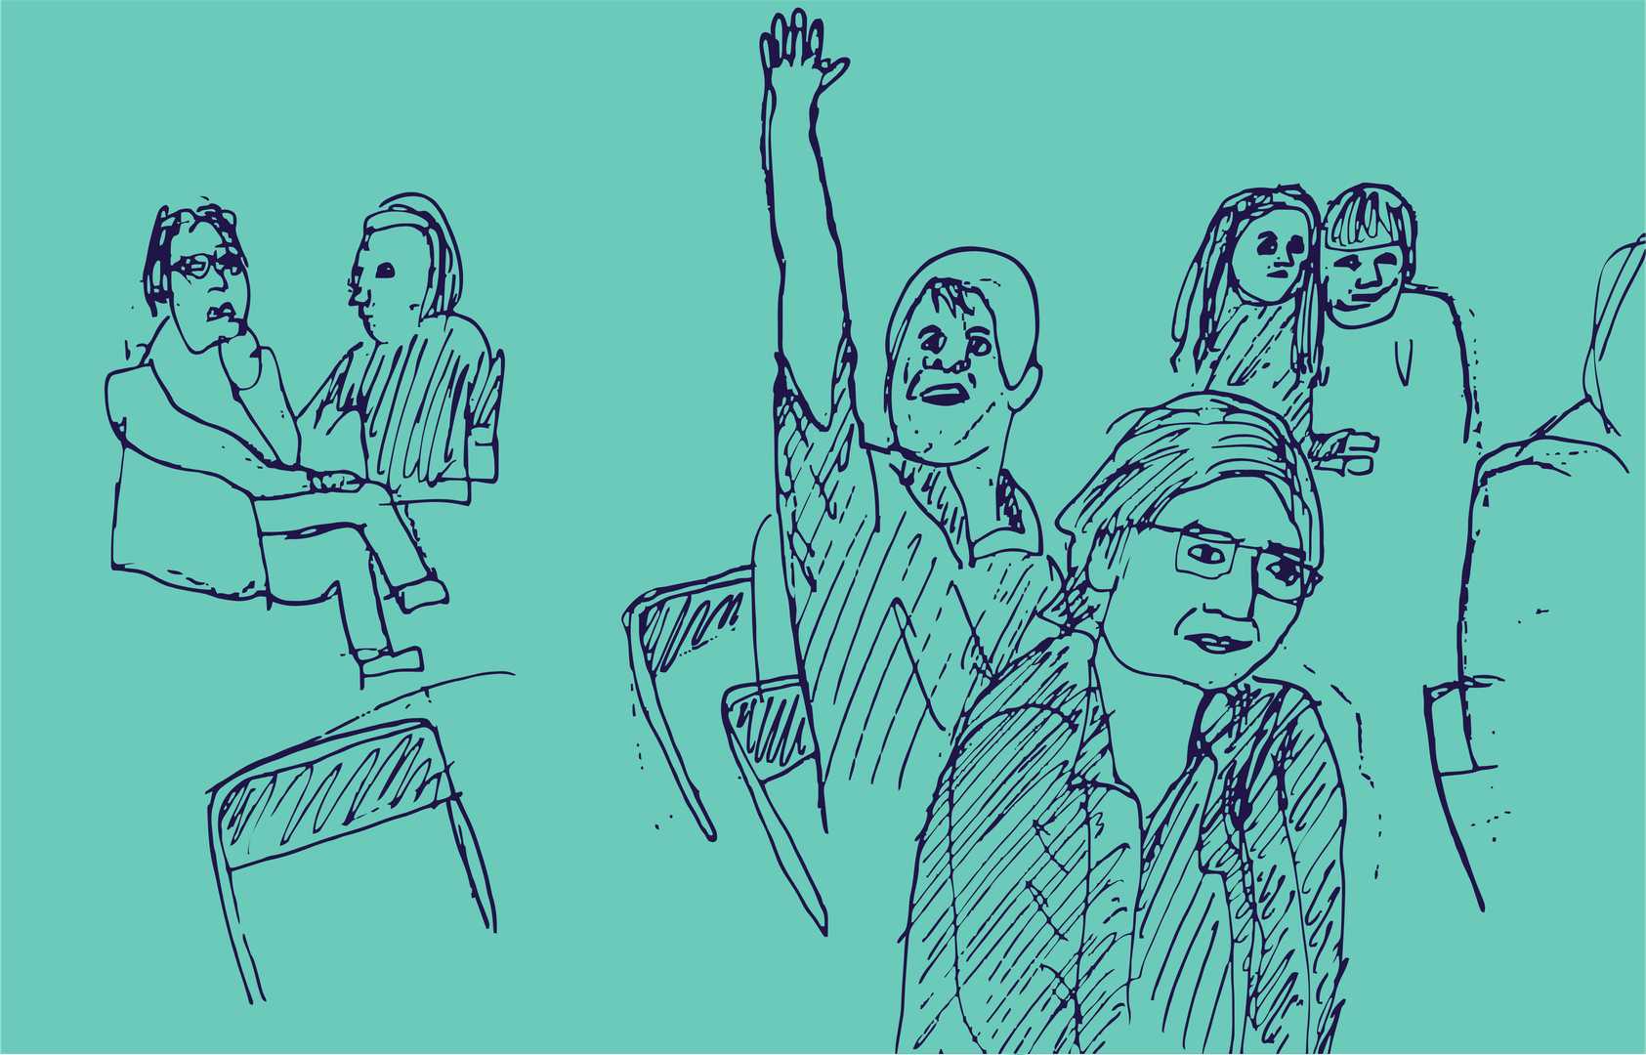
What is risk?
  Risk describes the uncertainty surrounding possible outcomes that could result in a negative impact.
  A risk assessment is the process by which you identify the possible risks that might be present or could occur.
  It may also include assessing the mitigation factors that are currently in place to lessen or control those risks
Notes:
EN
-Risk describes the uncertainty surrounding possible outcomes that could result in a negative impact.
-Risk assessments are all about reviewing the possible risks that could occur and what steps are currently being taken to manage that risk
-When we talk about risk we're not looking for reasons not to involve volunteers. We're looking for ways to understand potential challenges and put reasonable supports in place

Slide 28
How do we manage risk?
  First, we have to assess the risk.
  This can be done through various methods. Risk identification checklists, individual volunteer position assessments, seeking feedback, etc.
  For examples of how to manage risk, refer to the printed resources on your tables.
Notes:
EN
-VA has numerous resources related to risk management on our website.
-Assessing risk can be done through a variety of different methods, such as checklists, individual position assessments, and seeking feedback from volunteers and community members.

Slide 29
How do we manage risk?
  Avoid: Removing the related task, role, event, or program entirely
  Transfer: To move the responsibility of managing the risk from one source to another
  Mitigate: Enacting a strategy to act against the risk and then monitoring the result
  Accept: You acknowledge the risk but do nothing further
Notes:
EN
There are 4 strategies commonly used to categorize how to deal with risk:
1. The first is to Avoid– if something poses more risk then benefits, you may choose to remove it entirely, especially if its not a core activity you need to operate. This could look like ending a program or event, or even removing a volunteer role. Now, this isn’t IGNORING the risk, this is fully removing the situation involving the risk so it is no longer present
Ex. You opt out of doing a kayaking event for your youth program
2. You can also Transfer the risk, which is when the responsibility of monitoring and mitigating the risk is transferred from one source to another. This could be transferring it externally, like with insurance, or it could look like transferring the risk from a volunteer role to a staff role by moving responsibility from one to another.
Ex. You opt to have hired kayak instructors lead the kayak event for your youth program who use their organizations liability insurance
3. Mitigate is the most commonly discussed response, in fact you’ve heard me say it quite a few times already, and the actual implementation of it varies based on the type of risk, your own expertise and resources, and the sustainability of the practice. But essentially this is working to actively address and act against the risk.
Ex. You require mandatory safety training and parental consent forms before youth are able to attend the kayak event
4. And finally, you can just Accept – you acknowledge the risk but do nothing further. This is usually for risks that are not likely to happen, or may have too small an impact to dedicate resources to resolving.
Ex. There aren’t enough vans to bring all of the kids, so you accept that some parents who aren’t screened volunteers will carpool

Slide 30
The Swiss Cheese
Method
  Layering up your risk assessment strategies to cover the gaps other strategies may have.
  But be sure to apply the principle of Reasonable measures, Reasonably applied – your risk mitigation measures shouldn’t become to burdensome on your organization or create barriers for volunteer engagement.
Notes:
EN
Your response strategy may be to take bits from each of these and it may involve multiple steps as well. Theres a commonly used metaphor in risk management called the “Swiss Cheese Method” - you may find that some strategies only cover certain areas of risk, but not all, leaving “Holes” in your cheese. But the more you layer on, each strategy with its own holes, the more gaps you’re able to cover.
But I want to bring up the concept of “Reasonable measures, reasonably applied”. Be sure that you’re not stacking that swiss up too high where it becomes impossible to eat – it needs to be the perfect balance between addressing risks while still being practical and doable. You also want to be sure you’re not creating excessive barriers for engagement. If you find that you’re unable to justify or explain why a certain practice or tool is used and how it may mitigate risk, there’s a good likelihood it isn’t doing any favours for your program, and so you may want to look at how you could adapt or remove it so it does make sense for you.
And finally: make sure you are doing your risk assessments regularly! Whether that’s every quarter, or at the start and end of every program year, make sure that you continue to review, analyze, and monitor your risks. Make it a habit, make it part of the natural way you do things, and make sure that it makes sense for your program.

Slide 31

Some key aspects of
policy
  No consistent definition
  The whole policy document should apply to everyone
  States a boundary- what is and isn’t okay
  Provides guidelines for decision-making
  Often viewed as separate from procedures
Notes:
EN
Nonprofit leaders and boards talk about policy a whole lot, but there’s still a lot of confusion around what the term means. This is for good reason, as there is no consistent definition of policy. Although we reference them all the time and take hours and hours to develop them, there’s no single definition that will tell you exactly what needs to be in a policy and what doesn’t.
When we want to define policy in some usable way, there are a few key elements:
-Firstly, policies should apply to everyone. This includes the board, staff, volunteers, clients, or everyone in a specific group. This doesn’t mean that individual policies can’t be specific to a certain group within your organization, but the whole policy document should be a document that has application for everyone.
-Next, a policy states a boundary of what is and isn’t okay. This is why boards and leadership and management will spend such a long time developing policy. This element requires your organization go through the leg work to identify what, as an organization, has been decided to be acceptable.
-Next, a policy should provide guidelines for decision-making. When you are faced with a difficult or uncommon or contentious situation, the number of possible decisions grows and depends on the person. A policy should be a wayfinding tool that can help you navigate these situations more consistently as a team.
-And lastly, policies are often viewed as separate from procedures. The best way to describe this difference is, ideally, policies will tell you what to do and procedures will tell you how to do it. In practice though, this delineation often becomes murky. Some professionals in the field don’t think this is a useful way to talk about procedure either. They see it as more useful to talk about everything as policy, just with varying degrees of granularity. However, we’ll use this definition of policy and procedure for the purposes of this presention.

Slide 32
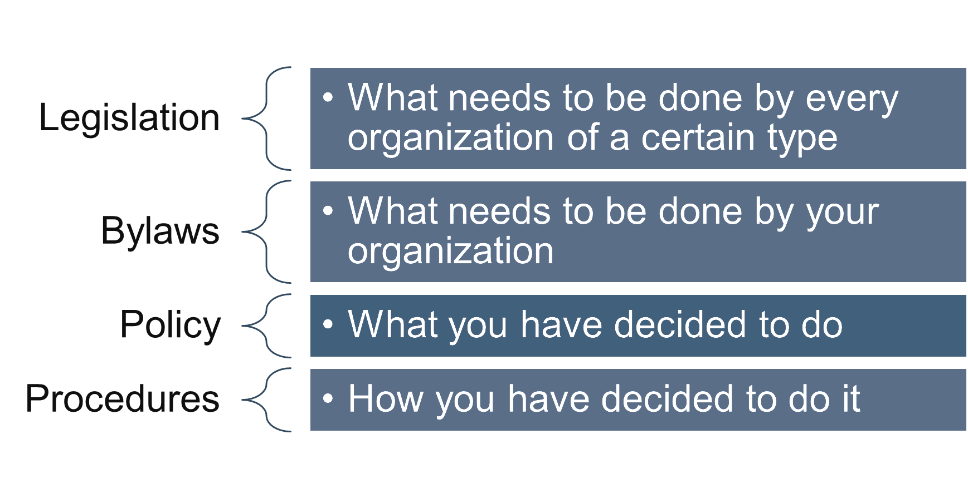
Notes:
EN
Now that we know roughly what goes into a policy and why they’re important, we can address the context exist within. When we talk about policies, it’s important to remember how they fit into the other guiding documentation related to your organization. Writing a bylaw or policy or procedure will depend also on what already exists, so never write policy in a vacuum.
Legislation: When writing a policy, it will have to be respectful of any legislation for your organization. You should take a read through whatever your incorporating legislation is every once in a while to keep yourself familiar with what the government requires every organization of your type to do. Most nonprofits in the province are incorporated under the societies act or companies act and many nonprofits also have charitable status. Beyond these common acts, there’s all sorts of less common acts a non-profit can be incorporated under, such as the Agricultural Societies Act, the Cemetery Companies Act, the Regional Health Authorities Act, the Libraries Act, or even special acts of the Alberta Legislature or Parliament. All these types of legislation should be reviewed on a regular basis and should inform policies.
Bylaws: Bylaws can be a little tricky, as they are legally required like legislation is. It’s, essentially, what your organization has stated it will do to the government. Your organization also needs to submit bylaws to become a nonprofit. These will be specific to your organization, but they are the basic rules you have stated you will follow. Like policy, they also aren’t static and need to be reviewed on a regular basis, but there is a bit more precedent in determining content for bylaws than policy. There’s a lot of topics to be considered standard for a set of bylaws, such as introductory articles and membership articles, but they still vary from organization to organization. Writing bylaws is a pretty complex topic in and of itself and you’d like more information on it, a great place to start is the Muttart Foundation’s guidebook Drafting and Revising Bylaws for Not-for-profit Organizations In Alberta. It’s very comprehensive and gives a lot of great common-sense information on bylaw development.
Policy: As we talked about previously, policies are things that your organization has decided it will do, internally. Policies are variable and there isn’t one set of policies that needs to be made for any given organization. They are the result of a many people making decisions about which path the organization will take given many different social, political, legal, and financial constraints.
Procedures: When we get to procedures, this is where you start outlining discrete steps for processes introduced in policy. So, if a policy states that an organization will screen volunteers working with high-risk populations using vulnerable sector checks, a procedure may outline things like which person in the organization communicates with police services, how long it will take to onboard volunteers after the check is requested, where the information from the check will be stored, etc.

Slide 33
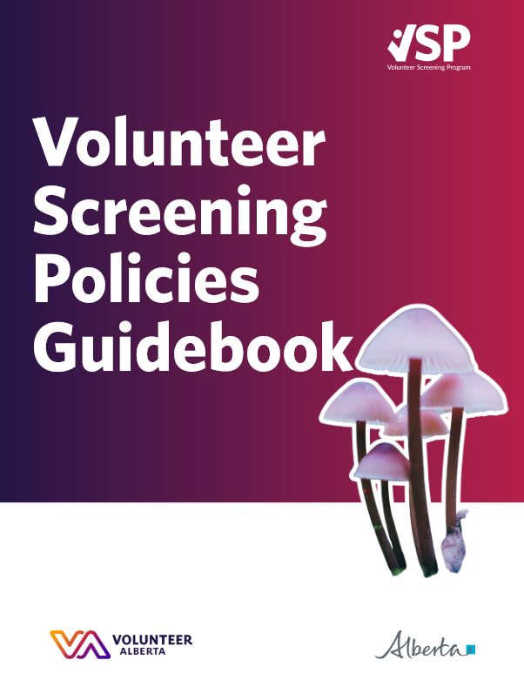
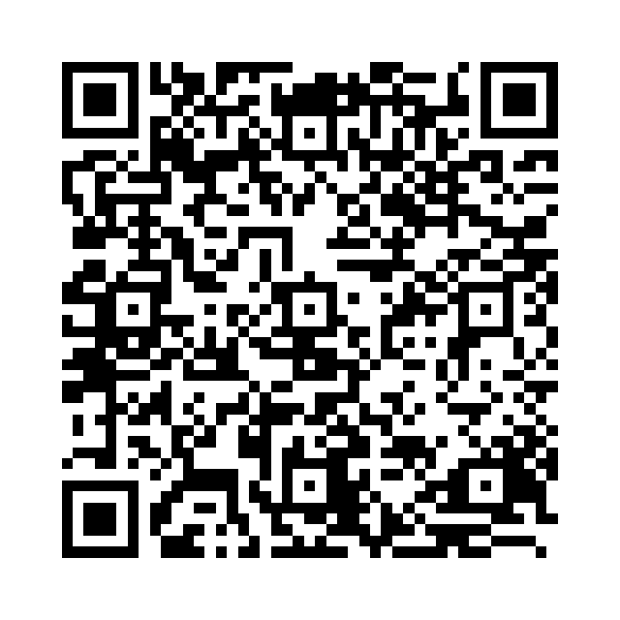
VA
Resource!
Notes:
EN

Slide 34
Use the blank volunteer position descriptions on your tables to make some descriptions for your organization’s volunteers. After, discuss with the group what was useful or not useful about the process.
Notes:
EN
Take some time to write out a volunteer position description on the hand-out provided. It could be for volunteers with your organization, or for something entirely made-up! Do this for about 15-20 minutes. Then we'll discuss as a group about the usefulness (or lack thereof) of these descriptions.
This activity is designed to help you think intentionally about the volunteer experience, expectations, support and needs, and about the value the role creates both for the vol and the organization. We’re not expecting perfection!
30 minutes total for exercise.

Slide 35
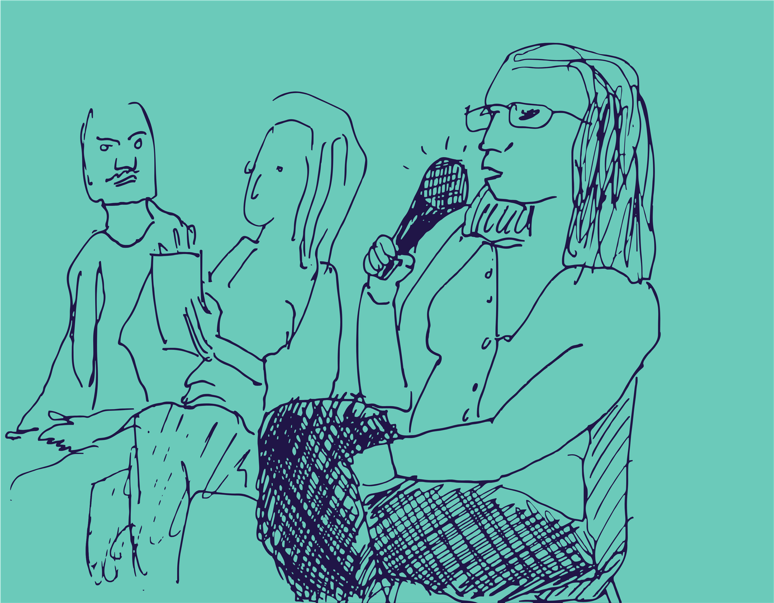
Volunteer Recruitment
  Plan, plan, plan!
  Get clear on your organization’s goals and mandate
  Identify the risks associated with the role and include them in a fully developed volunteer position description.
  Make a good first impression.
Notes:
EN
-Volunteer recruitment and engagement requires strong upfront planning
-Part of that planning is creating a recruitment strategy. It should definitely include who recruits, what’s needed, how many volunteers, what platforms you’re using for recruitment, and what methods of recruitment you’re using
-More later on the recruitment process and why it’s important to have all your info ready before you recruit
-Clearly explain the organization’s mission and goals
-Show volunteers how their role makes a difference
-Volunteers want to volunteer for a reason
-People do not volunteer because organizations need volunteers. People volunteer because they want to contribute something meaningful.
-Develop clear volunteer position descriptions (duties, hours, supervision, risks)
-Use position descriptions to set expectations and protect volunteers under the Freedom to Care Act
-Make a strong first impression through professional applications, interviews, and selection processes

Slide 36
Traditional Recruitment Tactics
  Mass Appeals
  Targeted Recruitment
  Networking
Notes:
EN
Mass appeals
-“Volunteers wanted” posts, posters, flyers
-Best for roles without specialized skills
-Use community bulletin boards, newsletters, local channels
-Broad reach; likely to get interest and help
Targeted recruitment
-Match volunteer skills to specific roles
-Clear, detailed position descriptions (tasks + required skills)
-Examples of skills: writing, marketing, graphic design, software use
-Recruit through:
--Student clubs/post-secondary institutions
--Other nonprofits in your sector (shared or overlapping skills)
--Local volunteer centres (e.g., via Volunteer Alberta)
Networking
-Ask current volunteers to refer others
-Leverage existing relationships and word of mouth
-Host open houses, mixers, or info sessions (in-person or virtual)
-Have current volunteers share their experiences
-Virtual events increase accessibility and geographic reach

Slide 37
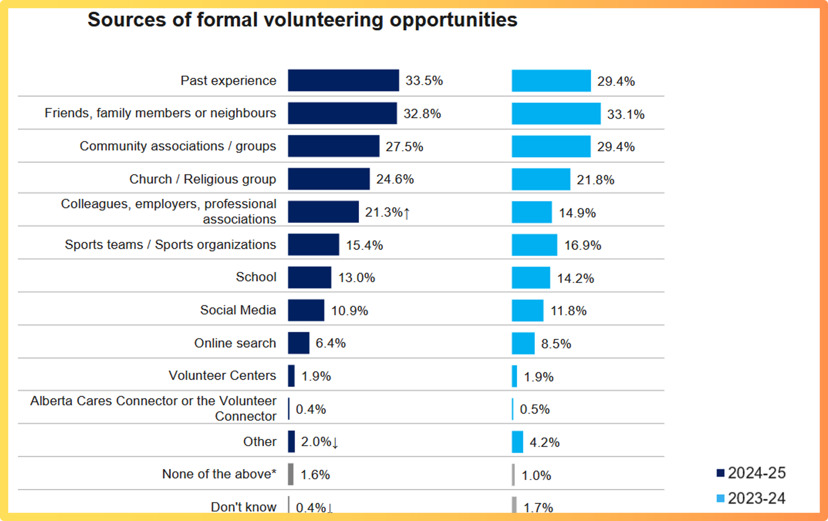
Source: Government of Alberta, Ministry of Arts, Culture, and Status of Women 2024-2025 Survey of Albertans
Notes:
EN
We should also talk about where volunteers come from. This data is from The Government of Alberta's Ministry of Arts, Culture, and Status of Women. It shows that the greatest recruitment tool you really have is word of mouth, family and friends, and past experiences. A very small percentage of people are doing web searches for your opportunities and only some are finding you on social media. It's friend, family, neighbourhood, and other nonprofits that make the biggest difference when you're recruiting volunteers.

Slide 38
Emergent Recruitment Tactics
  Mobilizing Community Members
  Low-commitment roles
Notes:
EN
-Based on some research we did recently through our project (Re)Engaged: Volunteerism from the Ground Up, we became very interested in the idea of “community scouts.” These would be people who have the volunteer role of informing people of opportunities to get involved in community. We have yet to prototype this idea officially, but it could be worth it for you to try leaning into the people already within your network and spend additional time training them on what opportunities exist in community and how to potentially strike up conversations with friends, family, or neighbours about these opportunities.
-To recruit new volunteers, you may have to rethink how to actually structure your volunteer positions. We often see volunteers who want to contribute, but they don’t want to be obligated to do so. They like the idea of commitment, but in healthy amounts that they have some control over. So, how could you take aspects of your volunteer roles and create microvolunteering opportunities? Small opportunities that help people get involved without having the pressure of doing something for years at a time.

Slide 39
Let’s chat!
What are the attributes of the volunteers you wish to reach? How could you possibly tailor your communications to them?
Notes:
EN
Who is the perfect volunteer?
Table discussion and shareback for 15-20 mins

Slide 40
Managing
Volunteers:
Hiring
Notes:
GD

Slide 41
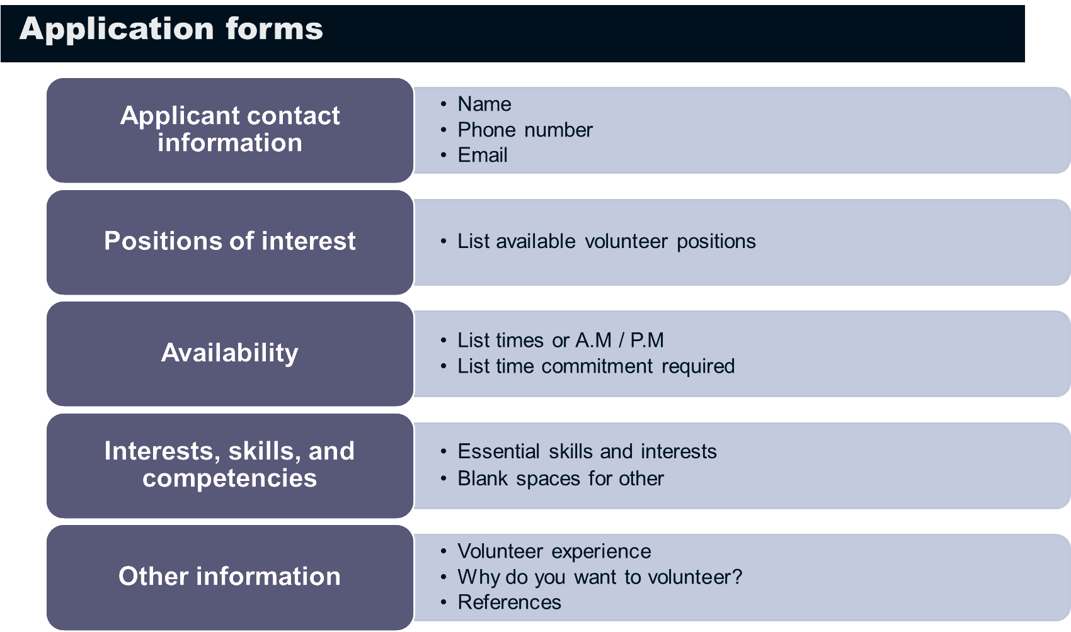
Notes:
GD
-Recruitment isn’t just outreach—a strong application form is essential.
-Surveys show volunteers are more likely to apply when there’s an application and interview.
-Applications let volunteers share interests, values, and skills, helping ensure good role matches.
-Most applications are online; some organizations also offer in‑office paper forms.
Accessibility and inclusivity matter:
-Online forms can exclude those without internet access.
-In‑person forms can exclude those unable to visit your office.
-Consider screen readers, visual impairments, and translations (e.g., GravityForms).
Scale the application to your needs:
-Complex roles may need detailed forms; simple roles may only need contact info.
-Ask only for what you need to avoid deterring applicants.
Typical application elements:
-Applicant contact info (respect privacy and confidentiality).
-Volunteer role selection with clear screening expectations.
-Availability and time commitment (time blocks, weekly hours, flexible options).
-Skills and interests (checkboxes, open text, or both).
-Optional background info (experience, motivation).

Slide 42
Application Form Activity
Which questions are appropriate? Why or why not?
Age:
Please list any medical conditions or disabilities:
Marital status:
Have you ever been arrested?
Do you have a valid Class 5 driver’s license?
Notes:
GD
For each one:
Yes? No? Depends?
Why? Why not?
What would it be dependent on?
What would be a better way of capturing that information?
Can it be moved out of the application form?

Slide 43
HR Tactics to Screen Volunteers
  Interviews
  Background checks
  Reference checks
Notes:
GD
We're going to cover some of the basic tactics used in volunteer hiring that are generally shared with standard HR processes.
First up is interviews, which helps ground us in what the volunteer is actually like and how they behave.
Second is background checks. This is a tricky topic and we'll take some time to go over why.
Third is reference checks, which is a good double check that the things the person says about themselves are true.

Slide 44

Interview tips
  Start by assessing what you want to know. Build questions around your needs
  Ask open-ended questions
  Try to use questions that include “why” or “how.”
  Set up the meeting in a place the interviewee will feel comfortable (i.e. a coffee shop might be more appropriate than a board room)
Notes:
GD
-Ask questions you want to know the answer to. Don't gather information that is unnecessary to make a decision about the person volunteering.
-Try to keep the conversation open and fruitful. You don't want to be asking yes or no questions or questions that could have easily been on the application form.
-Questions that use "why" or "how" often stimulate good discussion.
-Setting matters. Make sure to pick a place that is conducive to the tone you want to set.

Slide 45
Interview tips
  If you’re selecting from multiple candidates, use a scoring rubric to structure your decisions
  Assure the volunteer that you want them to do well. This isn’t a test, it’s just a chance to get to know the volunteer.
  Explain why you’re interviewing volunteers. Some volunteers feel that these types of processes aren’t necessary for volunteer roles, so you may have to clarify why you’re interviewing them.
Notes:
GD
Sometimes, especially for things like board roles, you're not interviewing to select from a huge host of candidates. You're just confirming the person is a good fit for the role they've applied to.
The volunteer should also know that this isn't some kind of super high-pressure situation. Ideally, an interview is casual and friendly.
You also want to keep setting expectations at this point. Explain why you're doing this. Some volunteers don't like going through these processes.

Slide 46
Interview Question Activity
Which questions are appropriate? Why or why not?
This role might require long or irregular hours. Is that a problem?
Where are you originally from?
How much weight can you lift?
Notes:
GD
For each one:
Is this question appropriate?
Yes? No? It depends?
Why? Why not?
What would it be dependent on?
What would be a better way of asking the question?
Can this information be captured elsewhere?

Slide 47
Background
Checks Are Not
Always Needed!
Notes:
GD
It’s important for me to make this clear whenever I speak about volunteer recruitment practices. Background checks—including police information checks, criminal record checks, vulnerable sector checks, or child intervention record checks—are not always needed.

Slide 48
Background Checks
  While we would never tell you to simply not do background checks, it’s important to know who actually requires them
  There’s very little legislation that mandates background check usage for volunteer organizations.
  While some insurance companies will require them, they are trending away from blanket rules about background check usage
Notes:
GD
-Background checks are just one of many screening tools, they are not the only one.
-Background checks can be invasive, retraumatizing, costly, and a deterrent to engagement.
-Background checks are generally not required by much legislation.
-The goal is not to eliminate screening tools. The goal is to use them intentionally and proportionately based on actual risk
-Many insurance companies are also moving away from stipulating blanket rules around background checks.

Slide 49
Background Checks
  Background checks can deter volunteers due to their price, invasiveness, and possibility of re-traumatizing folks who have had negative interactions with police/RCMP.
  However, some volunteers see the use of background checks as a sign of legitimacy for some volunteer organizations.
  It’s important to weigh the pros and cons of getting checks done and make a decision that fits your screening process
Notes:
GD
-Background checks can be a common, but harmful gatekeeping tool for volunteers that often singles out racialized and BIPOC folks, who are disproportionately affected by police/RCMP due to a variety of systemic and colonial barriers.
-However, some organizations and volunteers see them as a sign of legitimacy.
-You don't need to just immediately do away with all background checks. I'm just asking you to be careful about deciding to use them. Know why you want them and what you hope to accomplish with them.

Slide 50

Reference Check Tips
  Reference checks can be a useful tool for confirming a volunteer is able to do the work they say they can. However, they are also not necessary for every role.
  Like interviews and background checks, some volunteers will not want to do a reference check. Make it clear why you do them so the volunteer knows they’re not being singled out.
  Try to find reference checks that can attest to the kind of work the volunteer wants to do.
Notes:
GD
-Like background checks, reference checks aren't a requirement. The platform Volunteer Connector created a report on what barriers exist for racialized folks in the volunteering process. They found in their report, An Anti-Racist Approach to Volunteer Screening, that reference checks can create barriers for BIPOC individuals as well.
-That being said, they can be a useful tool for confirming information you need to know about a volunteer, like what skills they have and how they are to work with. They have more direct use than a background check. Just make sure the reference being requested is relevant to the work the volunteer wants to do
-Some volunteers still don't like the idea of doing these checks, as they don't think volunteering needs to be subject to those kinds of checks. This isn't a problem, just try to explain to them why you require volunteers to get reference checks, and remember you don’t need to get reference checks for literally every volunteer.

Slide 51
Managing
Volunteers:
Post-hiring
Notes:
EN

Slide 52

Volunteer Onboarding
  Individual or group?
  General or role-specific?
  Recorded or live?
  Chance for volunteers to meet staff/other volunteers
Notes:
Onboarding design impacts volunteer engagement. There is no single right onboarding model. The best onboarding process reflects the complexity of the role, the risks involved, and the needs of the volunteer. The key question is whether volunteers leave onboarding feeling prepared, connected, and confident in their role
Consider how formal training needs to be
-Some roles require formal training; others can be informal
-Avoid information overload in orientation
-Rule of thumb: if it takes 15 minutes or less, train on the first day
Individual vs. group training
-Individual training = more engaging (if time allows)
-Group training = more efficient and realistic for capacity
-Pair new volunteers with experienced volunteers for on-the-job learning
General vs. role-specific training
-Use role descriptions to guide training design
-General orientation for organizational basics
-Role-specific training for specialized positions
-Group orientations may be organized by role if numbers are small
Live vs. recorded orientations
-Live = more engaging
-Recorded = more efficient and flexible
-In-person training: provide snacks, swag, and welcome materials
-Always share training materials after the session
Connection and relationship-building
-Onboarding is a chance to meet people
-Introduce volunteers to staff and other volunteers
-Seeing experienced volunteers helps reduce intimidation

Slide 53
Volunteer Onboarding
  Helps further define the relationship between volunteer and organization
  A good onboarding process helps retain volunteers
  Fosters the kind of dialogue that helps volunteer managers determine best fit for a volunteer position
  Helps ensure the volunteer knows what is expected of them.
Notes:
EN
-Onboarding decisions directly affect volunteer engagement
-Onboarding and training help define the relationship between the organization and volunteers
-Every interaction is a chance to build trust and set expectations
-Volunteers should leave training feeling confident, supported, and clear—not nervous or uncertain
-Strong onboarding improves volunteer retention
-Confidence gained through onboarding helps volunteers stay engaged longer
-Onboarding should allow space for continuous learning beyond the basics
-Opportunities for additional training, professional development, or new roles support long-term engagement
-Onboarding helps managers assess volunteer readiness and fit
-Confusion or discomfort during onboarding signals a need for extra support or role adjustment
-Onboarding clarifies expectations and defines what success looks like
-Clear expectations help volunteers feel effective, valued, and motivated to continue

Slide 54
Volunteer Recognition
  Recognition is a year-round thing
  Handwritten thank-you cards
  Thank yous after their shift
  Provide food! Especially for shifts longer than three hours!
  Volunteers want to know how their hours impacted your organization and what your organization can do
Notes:
EN
Now, let's talk about how you can structure your recognition activities. This work is critical to good volunteer engagement: making volunteers feel seen, heard, and appreciated.
Recognition is a year-round thing. Make sure you take the time out of your day to do the work of engaging volunteers. Taking the time to simply appreciate your volunteers is not wasted effort. In fact, it's key to managing volunteers effectively. You can take the time to remember birthdays and major life events, write thank you notes for particularly big projects or events, and just generally be available for the needs of your volunteer team. Thank yous as people leave their shifts too is quite important.
Also, always provide food when a shift is longer than three hours. Providing food is a great way to show you care.
And lastly, lean into organizational evaluation so you can tell volunteers the story of their work. Keep track of data that tells you how the organization is performing and report back on it to other volunteers.

Slide 55
Volunteer Retention
Relationships really matter
Volunteer needs change over time
Feedback drives continuous improvement
Notes:
EN
-Screening is all about relationship building and relationship building is key to good volunteer engagement
-Screening is about figuring out why a volunteer is there, what they want to do, and where they fit in
-Volunteers’ interests and circumstances change over time, so engagement strategies must adapt
-Volunteer programs should regularly adjust to re‑engage volunteers as needs and passions shift
-Screening and engagement follow a model of continuous improvement
-Engagement strategies should be re‑evaluated regularly for both new and current volunteers
-Roles and experiences should evolve based on where volunteers are and what they need

Slide 56
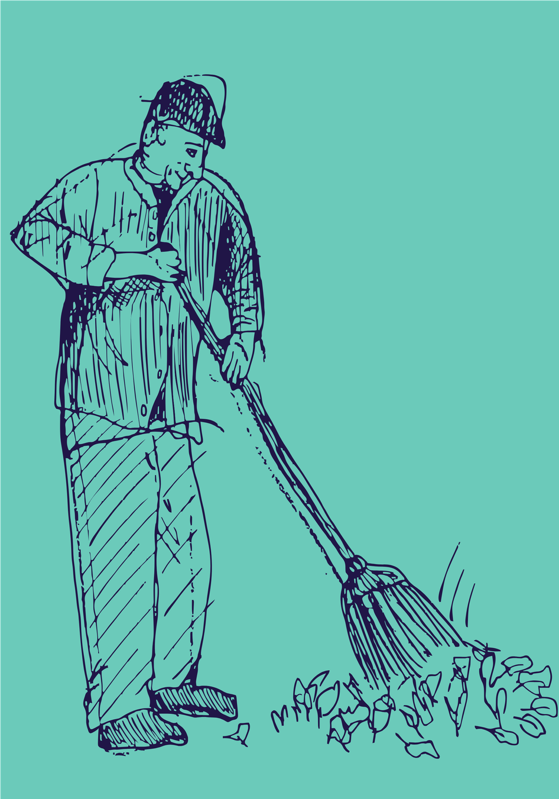
Volunteer Retention:
Anticipating Needs
  Preventative work
  Informed by past feedback
  User experience
Notes:
EN
-Anticipating volunteer needs is key to strong supervision and support
-A preventative approach removes barriers before volunteers start
-Ensure volunteers have needed access, tools, and clear guidelines
-Clarify expectations, boundaries, and how to handle public interactions
-Anticipatory planning helps set volunteers up for success from day one
-Plan roles from the volunteer’s perspective
-Use feedback from past volunteers to identify challenges
-Seek input from community, program users, or participants when relevant

Slide 57
Volunteer Retention:
Feedback
  Surveys
  Focus groups
  Individual discussions
  Check-ins
  Anonymous feedback
Notes:
EN
-Feedback strengthens volunteer engagement and trust
-Inviting feedback shows volunteers their opinions matter
-Feedback helps improve screening and engagement practices
-Surveys are a common tool for collecting feedback
-Keep surveys short and only ask what you’ll use
-Focus groups work well for new roles or programs
-Keep focus groups informal and action‑oriented
-One‑on‑one check‑ins can provide valuable insight
-Offer anonymous feedback options for comfort and equity

Slide 58
Big ideas!
Notes:
GD
As I close off the main portion of this presentation, I want to take a minute to talk about some of the most important ideas that came up today!

Slide 59
Volunteering doesn’t have
to be formal
Notes:
GD

Slide 60
Screening is relationship
building.
Notes:
GD

Slide 61
Explain yourself!
Notes:
GD

Slide 62
Planning is essential
Notes:
GD

Slide 63
Volunteers want to know
they’re making a
difference
Notes:
GD

Slide 64
Make volunteer position
descriptions!
Notes:
GD

Slide 65
Thanks so much!!!
Volunteer Alberta also offer other training, coaching, and consultation services.
For more information or for any questions about today’s content, please contact enavarro@volunteeralberta.ab.ca or
gdearden@volunteeralberta.ab.ca
Thanks very much for Edmonton Chamber of Voluntary Organizations, who developed some of the content for this presentation alongside Volunteer Alberta.
Notes:
GD

