Slide 1

Public Meeting
Proposed Official Plan Amendment and Zoning By-Law Amendments
January 12, 2026

Slide 2
This is a public meeting under sections 17(15), 22 and 34 of the Ontario Planning Act
ANY PERSON may attend the public meeting and/or make written or verbal representation either in support of or in opposition to the proposed Official Plan Amendment and Zoning By-law Amendment.
If a person or public body would otherwise have an ability to appeal the decision of Council of The United Counties of SDG and The Township of South Glengarry to the Ontario Land Tribunal (OLT) but the person or public body does not make oral submissions at a public meeting or make written submissions to the council of the United Counties of SDG and Township of South Glengarry before the by-law is passed, the person or public body is not entitled to appeal the decision.
If a person or public body does not make oral submissions at a public meeting or make written submissions to the Township of South Glengarry before the by-law is passed, the person or public body may not be added as a party to the hearing of an appeal before the OLT unless there are reasonable grounds to do so.

Slide 3
ZBLW 11-2025
This meeting will begin with a presentation summarizing the application by the Township and the applicant, followed by a discussion period during which all attendees will have an opportunity to provide input on the proposed zoning by-law amendment.

Slide 4
ZBLW 11-2025
Subject Property Location:
Part of Lot 8, Concession 1, being Part 1 on RP 14R2996 in the Geographic Township of Lancaster now in the Township of South Glengarry, County of Glengarry, located at 21899 Old Highway 2.
The subject property is approximately 7.4 acres in size.

Slide 5
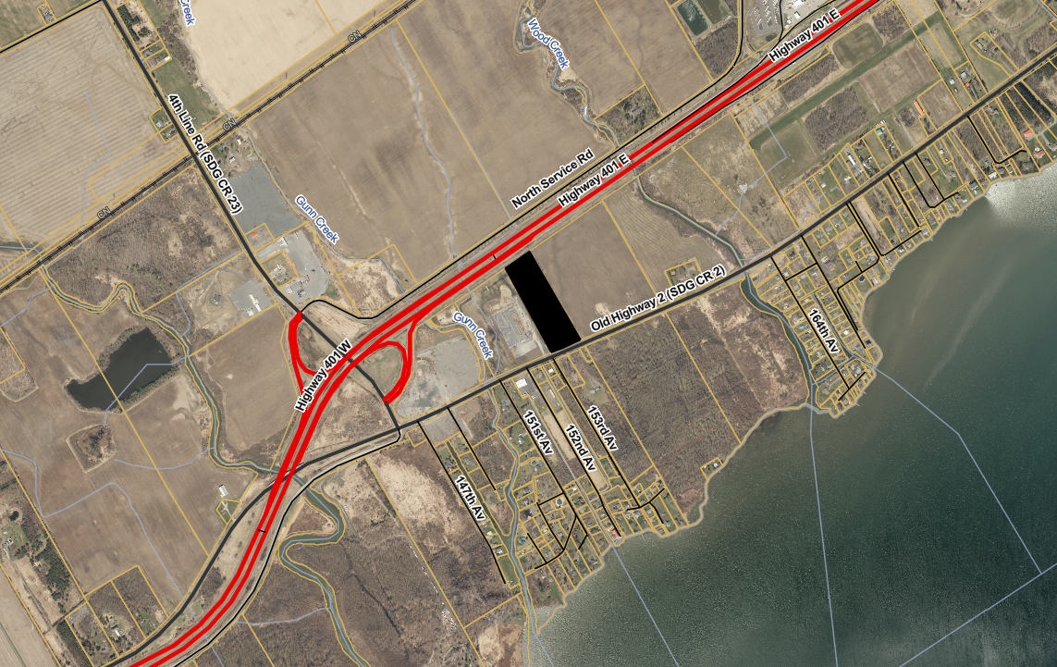
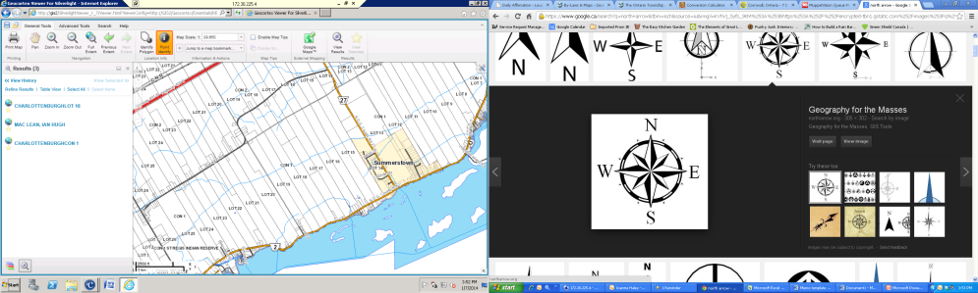
Subject Property

Slide 6
ZBLW 11-2025
The purpose of this Amendment is to rezone the subject property from Highway Commercial (CH) to Light Industrial (ML). The subject property contains 2 existing structures. These structures have been previously used as vehicle and tractor trailer repair, storage, sales and an office with a residential unit. There are no new buildings or structures proposed on the subject property at this time.
All other applicable provisions of Zoning By-law 38-09, as amended, shall continue to apply.

Slide 7
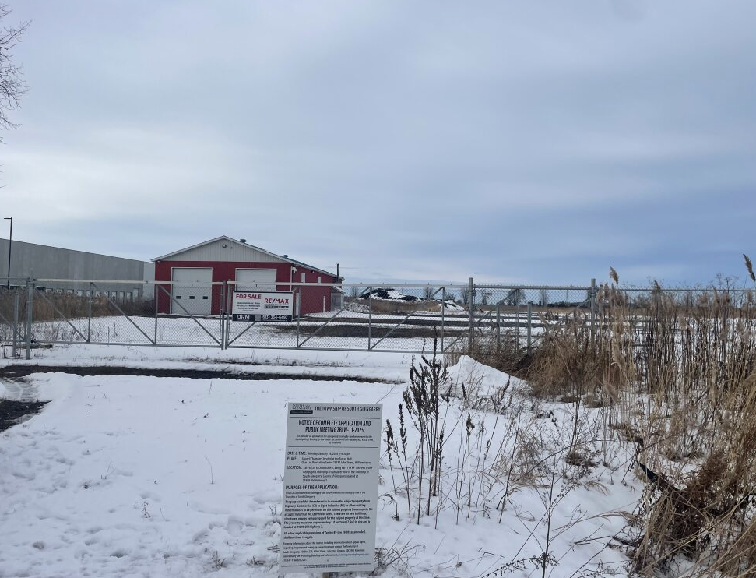
Subject Property - North

Slide 8
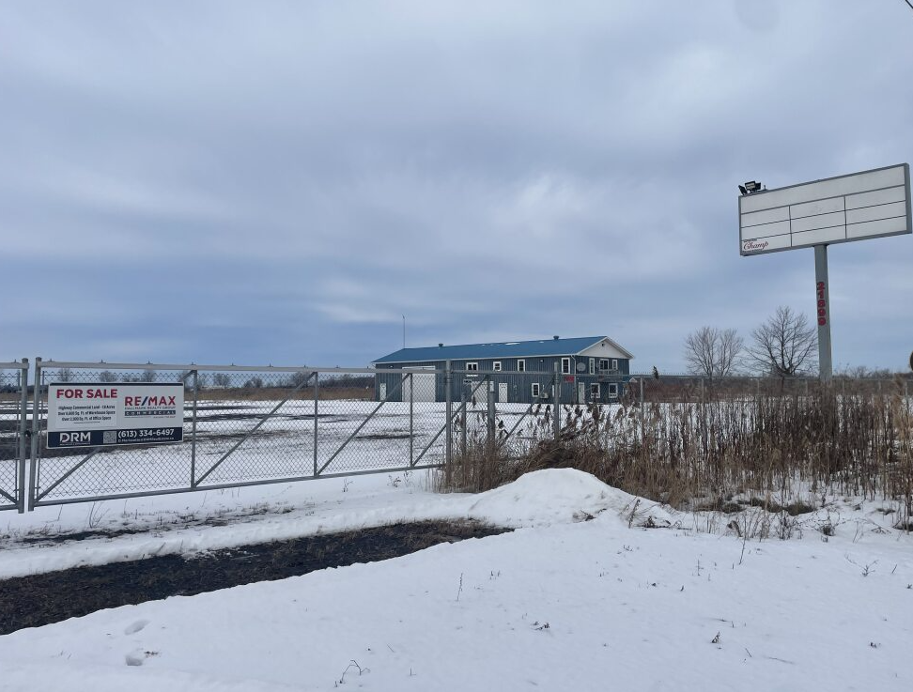
Subject Property – Northeast

Slide 9
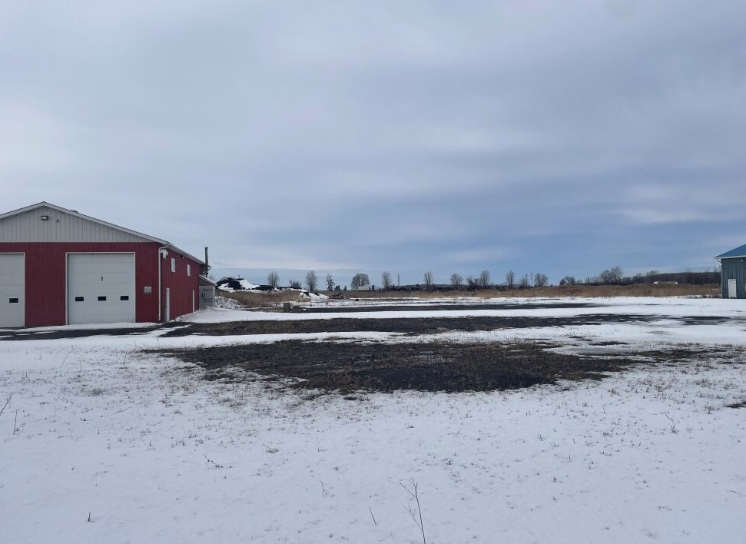
6610
6610
Subject Property - North

Slide 10
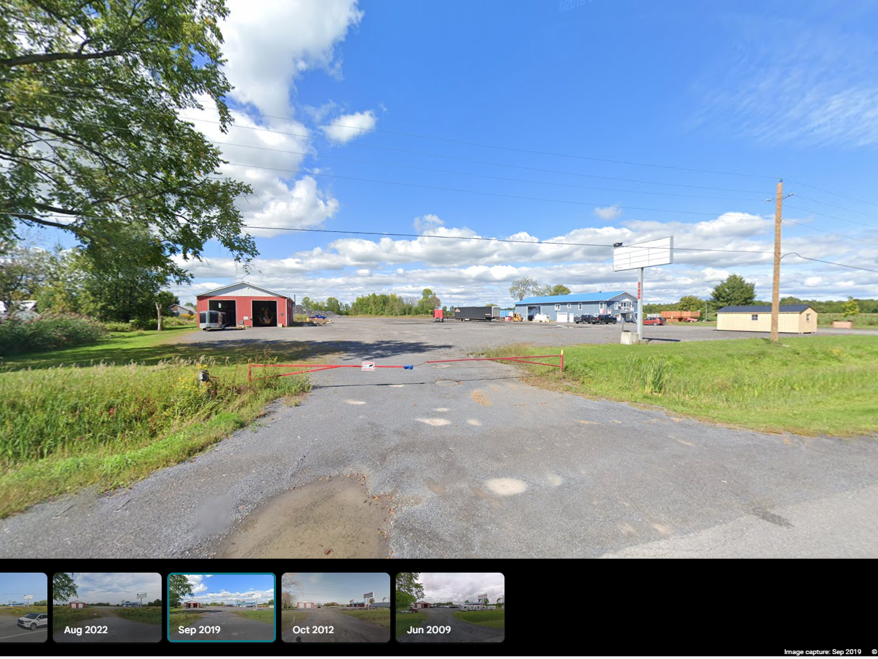
Subject Property (Sept 2019) - North

Slide 11
ZBLW 11-2025
The subject property is currently designated Rural District in the County Official Plan.
This proposed amendment conforms to the Official Plan and the Provincial Planning Statement 2024.

Slide 12
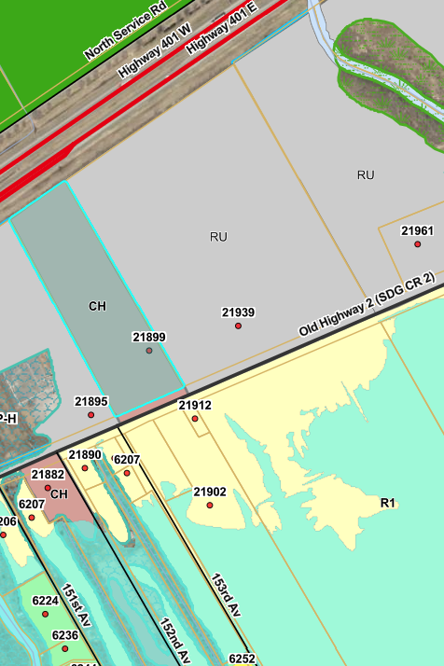
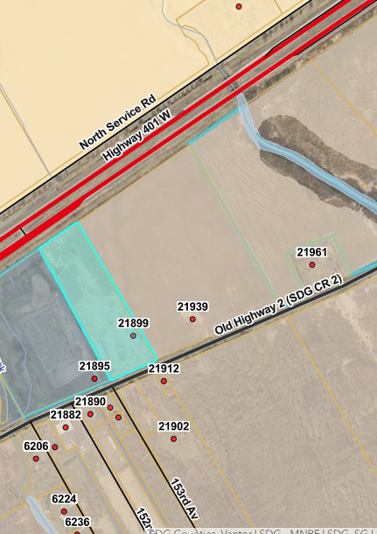
Zoning & OP Map
The subject property is currently designated Rural District in the County Official Plan
The subject property is currently Zoned Highway Commercial (CH) in the Zoning Bylaw

Slide 13
ZBLW 11-2025
The Applicant’s Agent, Chris Clarke, has prepared a presentation with additional information.

Slide 14
Zoning By-Law Amendment – 21889 Old Highway 2
Agent - Egis Canada (Chris Clarke)
Owner - 15990955 Canada Inc.

Slide 15
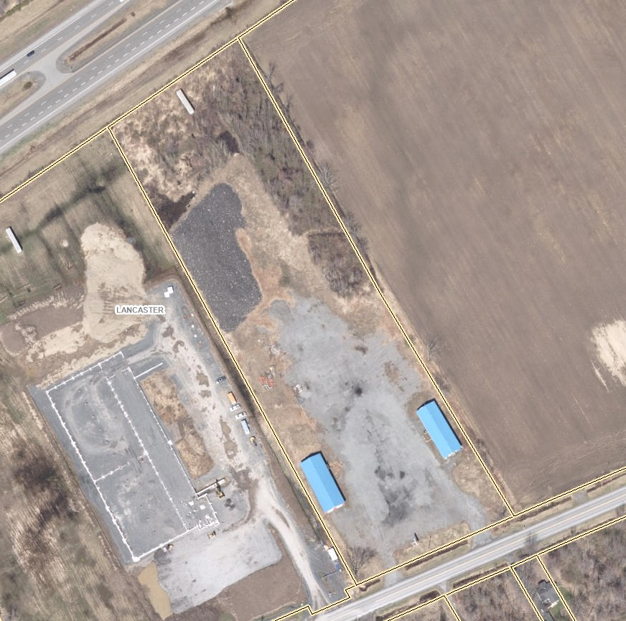
Subject Property – 21889 Old Highway 2

Slide 16
Purpose and Goals of Zoning Amendment
To re-zone the property from Highway Commercial (CH) to Light Industrial (ML)
Marketability - to allow for a wider range of permitted uses compared to the current property zoning.
Potential purchaser in place for the property, intended use would require Light Industrial (ML) zoning.
Removal of the asphalt shingles on-site would occur as part of the purchase and sale.

Slide 17
Provincial Planning Statement (2024)
Light Industrial Uses permitted in Rural Areas under the PPS 2024.
Rezoning will allow for diversification of the economic base and efficient utilization of existing infrastructure.
Rezoning will respect the Highway 401 corridor and will maintain transportation corridors for continued use.
No impacts to water, agriculture, or aggregate resources would result.

Slide 18
D-Series Guidelines
Compatibility between industrial and sensitive uses.
Class I Industrial Facility - A place of business for a small scale, self-contained plant or building which produces/stores a product which is contained in a package and has low probability of fugitive emissions. Outputs are infrequent, and could be point source or fugitive emissions for any of the following: noise, odour, dust and/or vibration. There are daytime operations only, with infrequent movement of products and/or heavy trucks and no outside storage.
Class II Industrial Facility - A place of business for medium scale processing and manufacturing with outdoor storage of wastes or materials (i.e. it has an open process) and/or there are periodic outputs of minor annoyance. There are occasional outputs of either point source or fugitive emissions for any of the following: noise, odour, dust and/or vibration, and low probability of fugitive emissions. Shift operations are permitted and there is frequent movement of products and/or heavy trucks during daytime hours.
Class III Industrial Facility - A place of business for large scale manufacturing or processing, characterized by large physical size, outside storage of raw and finished products, large production volumes and continuous movement of products and employees during daily shift operations. It has frequent outputs of point source and fugitive emissions of significant impact and there is high probability of fugitive emissions.

Slide 19
D-Series Guidelines
The current site would be considered a Class I facility.
No production planned and no open processes on-site.
Outside storage would be limited to vehicles.
Minor impacts related to noise and dust from vehicle travel.

Slide 20
D-Series Guidelines
Minimum separation distance for Class I – 20 metres.
Old Highway 2 Road Allowance provides separation.
Influence areas for Class I facilities can be experienced up to 70 metres away.
Existing buildings well setback on property with ample space to operate beyond 70 metres from nearby homes.

Slide 21
SDG Official Plan
Rural District on Schedule A6.
Designation allows for a variety of uses including industry.
Use would not be better located in a Settlement Area.
Mediation of potential impacts can be achieved.
Close access to 401 Interchange supports industrial activity.
Official Plan allows for small industry in the Rural District. Rezoning to Light Industrial (ML) would be consistent with the Official Plan.

Slide 22
South Glengarry Zoning By-Law
From Highway Commercial (CH) to Light Industrial (ML).
Ample space to provide parking and loading.
Site measures 3.17ha where only 0.4ha required.
Ample frontage on road for new zone.
Existing buildings comply with yard setback requirements.
No exceptions proposed as part of Zoning Amendment.

Slide 23
Thank You

Slide 24
ZBLW 11-2025
This application was circulated to the following agencies for commenting:
  MTO - The Ministry can support the proposed rezoning.
  SDG Counties Transportation– Currently Awaiting Comments

Slide 25
ZBLW 11-2025
Staff received 17 written comments. The public comments raise concerns regarding:
Current Storage of Waste Materials
Noise, Odour, Visual Pollution
Environmental Impacts & Studies
Road Conditions (noise, safety and wear)
Land-Use Compatibility - Residential Land-Uses
Traffic Impact Studies & Traffic Safety
Perceived Impacts on Property Values

Slide 26
ZBLW 11-2025
This zoning amendment application will be subject to a decision of Council.
A staff report including a recommendation will be brought to Council for a decision in the near future.

Slide 27

Members of the public are asked to state their name and address before providing any comments on the proposed Zoning By-Law Amendment.

Slide 29
OPA 29/ ZBLW-12-25
SDG Counties and the Township received an Official Plan Amendment Application (OPA) and a Zoning By-Law Amendment Application to redesignate and rezone the property legally described as Part of Lot 38, Concession 1, being Part 1 on RP 14R 573, in the geographic Township of Lancaster, now in the Township of South Glengarry, addressed as 5961 County Road 34

Slide 30
OPA 29/ ZBLW-12-25
The United Counties of SDG is responsible for OPA’s. Although, the County Official Plan (OP) is an upper tier planning document but it also serves as South Glengarry’s OP.

Slide 31
OPA 29/ ZBLW-12-25
This meeting will begin with a presentation by:
  SDG Counties Planning Staff explaining the requested OPA,
  Township Planning Staff explaining the requested Zoning Amendment, followed by a;
  presentation by the Applicant’s Planner explaining the reason for requesting the amendments.
Member of the public will be permitted to speak following the presentations

Slide 32
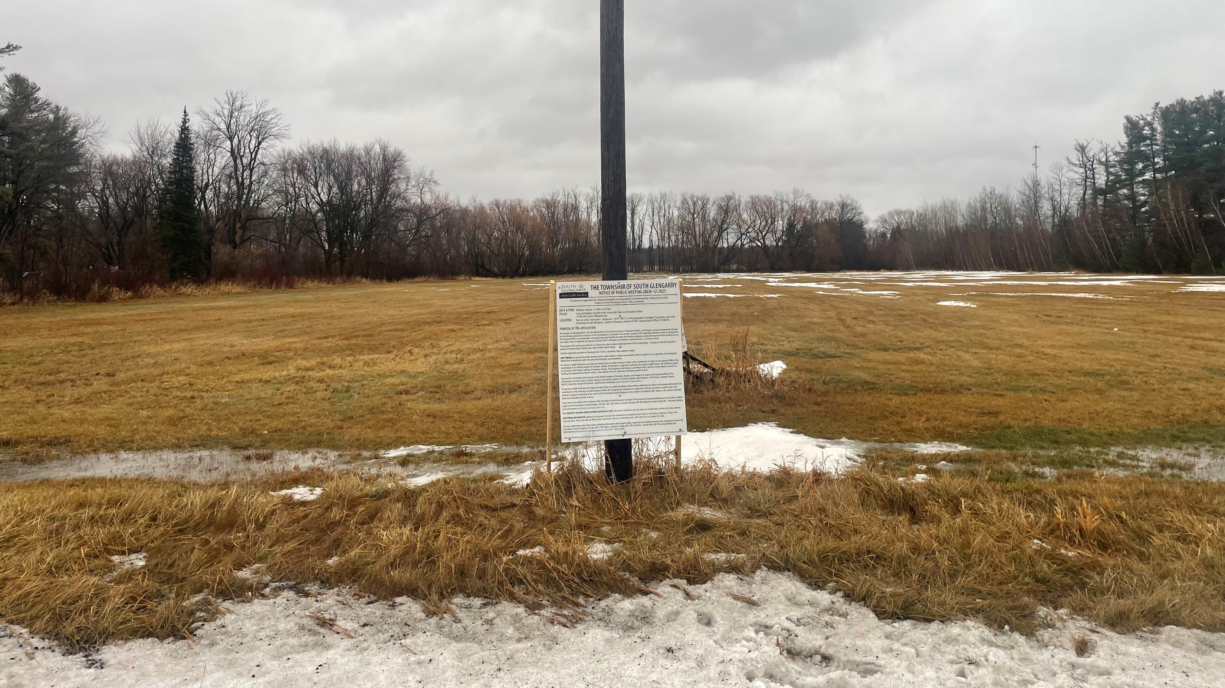
Official Plan Amendment
No. 29
5961 County Road 34,
Township of South Glengarry
Lindsay Parisien, RPP, MCIP
Public Meeting
January 12, 2026

Slide 33

Presentation Overview
5961 County Road 34, Lancaster
  Existing Site Conditions
  Surrounding Land Uses
Proposed Official Plan Amendment
  Planning Rationale & Justification
  Agricultural Impact Assessment (AIA)
Applicable Provincial Planning Statement (2024) & Provincial Guidelines
  Alternative Location Examples
Official Plan Policies
Comments Received to Date
Summary of Findings
Next Steps

Slide 34
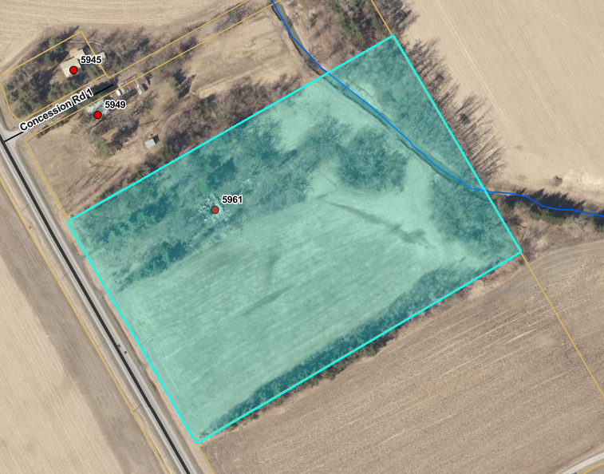
Subject Site
5961 County Road 34, Lancaster

Slide 35
Existing Site Conditions
5961 County Road 34, South Glengarry
Official Plan Land Use Designation | Agricultural Resource Lands
Within the Settlement Boundary | Outside Boundary
Zone Classification | Agricultural (AG)
Lot Area | 5.33 Hectares (13.15 acres)
Current Use | Vacant (former residence); Finney Creek Drain
Soil Classification - Canada Land Inventory (CLI) | CLI Class 2 & Class 5
Distance to Highway 401 Interchange | +/- 1.85 Kilometers

Slide 36
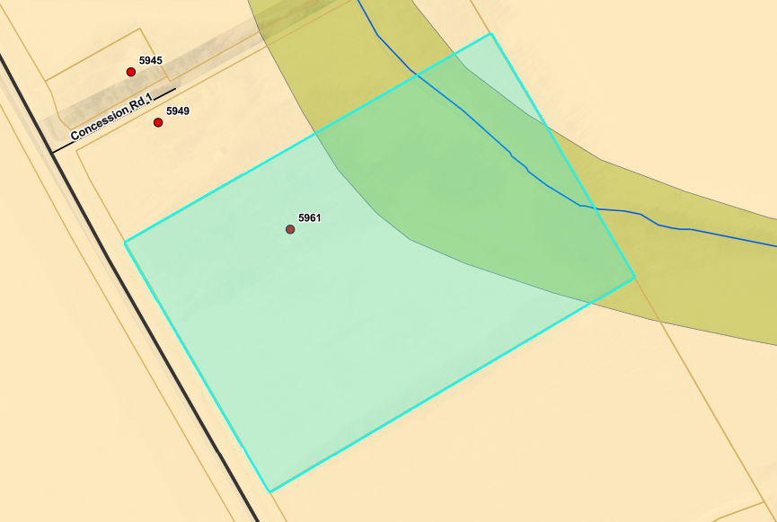
Canada Land Inventory (CLI)
Notes:
Order of Priority for protecting farmland within Prime Agricultural Areas
Specialty crop areas
CLI Class 1,2, and 3 lands followed by Class 4 through 7 lands

Slide 37
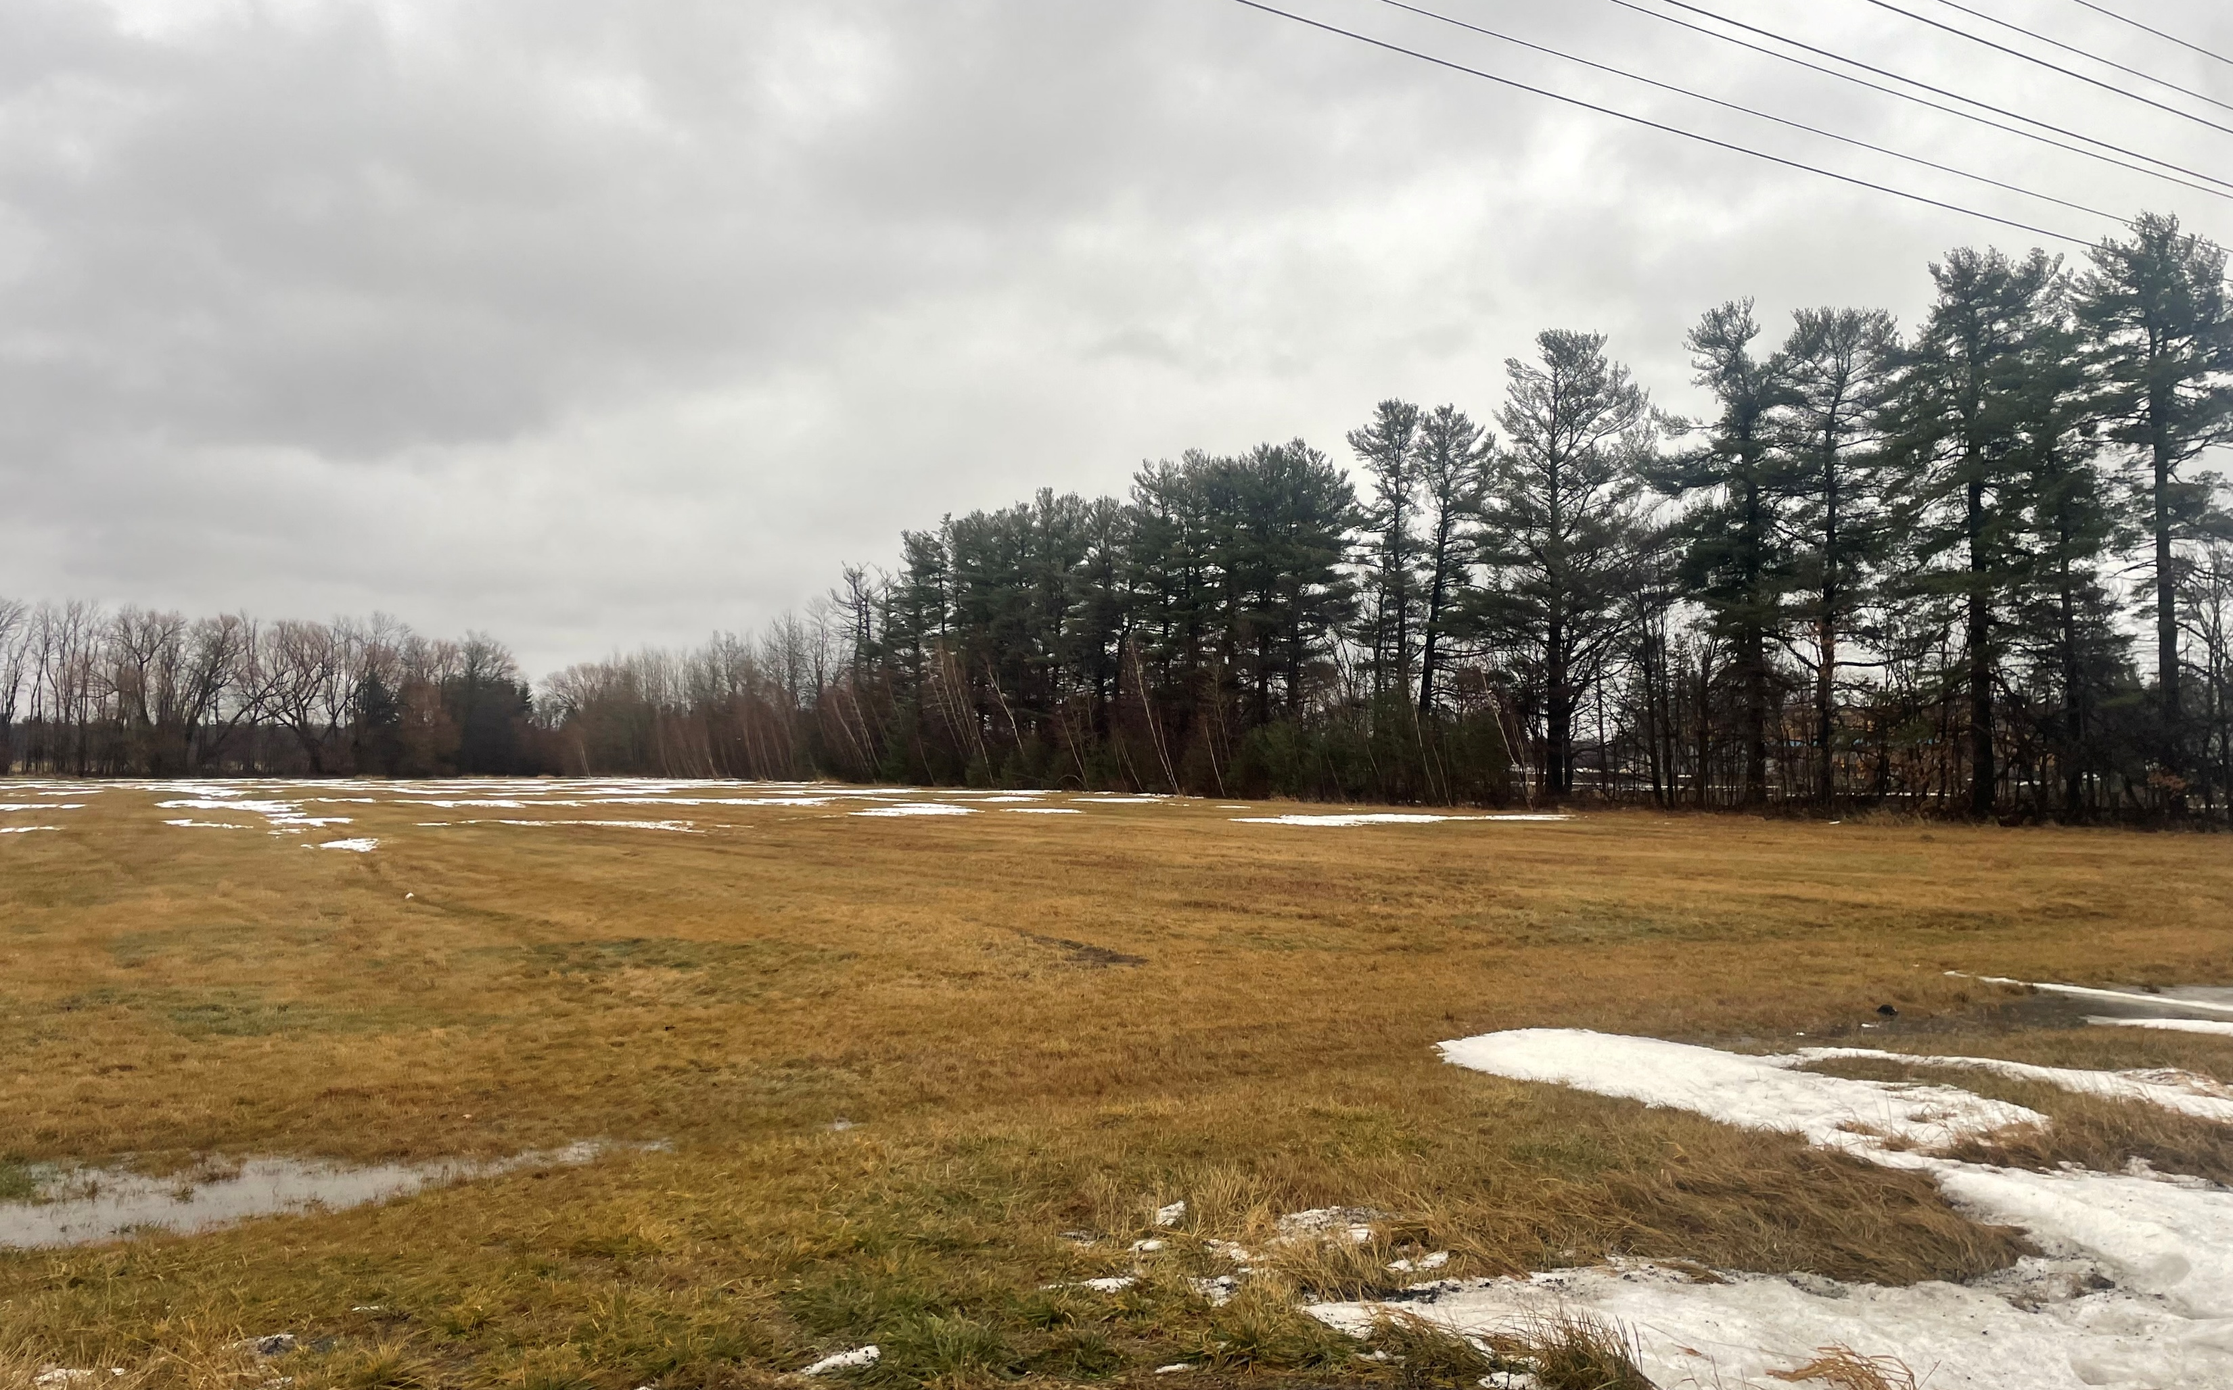
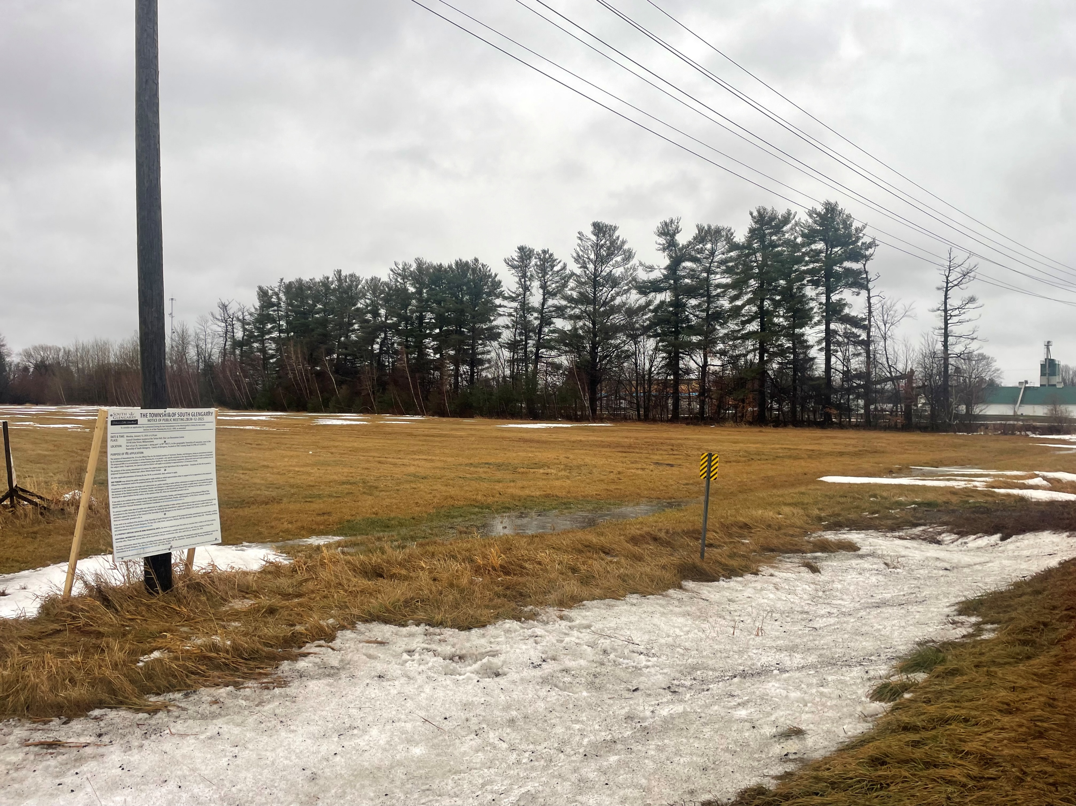
5961 County Road 34
Recent photos of the subject site taken December 2025.

Slide 38
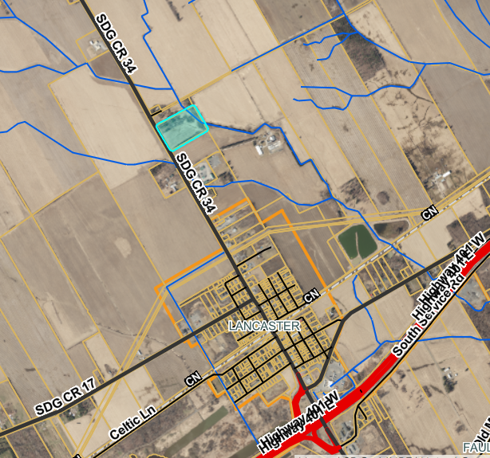
Surrounding Land Uses
North – Residential (Agricultural)
South – Agricultural
East – Agricultural
West - Agricultural

Slide 39

Proposed Official Plan Amendment No. 29
To permit a site-specific exception to the Agricultural Resource Lands use designation.
The proposed OPA is to accommodate a transportation depot facility for trucks and farming equipment, along with truck and trailer parking uses on the subject lands.
If approved, the Special Land Use District will apply as an overlay to approximately 5.33 hectares of land.

Slide 40
Planning Rationale & Justification
Report
Planning Rationale and Justification Report, prepared by GWD Consulting Inc., July 2025
Proposed development is considered agricultural related as the intent is to offer farm vehicle repair services.
The subject site is naturally separated from the larger agricultural lands and is currently not being farmed.
Proposed development serves the needs of the surrounding community and provides economic opportunities.
Location of subject site in close and direct proximity to Highway 401.

Slide 41
Agricultural Impact Assessment (AIA)
Agricultural Impact Assessment (AIA), prepared by Colville Consulting Inc., November 2024
The subject lands are within prime agricultural areas but are considered lower priority and do not form part of a specialty crop area.
Potential limited impacts associated with the proposed development (e.g. loss of prime agricultural lands, cultivatable land).
The proposed development complies with applicable MDS setback requirements.
Justification for locating the proposed development within a prime agricultural area is required.

Slide 42
Applicable Provincial Planning Statement Policies & Guidelines
Provincial Planning Statement (PPS, 2024) provides overall policy directions on matters of provincial interest related to land use planning and development in Ontario.
Guidelines on Permitted Uses in Ontario’s Prime Agricultural Areas (2016)
  Provincial document that provides guidance on limited non-agricultural uses in prime agricultural areas.
Provincial Guidelines are issued to assist planning authorities and decision-makers with implementing the policies of the Provincial Planning Statement.

Slide 43
Provincial Planning Statement (2024)
Section 4.3.5 Non-Agricultural Uses
PPS 4.3.5 Non-Agricultural Uses in Prime Agricultural Areas:
1. Planning authorities may only permit non-agricultural uses in prime agricultural areas for:
b) limited non-residential uses, provided that all of the following are demonstrated:
1. the land does not comprise a specialty crop area;
2. the proposed use complies with the minimum distance separation formulae;
3. there is an identified need within the planning horizon identified in the official plan provided for in policy 2.1.3 for additional land to accommodate the proposed use; and
4. alternative locations have been evaluated, and
i. there are no reasonable alternative locations which avoid prime agricultural areas; and
ii. there are no reasonable alternative locations in prime agricultural areas with lower priority agricultural lands.
2. Impacts from any new or expanding non-agricultural uses on the agricultural system are to be avoided, or where avoidance is not possible, minimized and mitigated as determined through an agricultural impact assessment or equivalent analysis, based on provincial guidance.

Slide 44
Guidelines on Permitted Uses in Ontario’s Prime Agricultural Areas
Section 3.2 Limited Non-Agricultural Uses in Prime Agricultural Areas
  Includes commercial, industrial, institutional or recreational uses.
These uses may only be considered in prime agricultural areas if other locations are unavailable.
In addition, the following tests are applied if a limited non-agricultural use is proposed prime agricultural areas:
  Preliminary Assessment
  Demonstration of Need
  Evaluation of Alternative Locations
  Mitigation of Impacts

Slide 45
Demonstration of Need & Evaluation of Alternative Locations
Demonstrating the need for a non-agricultural use usually includes information on and analysis of:
  The demand for the product or service
  Inventory of current suppliers/competitors
  How much of the current or future projected demand is met within a given market or service area
  Distance to markets or clients
  Economic impacts of the proposed use
  A preliminary assessment of the potential impacts on agricultural operations.
Evaluation of reasonable alternative locations for limited non-agricultural uses is mandatory.
Order of priority in which applicants must evaluate alternative locations:
  1) Lands outside prime agricultural areas.
  2) Sites within settlement areas and on rural lands within the geographic areas to be served.
  3) If none are available, lower-priority areas within prime agricultural areas can be identified and evaluated.

Slide 46
Evaluation of reasonable Alternative Locations
“Arguing that applicants own only one site, or that sites in settlement areas are unaffordable for the proposed use, are insufficient reasons and should not be considered adequate justification” (pg. 41).

Slide 47
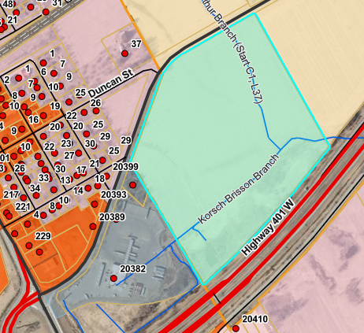
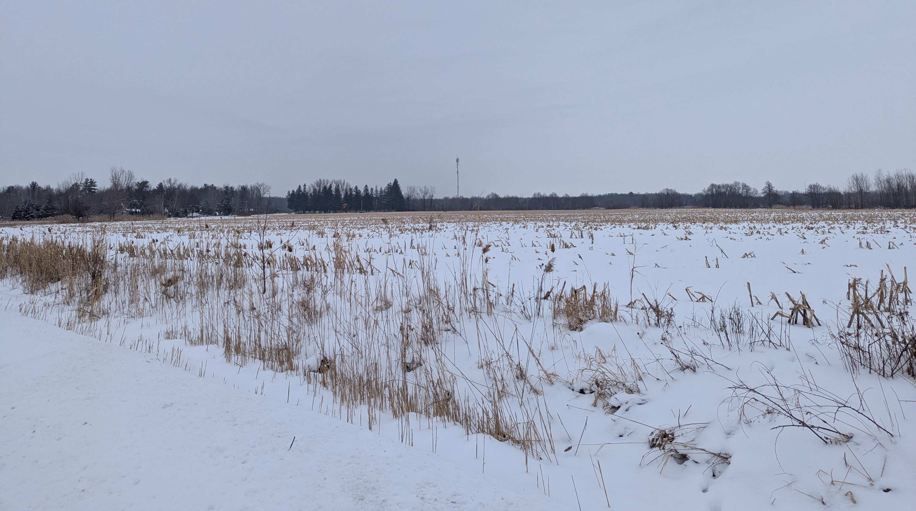
Alternative Location: Example #1 Lancaster
South of Old Highway #2, North of Highway 401, Lancaster
Official Plan Land Use Designation | Agricultural Resource Lands
Within Settlement Area Boundary | Outside Boundary
Zone Classification | Agricultural (AG)
Lot Area (total) Potential developable | 13.54 hectares (33.48 acres) +/- 7.93 hectares (19.6 acres)
Current Use | Vacant
Soil Classification - Canada Land Inventory (CLI) | CLI Class 2 & Class 5
Distance to HWY 401 Interchange | +/- 350 meters

Slide 48
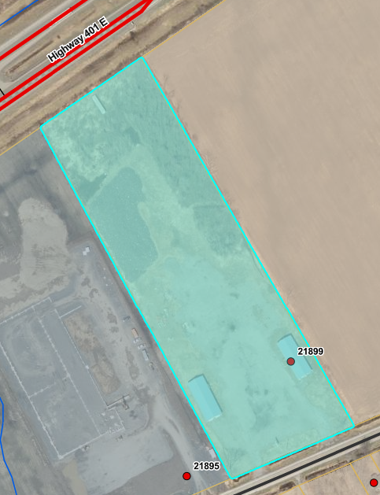
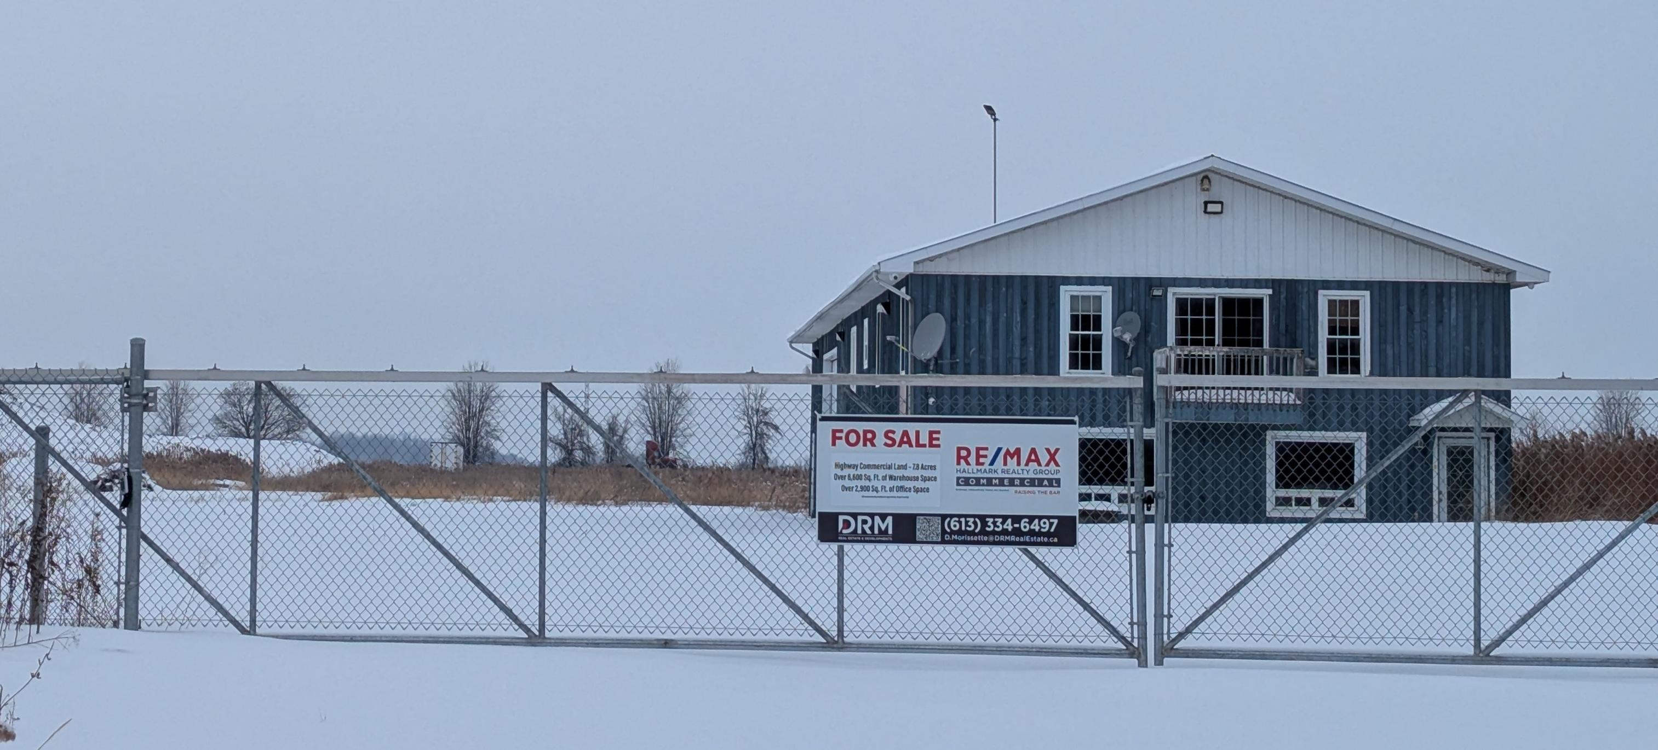
Alternative Location: Example #2, Curry Hill
21899, Old Highway #2, Curry Hill
Official Plan Land Use Designation | Rural District
Within Settlement Area Boundary | Outside Boundary
Zone Classification | Proposed rezoning Highway Commercial (CH) to Light Industrial (ML)
Lot Area (total) | 3 hectares (7.46 acres)
Current Use | Two existing buildings
Soil Classification - Canada Land Inventory (CLI) | CLI Class 2
Distance to HWY 401 Interchange | +/- 650 meters
Notes:
Approximately 12 km east of the subject property, next Hwy 401 interchange, closer to Montreal, Quebec border

Slide 49
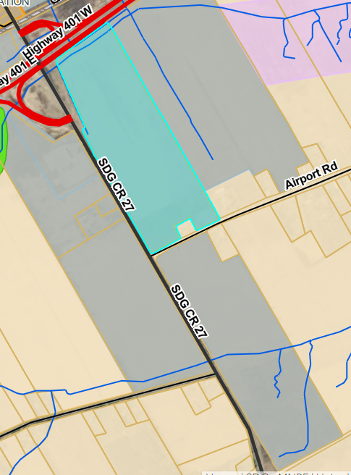
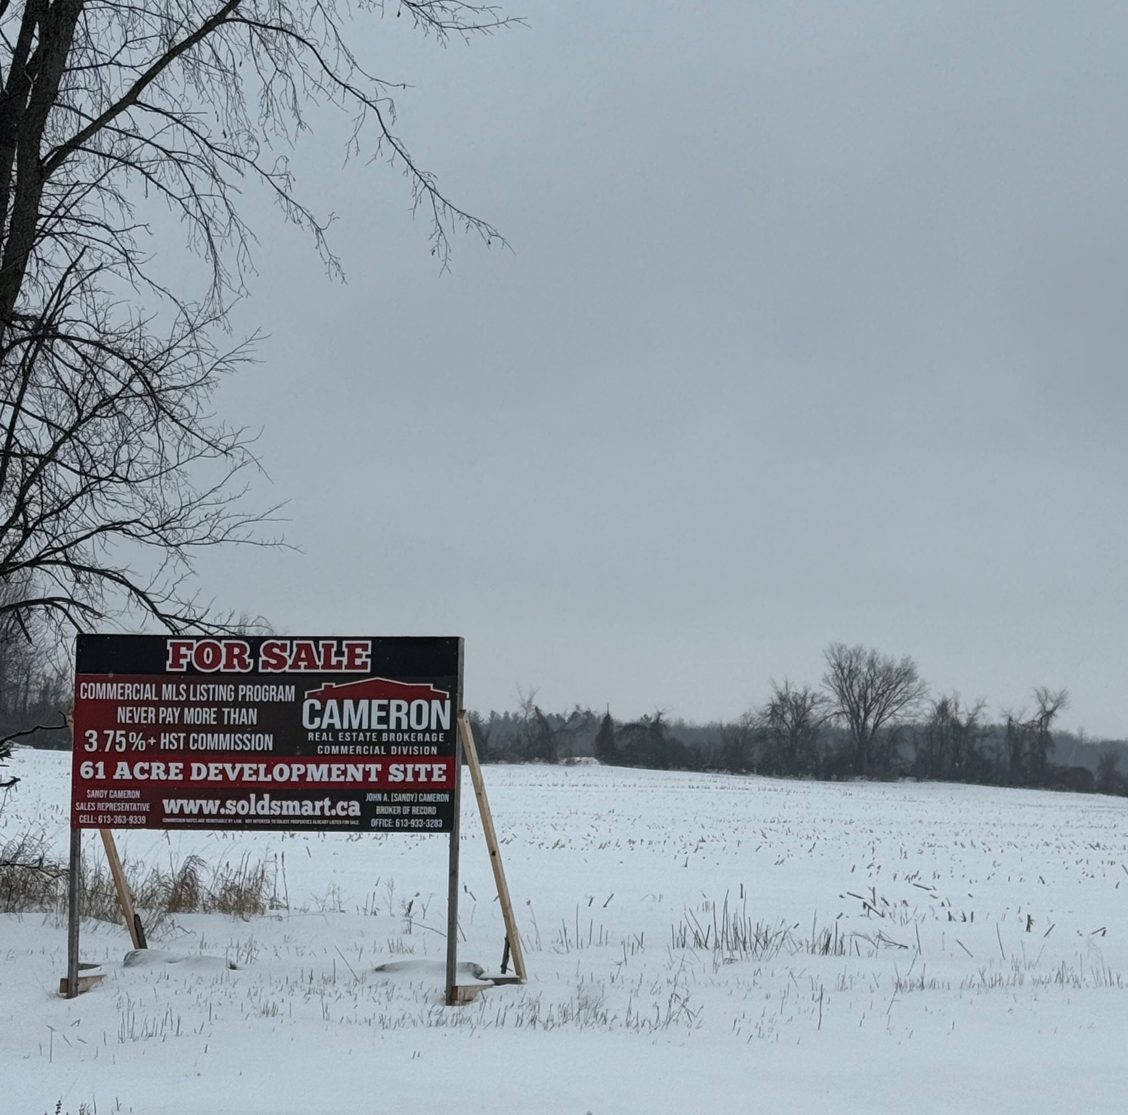
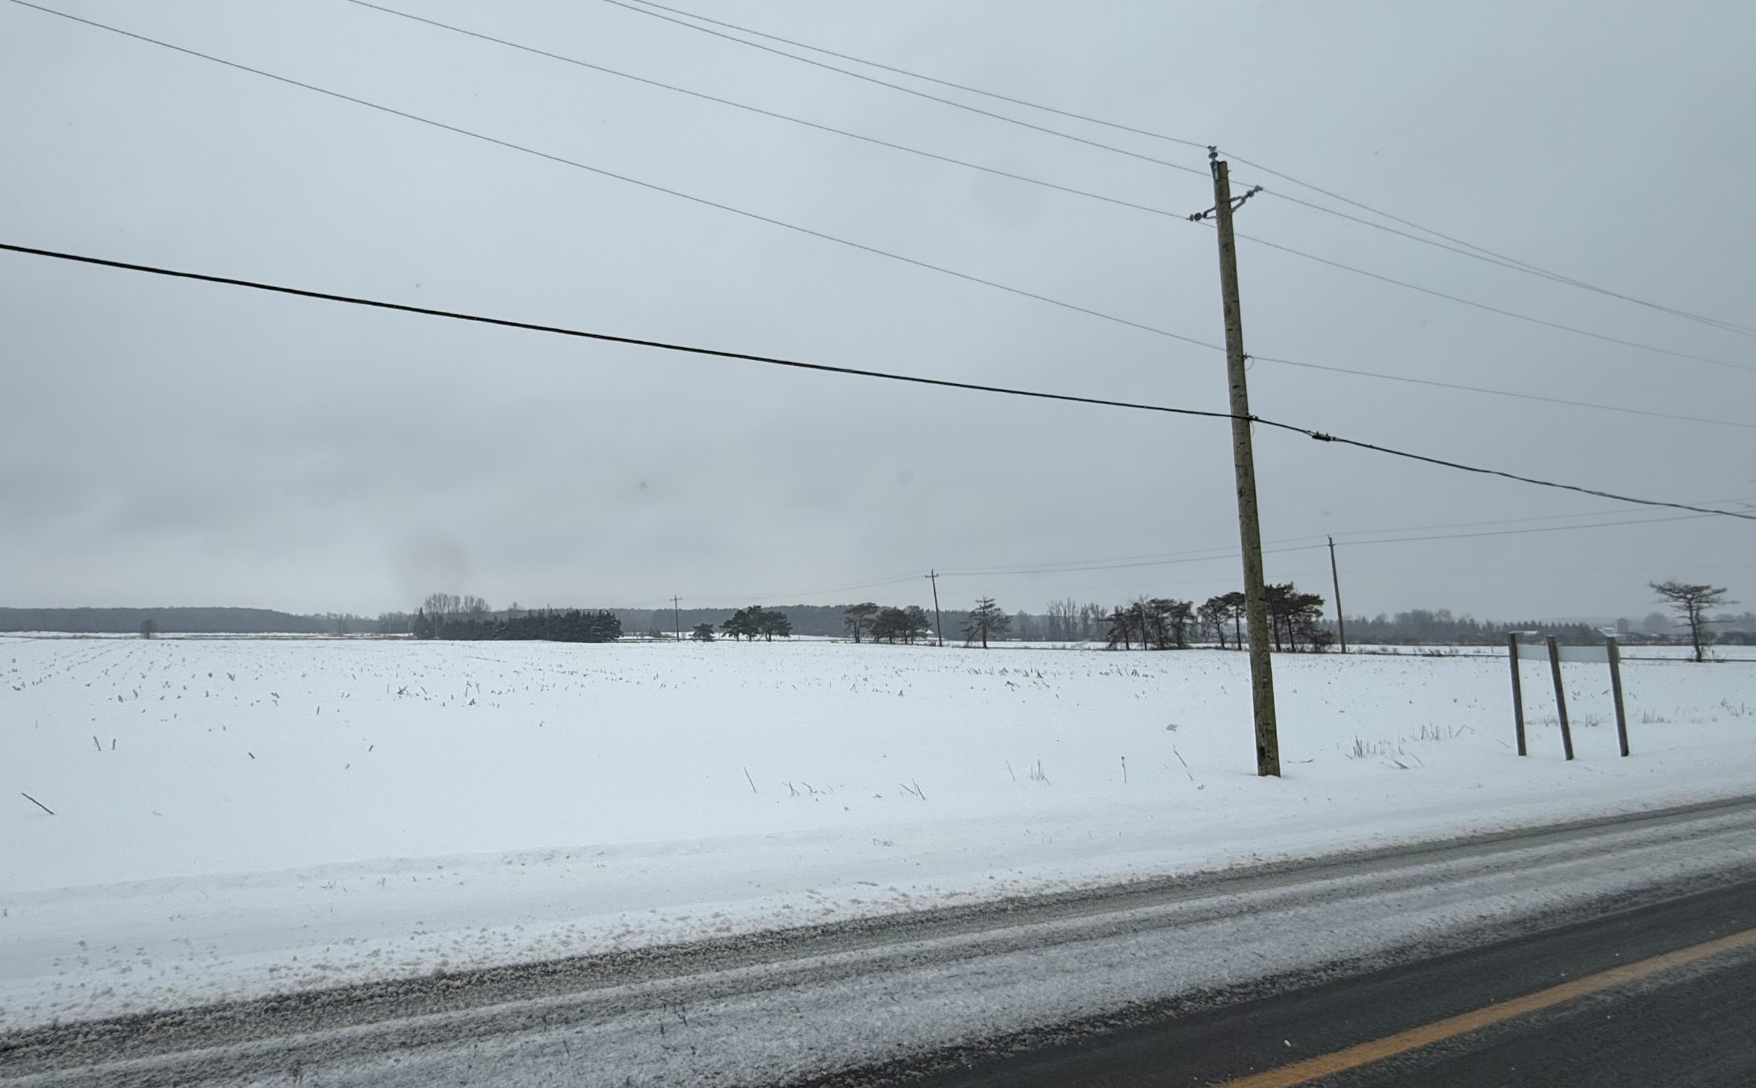
Alternative Location: Example #3, Summerstown
County Road 27 & Airport Road , Summerstown
Subject site | North of Airport Road | South of Airport Road
Official Plan Land Use Designation | Employment District | Employment District
Within Settlement Boundary | Outside Boundary | Outside Boundary
Zone Classification | Light Manufacturing (ML-6) | Light Manufacturing (ML)
Lot Area (total) | 22 hectares (54.43 acres) | 24 hectares (61.20 acres)
Current Use | Vacant | Vacant (Fraser Creek)
Soil Classification Canada Land Inventory (CLI) | CLI Class 2 | CLI Class 2
Distance to Highway 401 Interchange | +/- 580 meters | +/- 580 meters
Notes:
Approximately 9 km West of the subject property, next Hwy 401 interchange, closer to Cornwall and US Border crossing. Note: parcel north of Airport Road has draft plan of subdivision approval

Slide 50
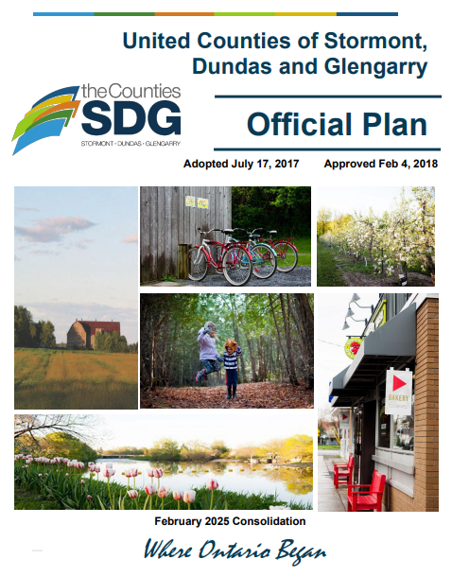
SDG Counties Official Plan Policies – Section 5.3 Agricultural Resource Lands
If proposals are made for a non-agricultural use:
An Official Plan Amendment is required to permit a non-agricultural use.
The lands would remain in an Agricultural designation however site-specific provisions would permit the specific use identified in the proposal.
Should approval be obtained it would only permit the use specified in the proposal and is not intended to establish a ‘general approval’ for a series of uses.

Slide 51

Comments Received to Date
SDG Counties met with MMAH staff regarding the applicable PPS policies and provincial guidelines.

Slide 52
Summary of Findings
Planning authorities may only permit non-agricultural uses in prime agricultural areas, provided that all tests in the PPS and guidelines are demonstrated.
AIA study noted that the subject site is located within lower priority prime agricultural lands, but an evaluation of alternative locations was not provided.
AIA study also noted that vacant rural lands are located 1.6 km away and are closer to Highway 401 than the subject parcel.

Slide 53
Next Steps
Public meeting January 12th
Prepare Council report for upcoming meeting agenda
February 16th County Council Meeting
If approved, 20-day appeal period commences

Slide 54
OPA 29/ ZBLW-12-25
The Township has received a Zoning Amendment Application to rezone the subject property. The proposed zoning amendment conforms to the requested OPA.

Slide 55
OPA 29/ ZBLW-12-25
The purpose of the zoning amendment is to rezone the subject property from Agricultural (AG) to Agriculture – Exception 40 (AG-40) to permit a proposed Transportation Terminal and a Motor Vehicle Repair Garage. All other applicable provisions of Zoning By-law 38-09, as amended, shall continue to apply.

Slide 56
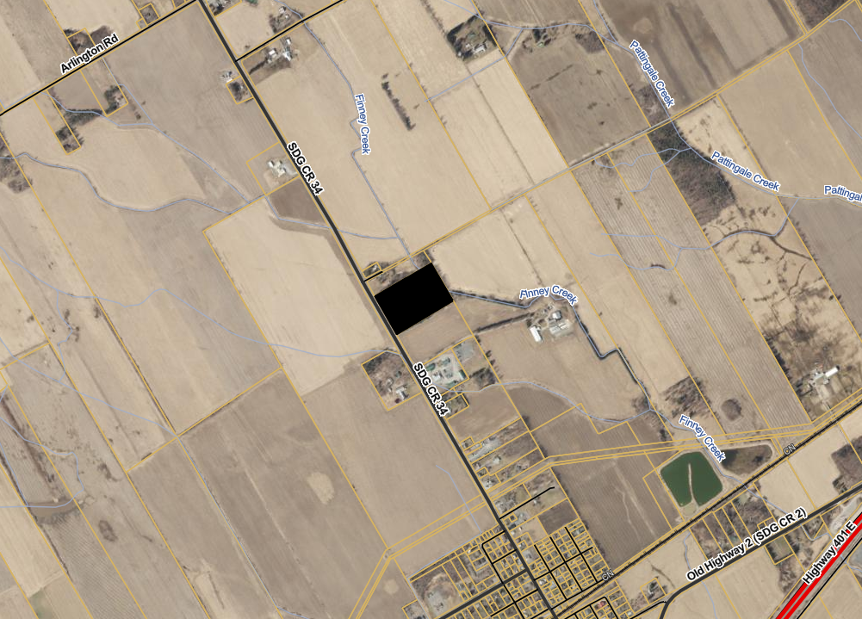
Subject Property

Slide 57
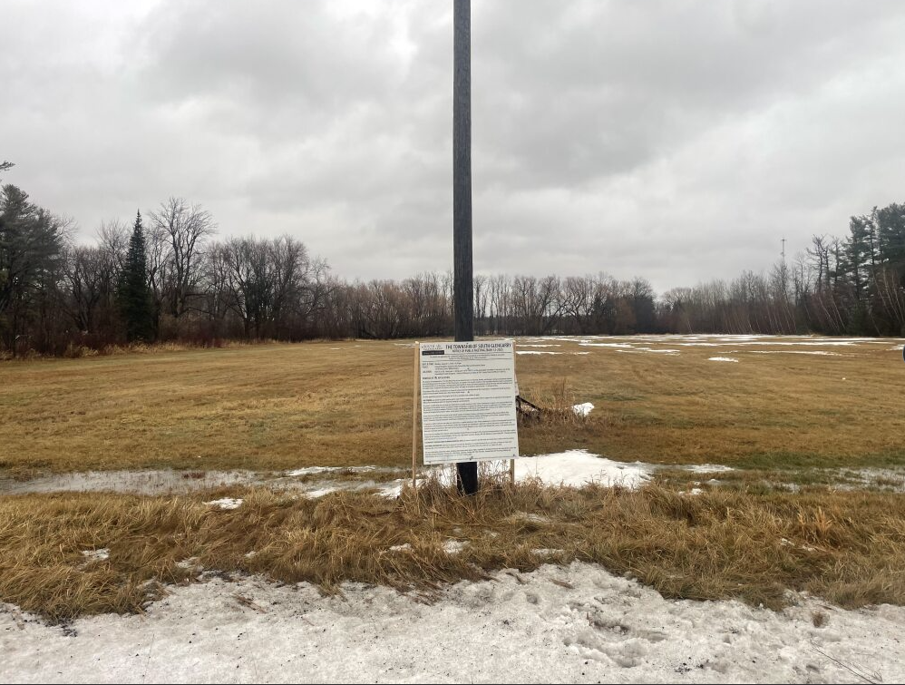
Subject Property - East

Slide 58
OPA 29/ ZBLW-12-25
The subject property is currently vacant and is approximately 5.3 ha (13 acres) in size
A portion of the subject property was residentially developed, in 2024, a demolition permit was issued to demolish the single detached dwelling.

Slide 59
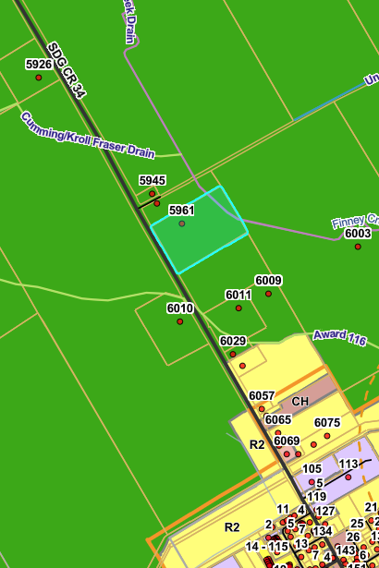
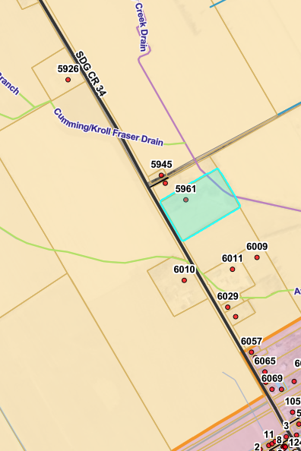
Zoning & Official Plan Designation Maps
Subject Property
Subject Property
Settlement area of Lancaster
Settlement area of Lancaster
The Subject Property is zoned Agricultural in Zoning By-law 38-09
The Subject Property is Designated Agricultural Resource in the SDG Official Plan

Slide 60
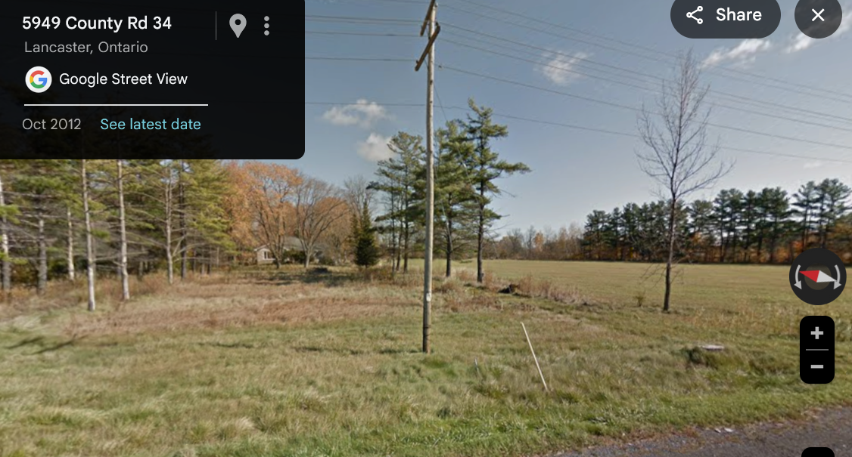
Google Street View Image

Slide 61
OPA 29/ ZBLW-12-25
The applicant is proposing to construct a 582 sq. m (6,264 sq. ft.) Repair Bay building with a large parking lot to accommodate 11 cars and 150 tractor trailers

Slide 62
OPA 29/ ZBLW-12-25
This proposed amendment does not conform to the Official Plan nor the Provincial Planning Statement 2024.

Slide 63
OPA 29/ ZBLW-12-25
The Applicant’s Agent has prepared a presentation providing additional information regarding the requested zoning amendment.

Slide 64

STATUTORY PUBLIC MEETING – JANUARY 12, 2026
APPLICATION to AMEND the ZONING BY-LAW & OFFICIAL PLAN
1733286 ONTARIO INC.
5961 COUNTY ROAD 34 TOWNSHIP of SOUTH GLENGARRY
TOWN FILES: ZBLW-11-25 & ZBLW-12-25

Slide 65

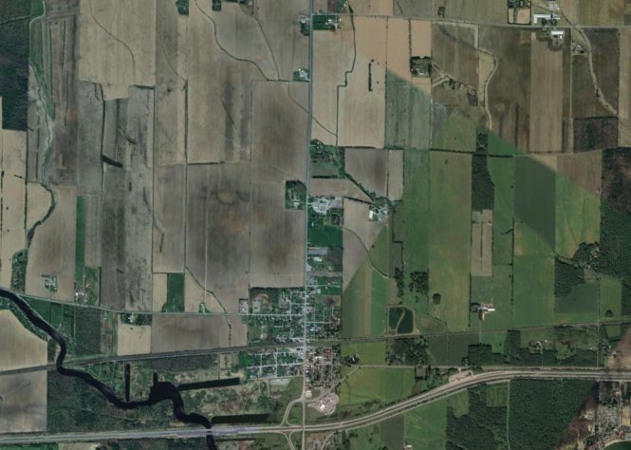
SURROUNDING CONTEXT
5961 COUNTY ROAD 34
TOWNSHIP of SOUTH GLENGARRY
CONCESSION ROAD 2
CONCESSION ROAD 1
COUNTY ROAD 34
PINE STREET

Slide 66
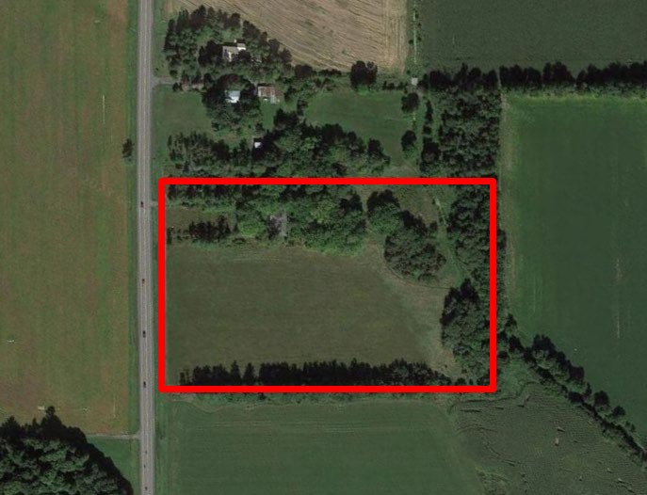
SUBJECT SITE
5961 COUNTY ROAD 34
TOWNSHIP of SOUTH GLENGARRY
COUNTY ROAD 34
CONCESSION ROAD 1

Slide 67
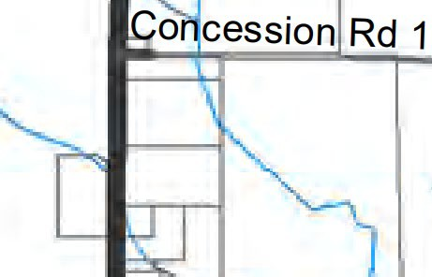
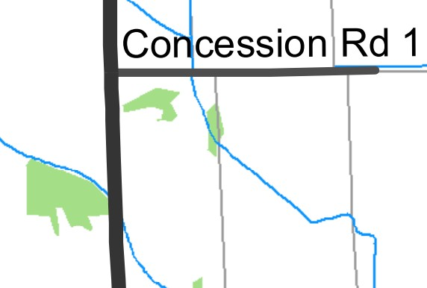



COUNTIES of STORMONT-DUNDAS-GLENGARRY OFFICIAL PLAN LAND USE SCHEDULE & CONSTRAINTS PLAN
5961 COUNTY ROAD 34
TOWNSHIP of SOUTH GLENGARRY
COUNTY ROAD 34
COUNTY ROAD 34
Schedule A6: Land Use
Schedule B6: Constraints Plan

Slide 68
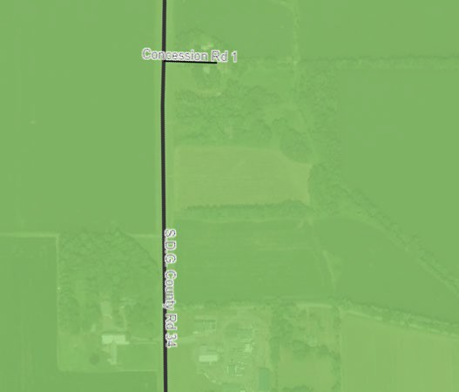
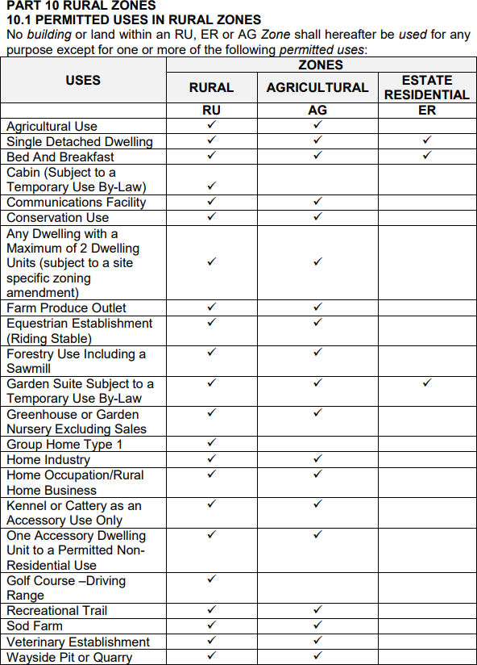
TOWNSHIP of SOUTH GLENGARRY ZONING BY-LAW 06-2023
5961 COUNTY ROAD 34
TOWNSHIP of SOUTH GLENGARRY
COUNTY ROAD 34
CONCESSION ROAD 1
Township of South Glengarry Zoning By-law 06-2023 (Extract)

Slide 69
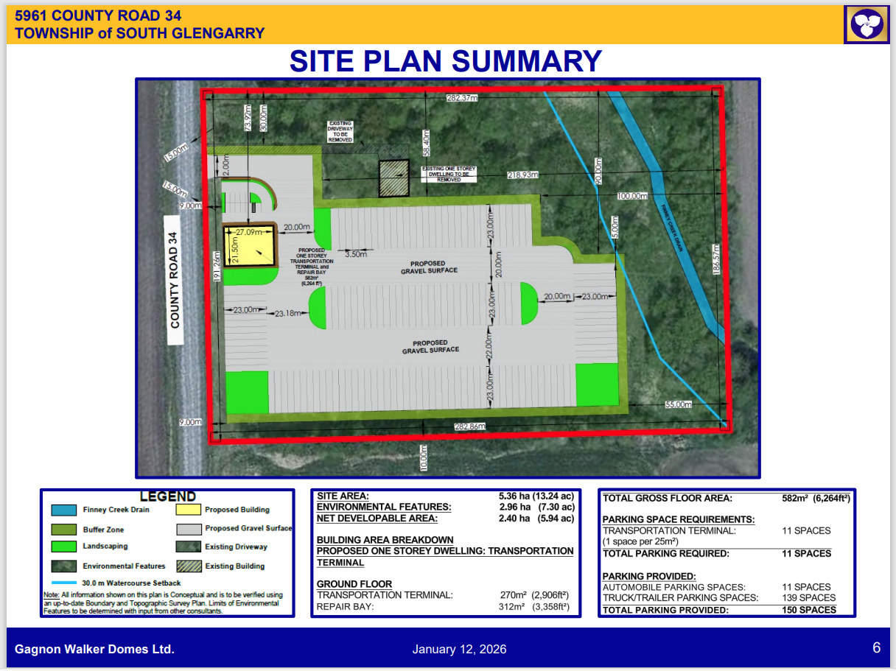
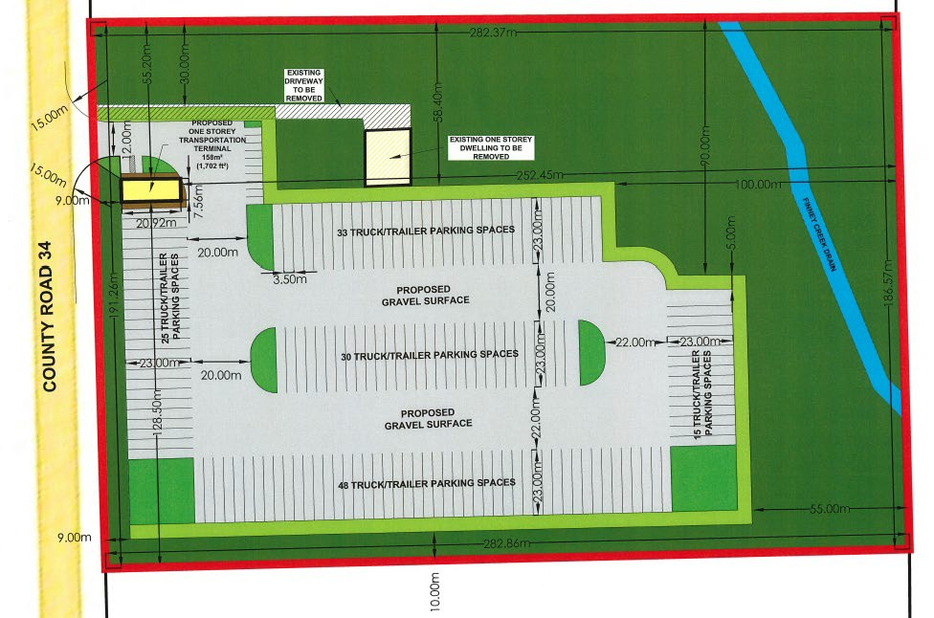
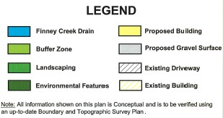
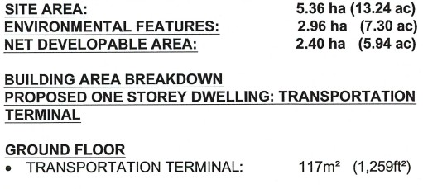
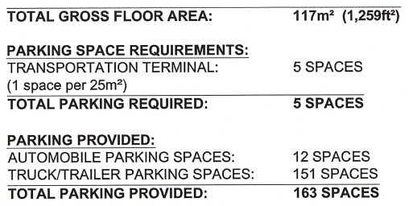
SITE PLAN SUMMARY
5961 COUNTY ROAD 34
TOWNSHIP of SOUTH GLENGARRY

Slide 70
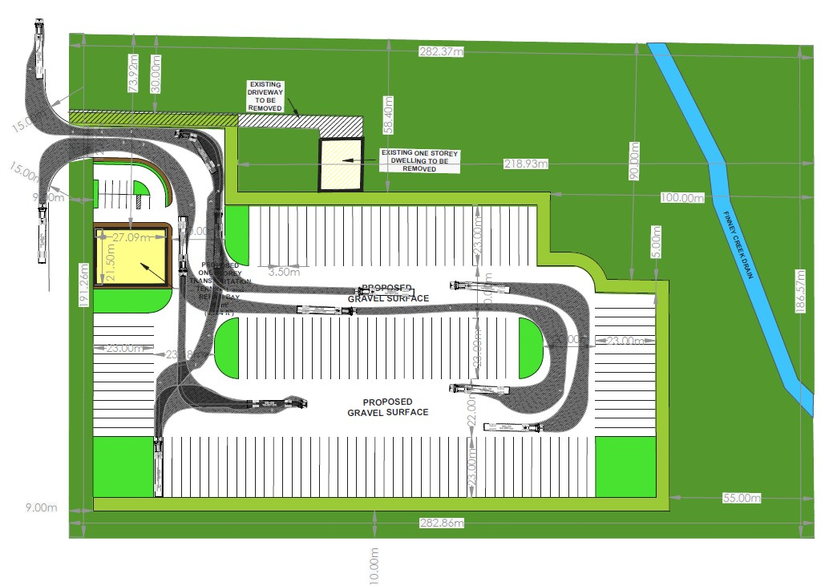
SITE CIRCULATION
5961 COUNTY ROAD 34
TOWNSHIP of SOUTH GLENGARRY

Slide 71
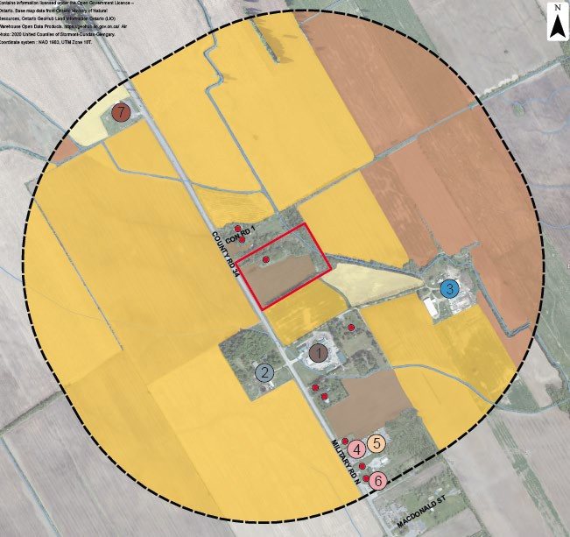
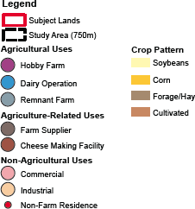
SURROUNDING USES
5961 COUNTY ROAD 34
TOWNSHIP of SOUTH GLENGARRY

Slide 72
APPLICATION TECHNICAL STUDIES, REPORTS, PLANS
5961 COUNTY ROAD 34
TOWNSHIP of SOUTH GLENGARRY
Planning Justification Report
Traffic Impact Study
Agricultural Impact Assessment

Slide 73
THANK YOU
5961 COUNTY ROAD 34
TOWNSHIP of SOUTH GLENGARRY

Slide 74
OPA 29/ ZBLW-12-25
4 written comments have been received to date from members of the public. The comments received express concerns regarding:
Traffic Safety Between 401 and Subject Property
Environmental, Noise & Odour Pollution
Perceived Negative Impacts on:
  Downtown Lancaster Businesses – Roadway Infrastructure
  Drainage
  Nearby Residential and Agricultural Operations

Slide 75
OPA 29/ ZBLW-12-25
This zoning amendment application will be subject to a decision by Council.
A staff report including a recommendation will be brought to Council for a decision in the near future.
.

Slide 76
Members of the public are asked to state their name and address before providing any comments on the proposed OPA and Zoning By-Law Amendment.

