Slide 1

Public Meeting
Proposed Zoning Amendments
July 27th, 2026

Slide 2
This is a public meeting under section 34 of the Ontario Planning Act
ANY PERSON may attend the public meeting and/or make written or verbal representation either in support of or in opposition to the proposed Zoning By-law Amendment.
If a person or public body would otherwise have an ability to appeal the decision of Council of The Township of South Glengarry to the Ontario Land Tribunal (OLT) but the person or public body does not make oral submissions at a public meeting or make written submissions to the council of the Township of South Glengarry before the by-law is decided upon, the person or public body is not entitled to appeal the decision.
If a person or public body does not make oral submissions at a public meeting or make written submissions to the Township of South Glengarry before the by-law is decided upon, the person or public body may not be added as a party to the hearing of an appeal before the OLT unless there are reasonable grounds to do so.

Slide 3
Knight Zoning By-Law Amendment
This meeting will begin with a presentation summarizing the application, followed by a discussion period during which all attendees will have an opportunity to provide input on the proposed by-law.

Slide 4
Knight Zoning By-Law Amendment
Subject Property Location:
  East Part of Lot 24, Concession 1 Front, being parts 1 and 4 to 7 on Reference Plan 14R6680, in the Geographic Township of Charlottenburgh, now in the Township of South Glengarry, County of Glengarry, located at 18645 Prevost Point Road.

Slide 5
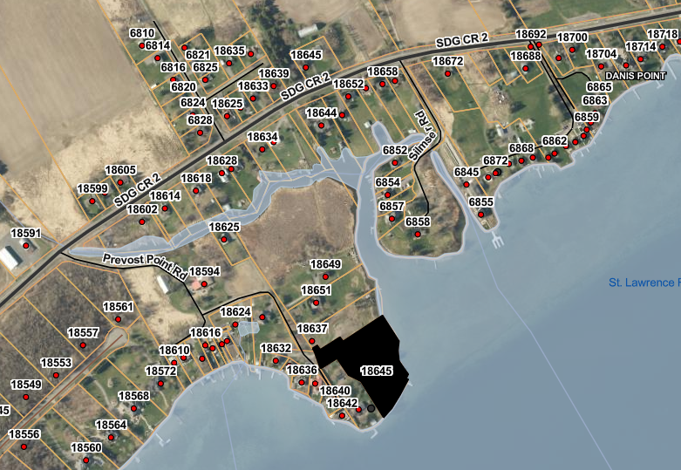
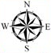
Subject Property

Slide 6
Knight Zoning By-Law Amendment
The subject property is currently designated Rural District in the County Official Plan and is zoned Limited Service Residential- Exception Four (LSR-4), and Floodplain-Holding in the Township’s Zoning By-Law.

Slide 7
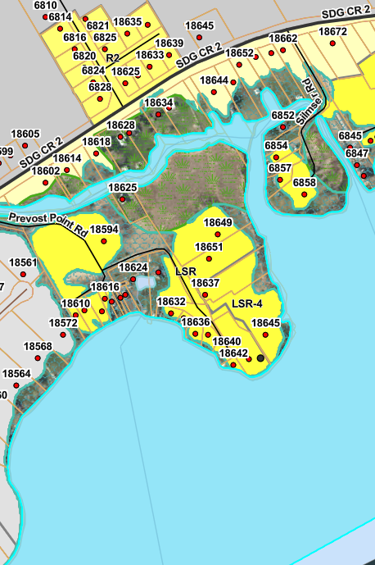
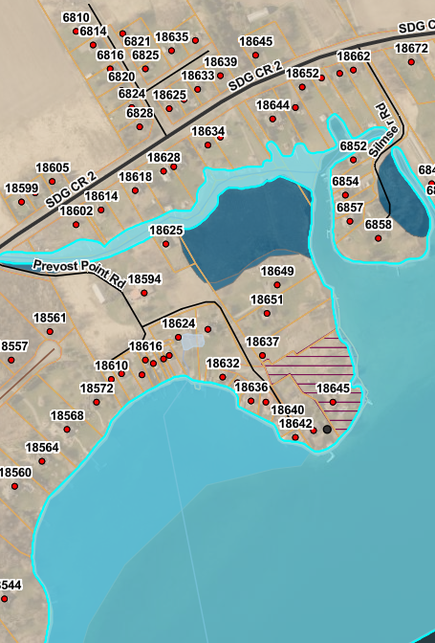
Zoning & OP Map
Subject Property
The subject property is designated Rural District in the County Official Plan
The subject property is currently Zoned FP-H and LSR-4 in the Zoning Bylaw

Slide 8
Knight Zoning By-Law Amendment
The purpose of this amendment is to amend LSR-4 to permit an additional dwelling unit on the subject property which will result in a total of three dwelling units.
All other applicable provisions of Zoning By-law 38-09, as amended, shall continue to apply.

Slide 9
Knight Zoning By-Law Amendment
The subject property was previously subject to a site specific Zoning Amendment which rezoned it to LSR-4 to permit an apartment within an existing single detached.

Slide 10
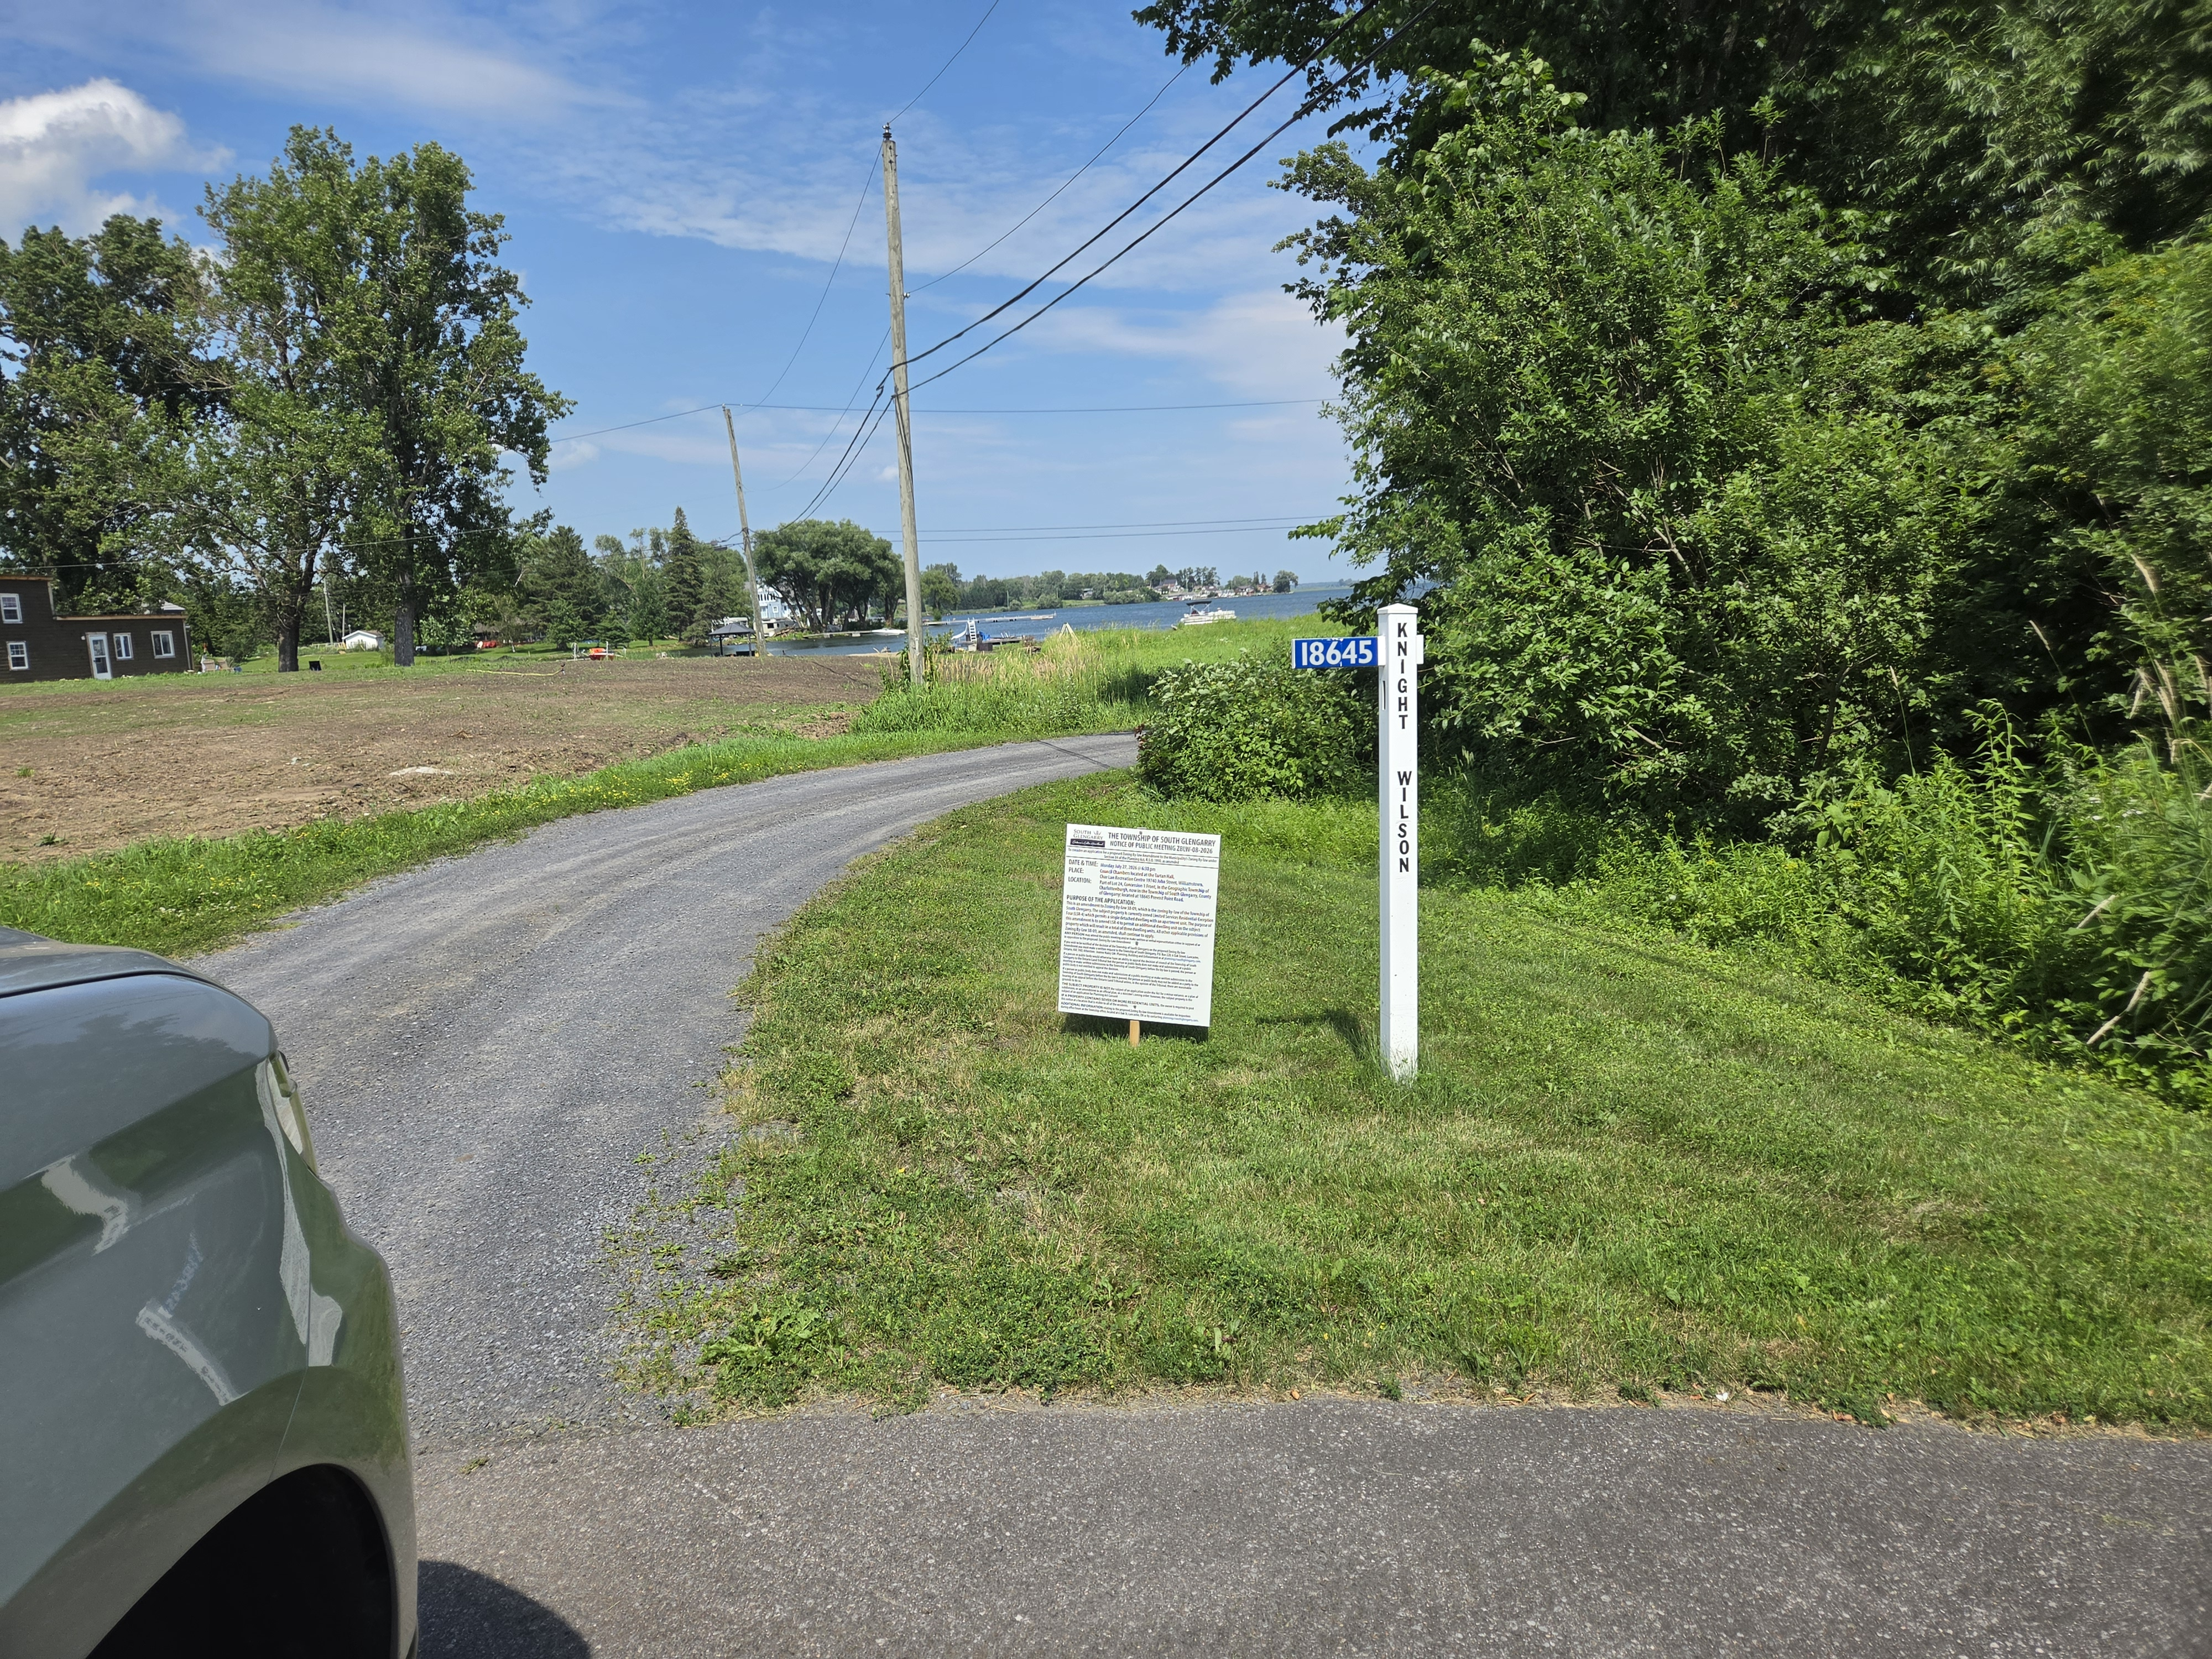
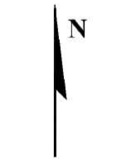
Existing Site - 18645 Prevost Point Road

Slide 11
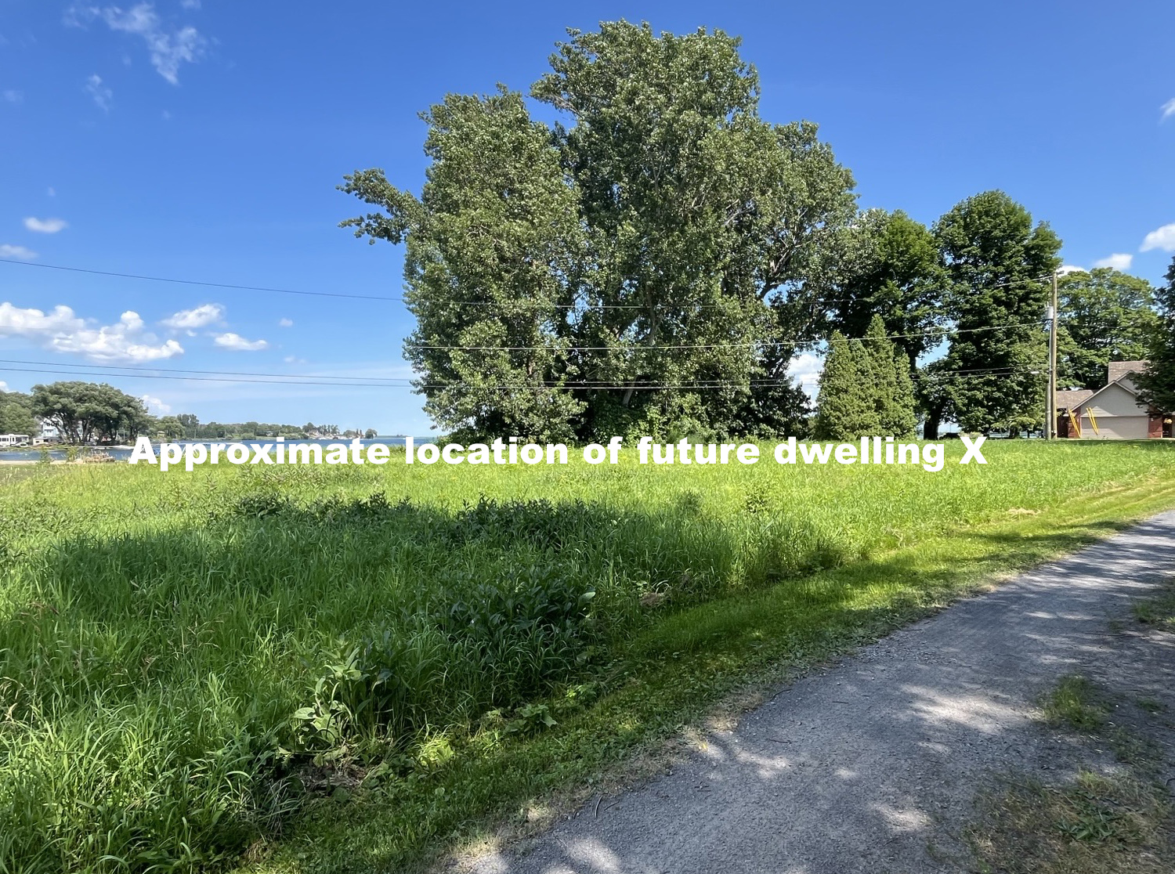
Existing Site - 18645 Prevost Point Road

Slide 12
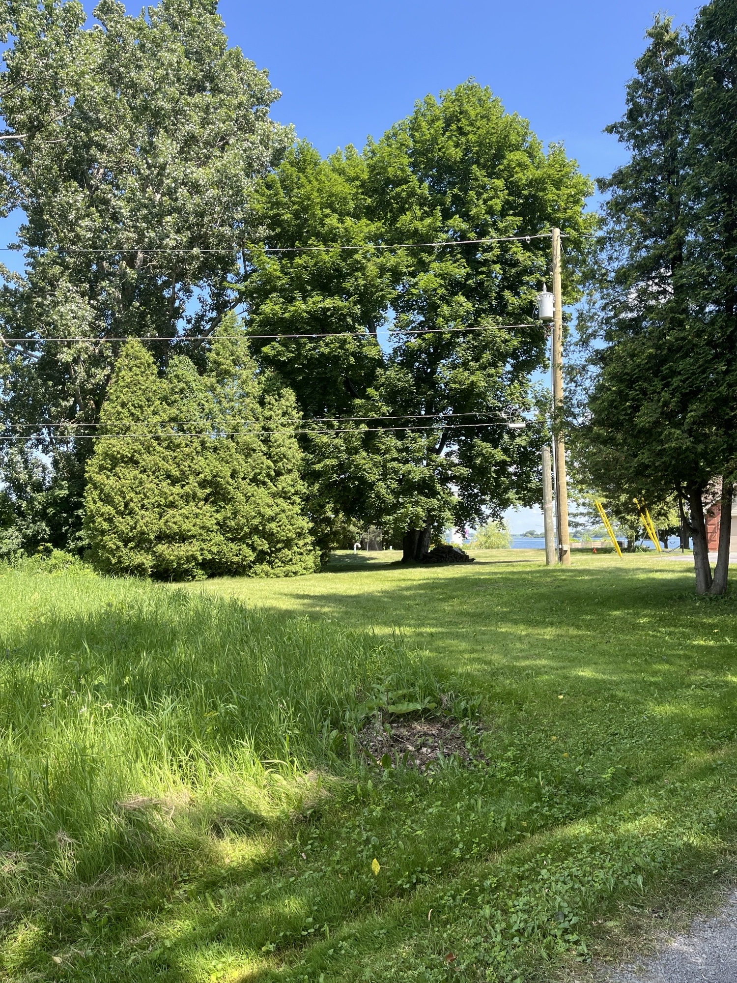
Existing Site - 18645 Prevost Point Road

Slide 13
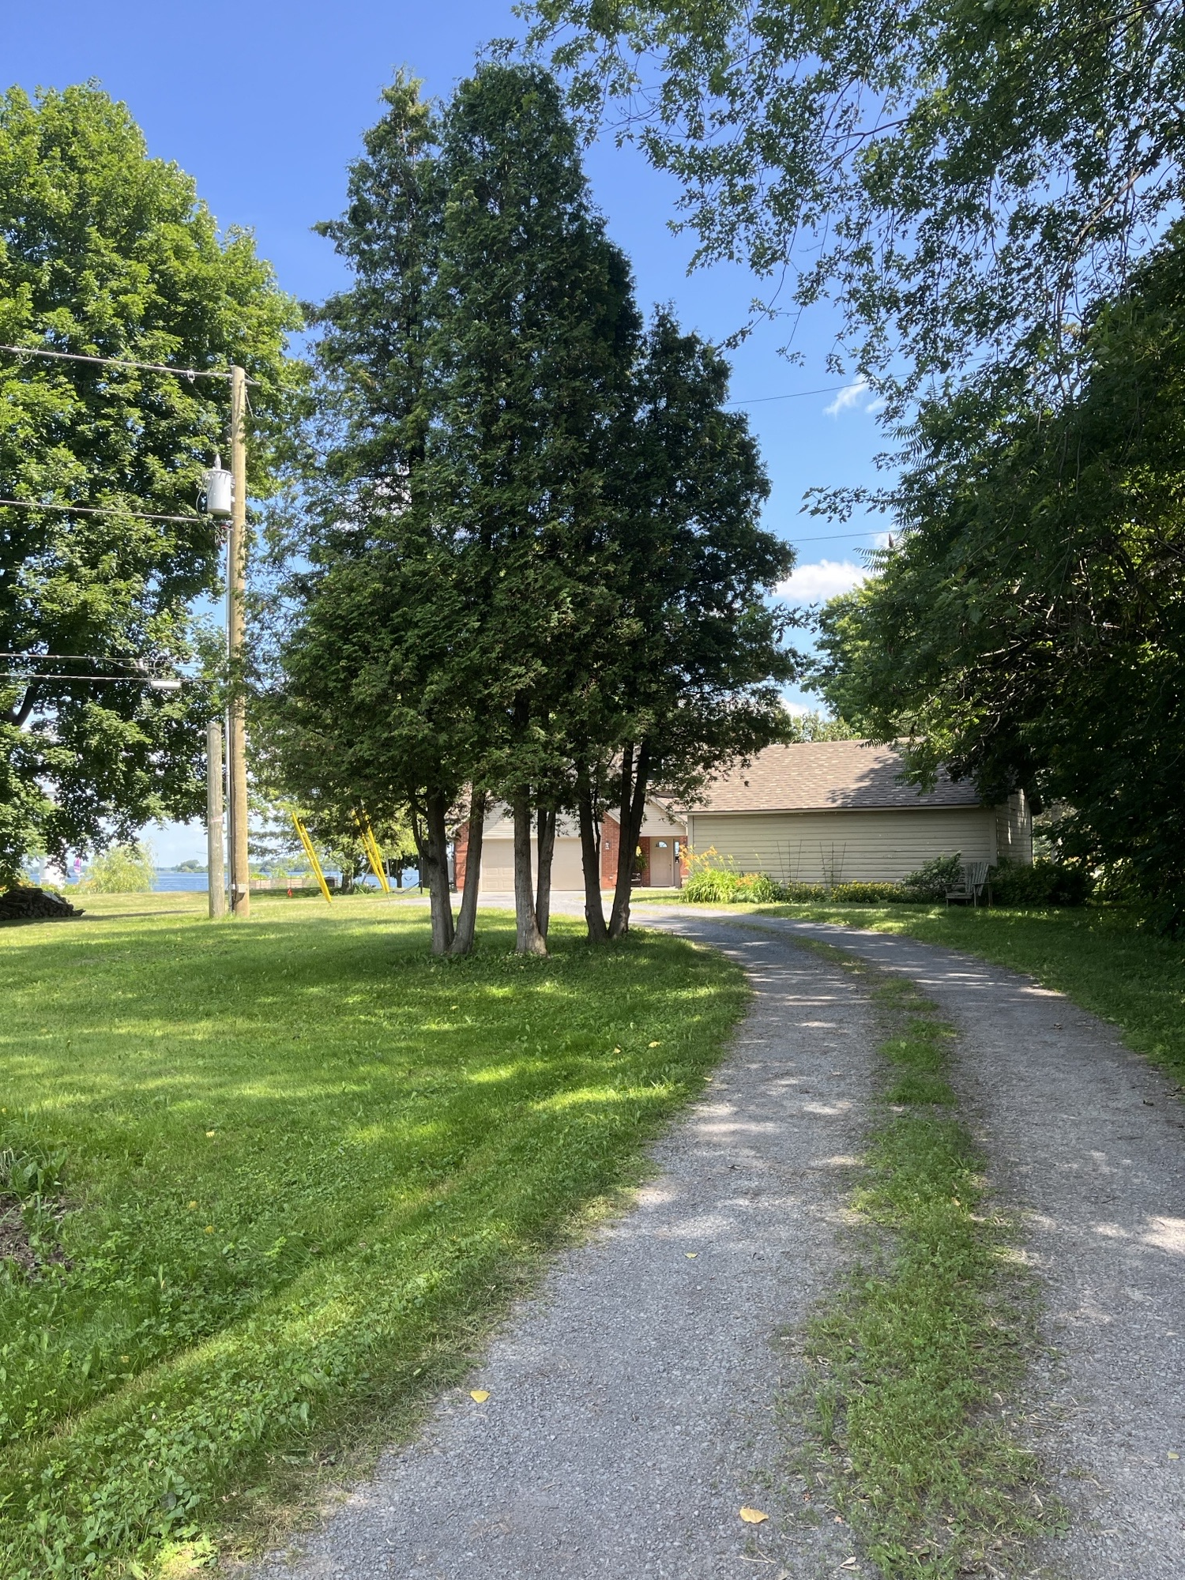
Existing Site - 18645 Prevost Point Road

Slide 14
Knight Zoning By-Law Amendment
A Notice of Public Meeting was circulated to the neighbouring property owners within 120m, a sign was erected on the subject property, and an ad was placed in the Standard Freeholder.
Staff have not received any written or oral comments regarding the proposed amendment from members of the public to date.

Slide 15
Knight Zoning By-Law Amendment
The application was also circulated to the Raisin Region Conservation Authority who have provided the following comments and map:
  “The RRCA does not object to the proposed zoning amendment (ZBLW-08-2026) as the area shown in black on the Key Map provided in the Township’s Notice is consistent with an area the RRCA believes contains a suitable envelope which can support the proposed residential development and is not contrary to the policies of the Natural Hazards section of the Provincial Planning Statement, the Conservation Authorities Act, or the Clean Water Act.”

Slide 16
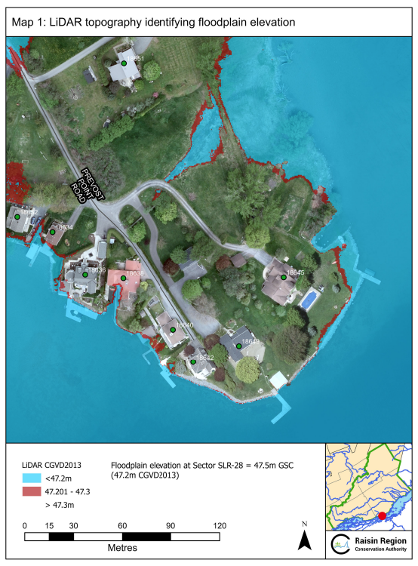

Slide 17
Knight Zoning By-Law Amendment
This zoning amendment application will be subject to a decision of Council and will be brought to a future Council meeting with a recommendation report once a comprehensive review has been completed and public input received and considered.

Slide 18

Please state your name and civic address for the Clerk/public record.

