Slide 1
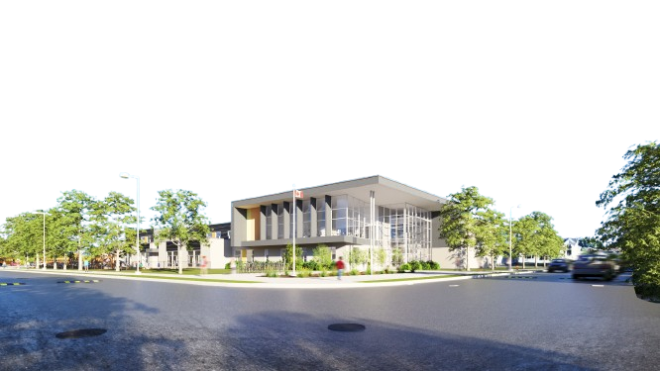


NEW WEST LONDON PUBLIC SCHOOL
COMMUNITY INFORMATION MEETING

Slide 2
INTRODUCTION
This presentation provides a summary of the design process for the new West London Public School. The design accommodates 525 full-time students, from junior kindergarten to grade 8 as well as 88 children for the childcare centre.
PRESENTATION
Aerial View
Site Plan
Floor Plans
Building Exteriors

Slide 3
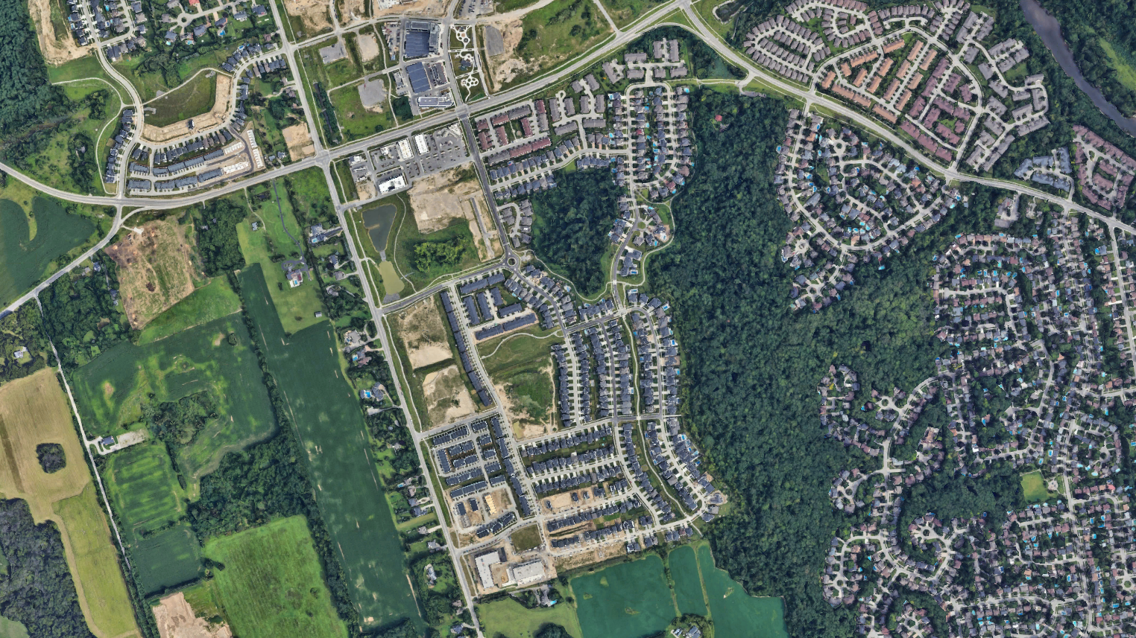

Oxford St W
Westdel Bourne
Commissioners Rd W
Oxford St W
Oxford St W
Riverbend Rd
Sumac Way
Oxford St W
Commissioners Rd W
Westdel Bourne
Upperpoint Blvd.
Upperpoint Ave
Riverbend Rd
Upperpoint Gate
Boardwalk Way
Trailsway Dr
Trailsway Ave
Westdel Bourne
Upperpoint Ave
Fountain Grass Dr
Upper W Ave

Slide 4
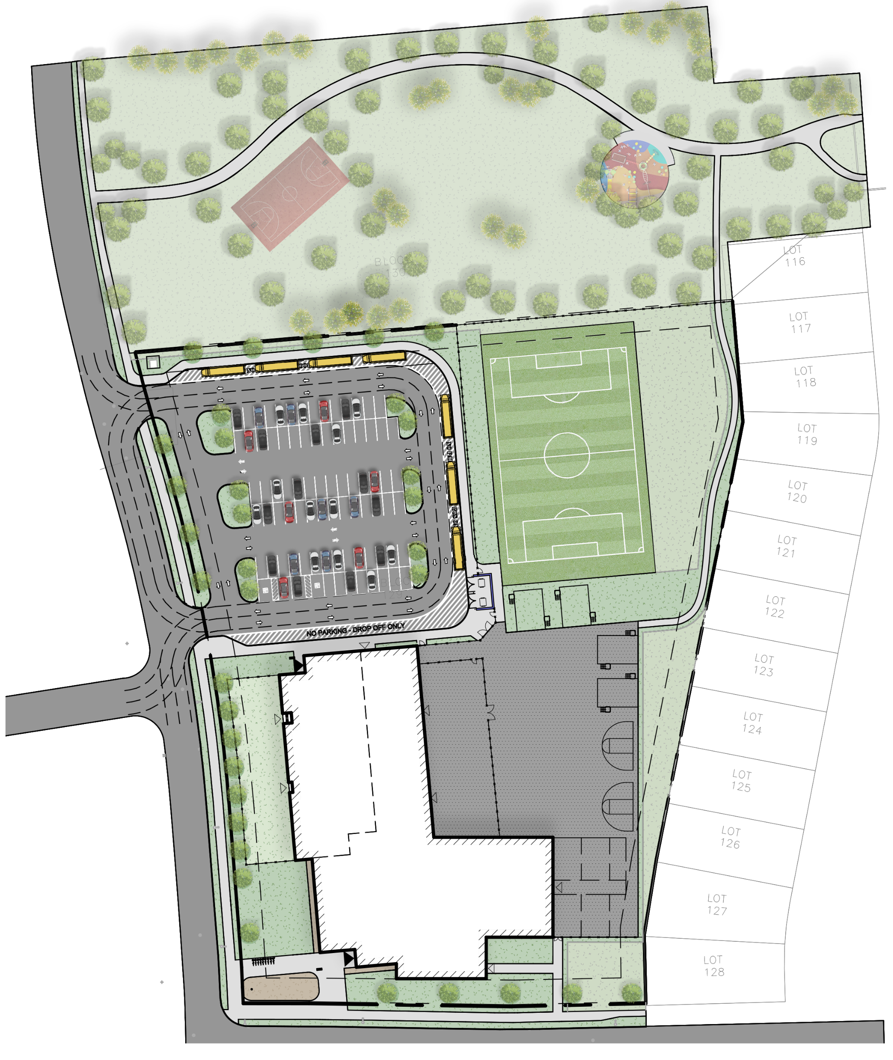
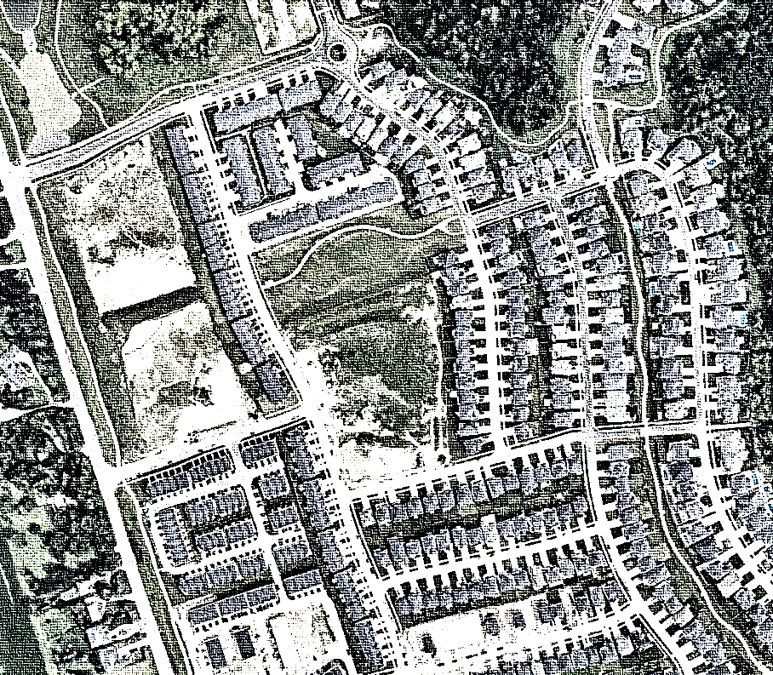
SITE PLAN
GROUND PLAN
SECOND PLAN
Upperpoint Ave
■ LEGEND
MAIN ENTRANCE
CHILDCARE ENTRANCE
CHILDCARE
PLAY AREA
DROP OFF
Upperpoint Gate
SCHOOL BUS
DROP OFF
PROPOSED
CHILD CARE
CENTRE
PARKING
Upperpoint Ave
PROPOSED 2 STOREY
ELEMENTARY SCHOOL
Boardwalk Way

Slide 5
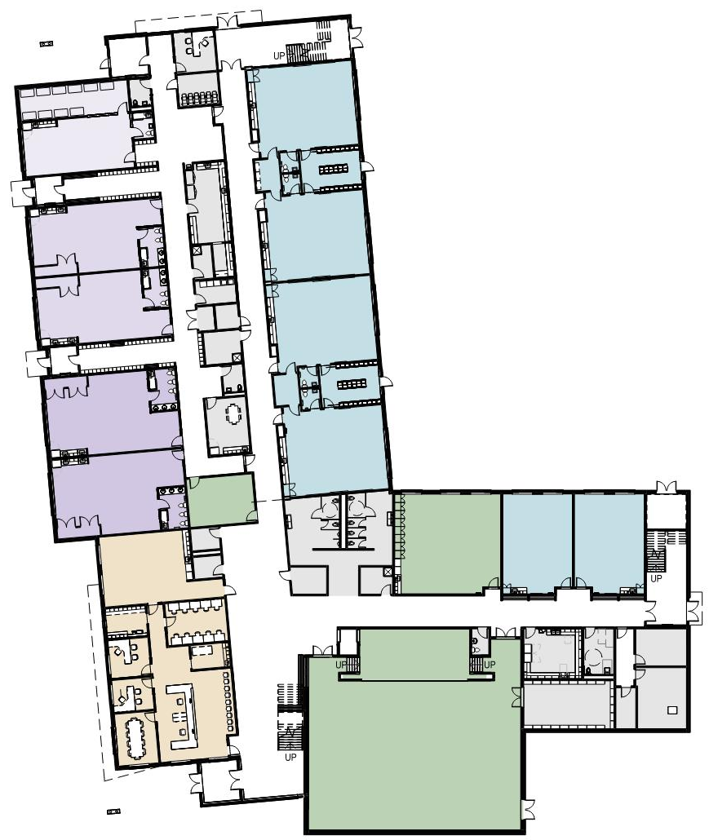
SITE PLAN
GROUND PLAN
SECOND PLAN
■ LEGEND
CHILDCARE - INFANT
CHILDCARE - TODDLER
CHILDCARE - PRESCHOOL
CLASSROOM
GYM
STAFF, OFFICE
TECHNICAL

Slide 6
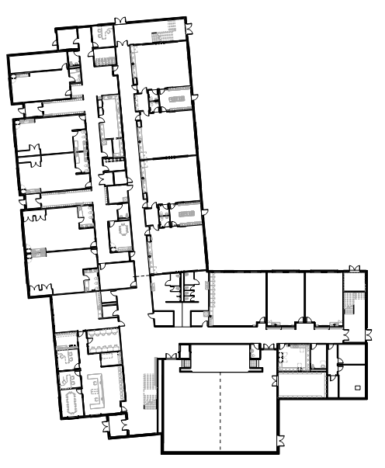
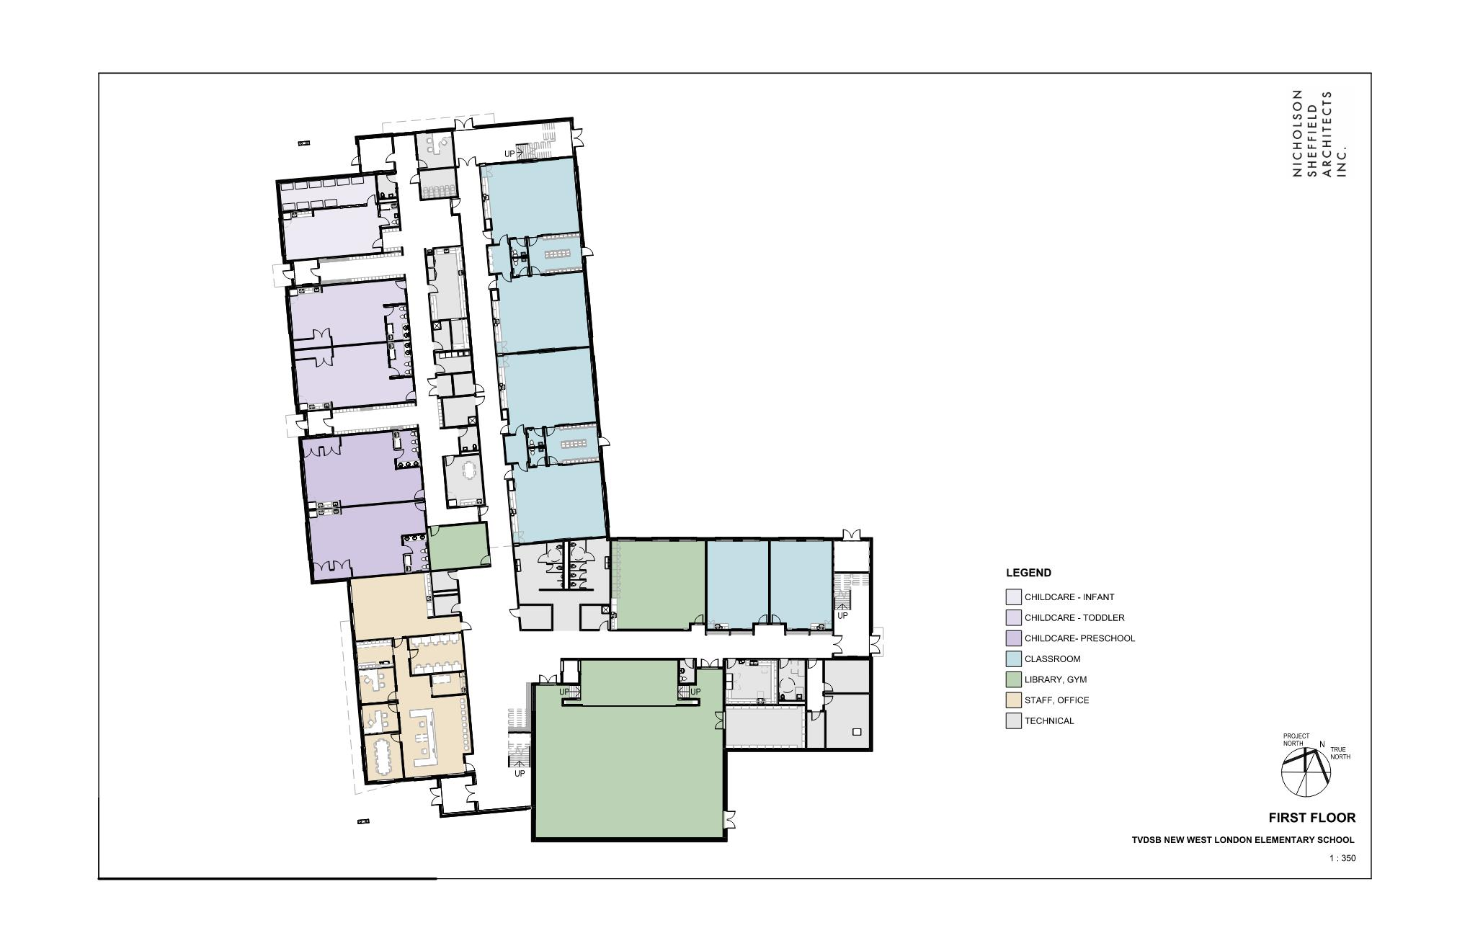
SITE PLAN
GROUND PLAN
SECOND PLAN
■ KEY PLAN
PRESCHOOL
RESOURCE
ROOM
■ LEGEND
ART
CLASSROOM
SPECIAL
EDUCATION
CLASSROOM
SPECIAL
EDUCATION
CLASSROOM
CHILDCARE - INFANT
WR
WR(M)
STAFF ROOM
&
LOUNGE
WR
WR(W)
CHILDCARE - TODDLER
STAIR
CHILDCARE - PRESCHOOL
COPY
WORK
ROOM
CORRIDOR
LOBBY
CLASSROOM
STAGE
KITCHEN
UWR
STORAGE
PRINC.
GYM
VICE
PRINC.
GENERAL
OFFICE
GYM
STORAGE
ELEC.
STAFF, OFFICE
MEETING
TECHNICAL
MAIN
ENTRANCE
GYMNASIUM

Slide 7
SITE PLAN
GROUND PLAN
SECOND PLAN
■ KEY PLAN
VEST
OFFICE
STAIR
SLEEPING
STORAGE
FDK
INFANT
COATS
■ LEGEND
CHILDCARE - INFANT
KITCHEN
FDK
TODDLER
CHILDCARE - TODDLER
LAUNDRY
CHILDCARE - PRESCHOOL
TODDLER
FDK
CLASSROOM
CUST
OFFICE
GYM
COATS
STAFF, OFFICE
PRESCHOOL
STAFF
LOUNGE
TECHNICAL
FDK
PRESCHOOL
RESOUCE
ROOM
WR(M)
WR(W)

Slide 8
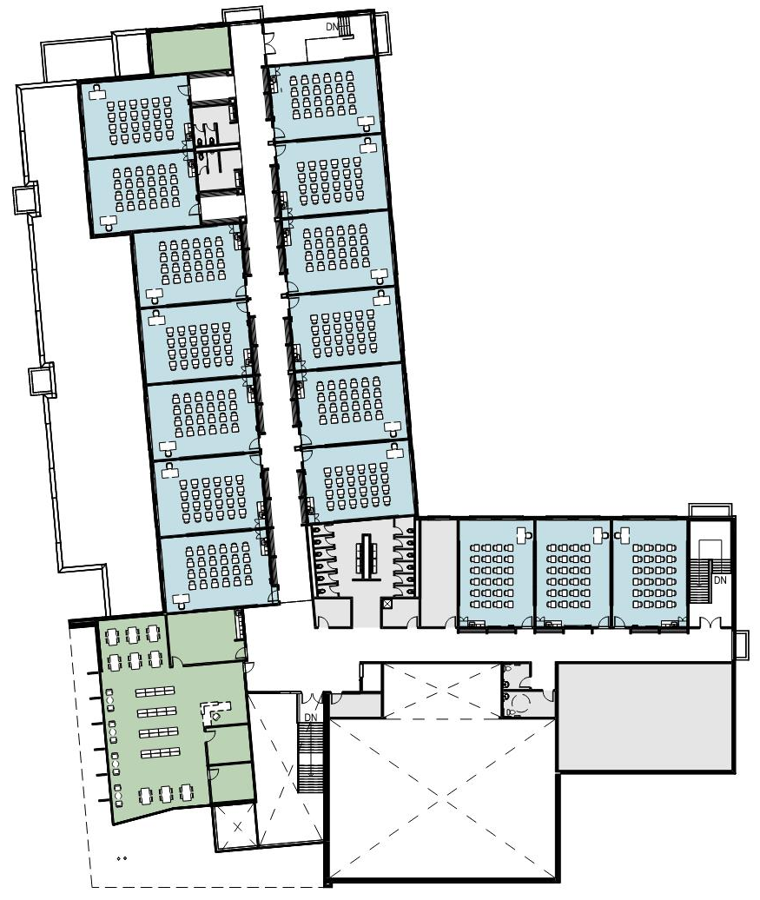
SITE PLAN
GROUND PLAN
SECOND PLAN
■ LEGEND
CLASSROOM
LEARNING COMMONS
TECHNICAL

Slide 9
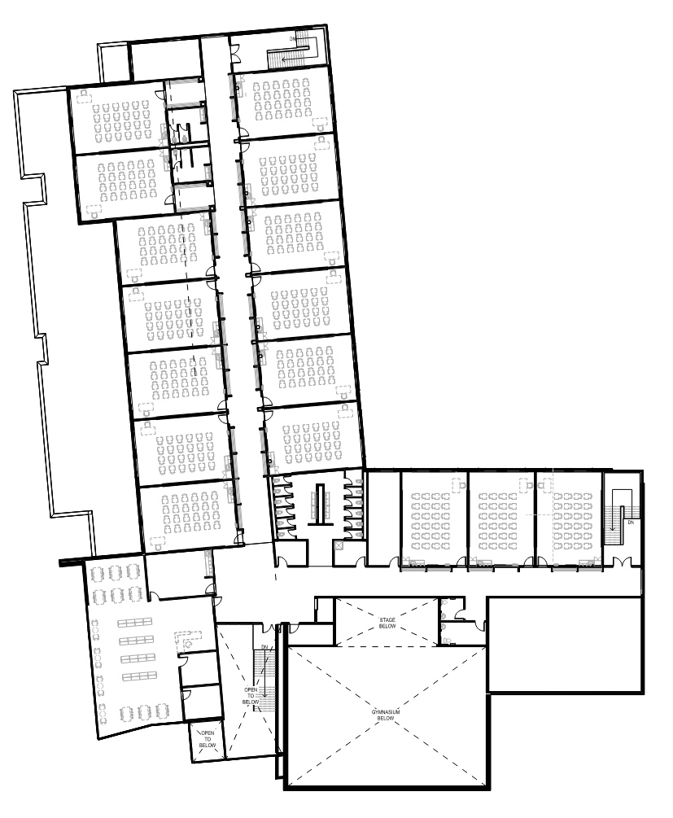
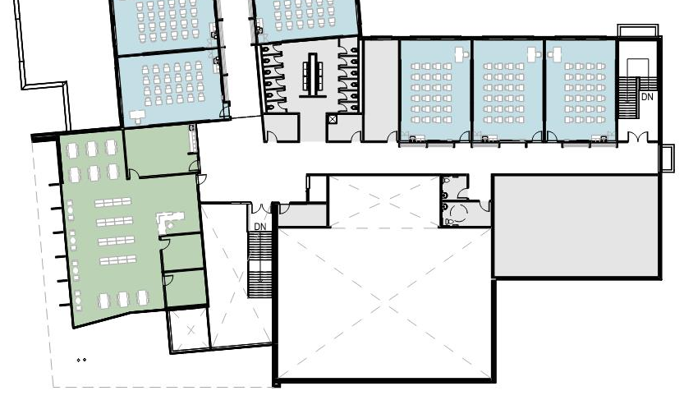
SITE PLAN
GROUND PLAN
SECOND PLAN
■ KEY PLAN
CLASSROOM
CLASSROOM
■ LEGEND
CORRIDOR
CLASSROOM
CLASSROOM
ACADEMIC
STORAGE
CLASSROOM
CLASSROOM
CLASSROOM
GENDER
NEUTRAL WR.
LEARNING COMMONS
STAIR
TECHNICAL
CORRIDOR
ELEV.
STAGE
BELOW
LEARNING
COMMONS
MECH
MECHANICAL
ROOM
OPEN
TO
BELOW
GYMNASIUM
BELOW
OPEN
TO
BELOW

Slide 10
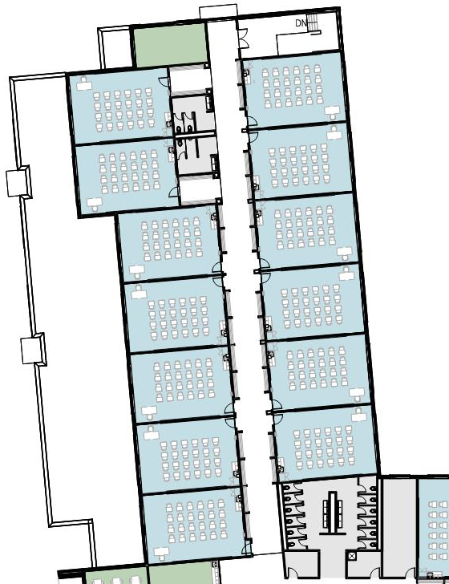
SITE PLAN
GROUND PLAN
SECOND PLAN
■ KEY PLAN
RESOURCE
ROOM
STAIR
CLASSROOM
CLASSROOM
CLASSROOM
CLASSROOM
■ LEGEND
CLASSROOM
CLASSROOM
CLASSROOM
LEARNING COMMONS
TECHNICAL
CLASSROOM
CLASSROOM
CORRIDOR
CLASSROOM
CLASSROOM
CLASSROOM
CLASSROOM
CLASSROOM
ACADEMIC
STORAGE
GENDER
NEUTRAL WR.

Slide 11
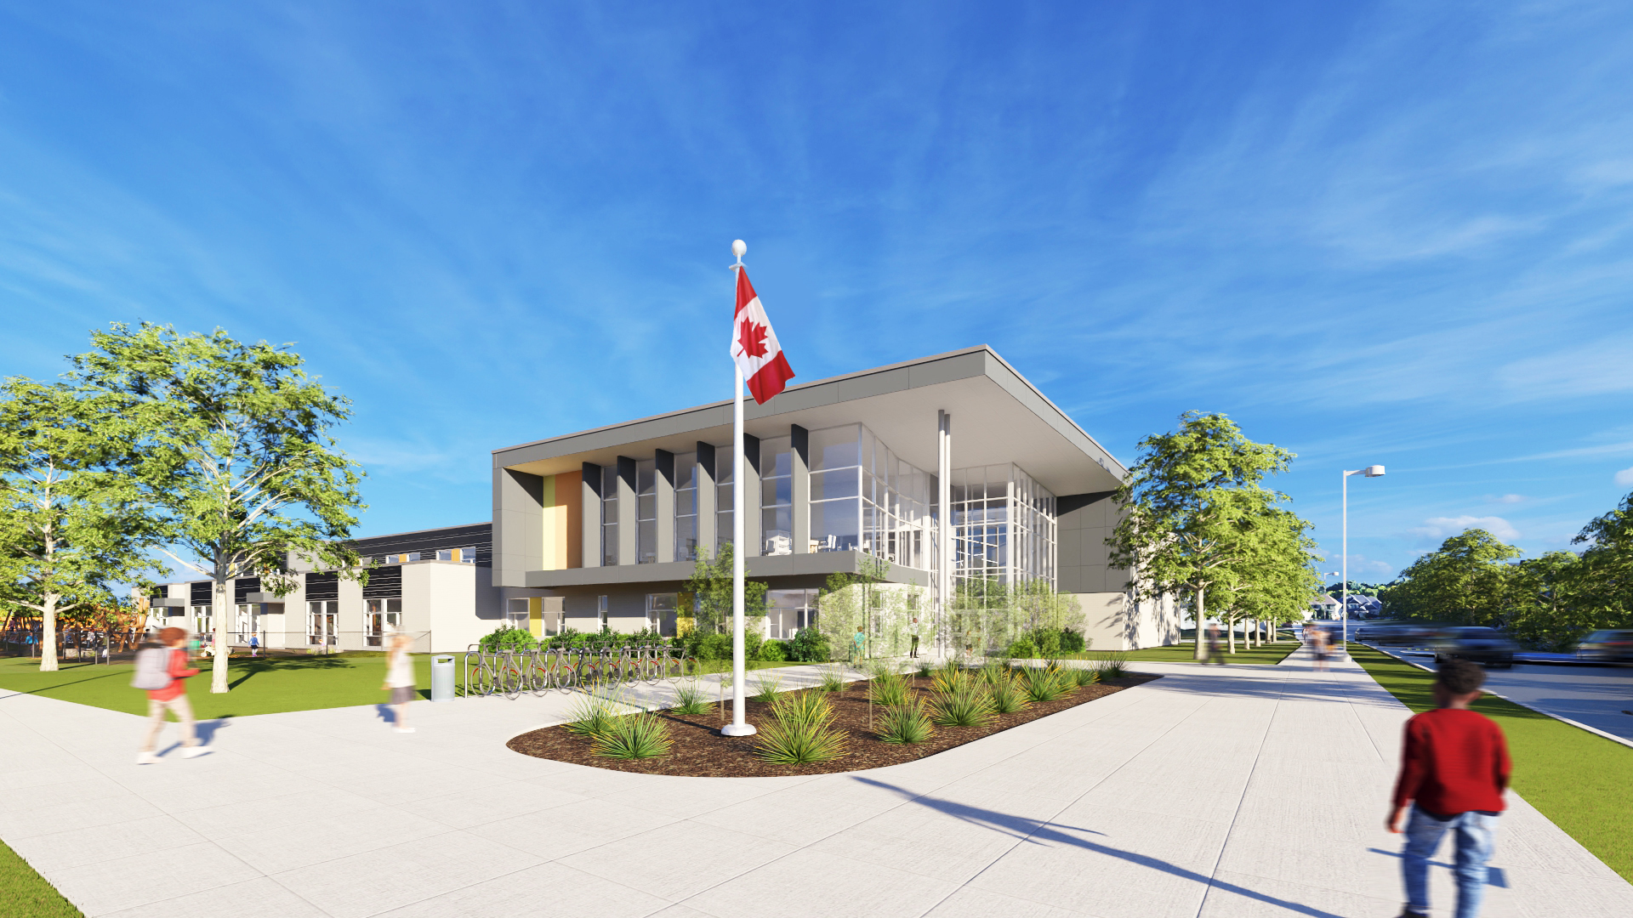


Slide 12
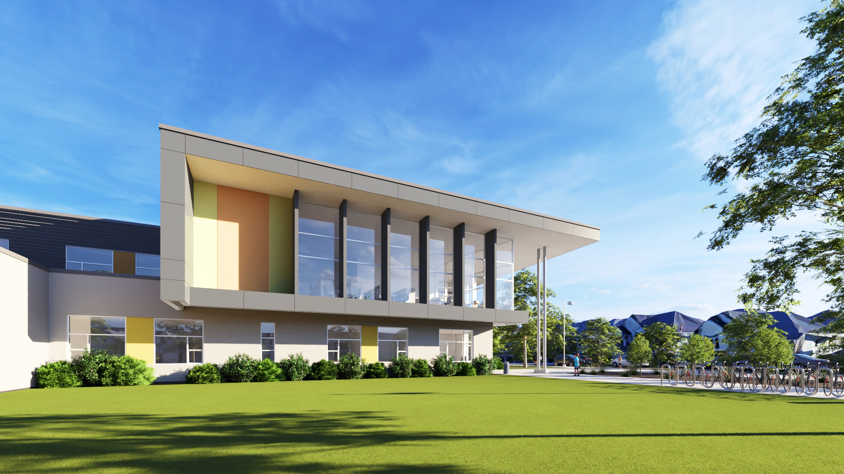

Slide 13
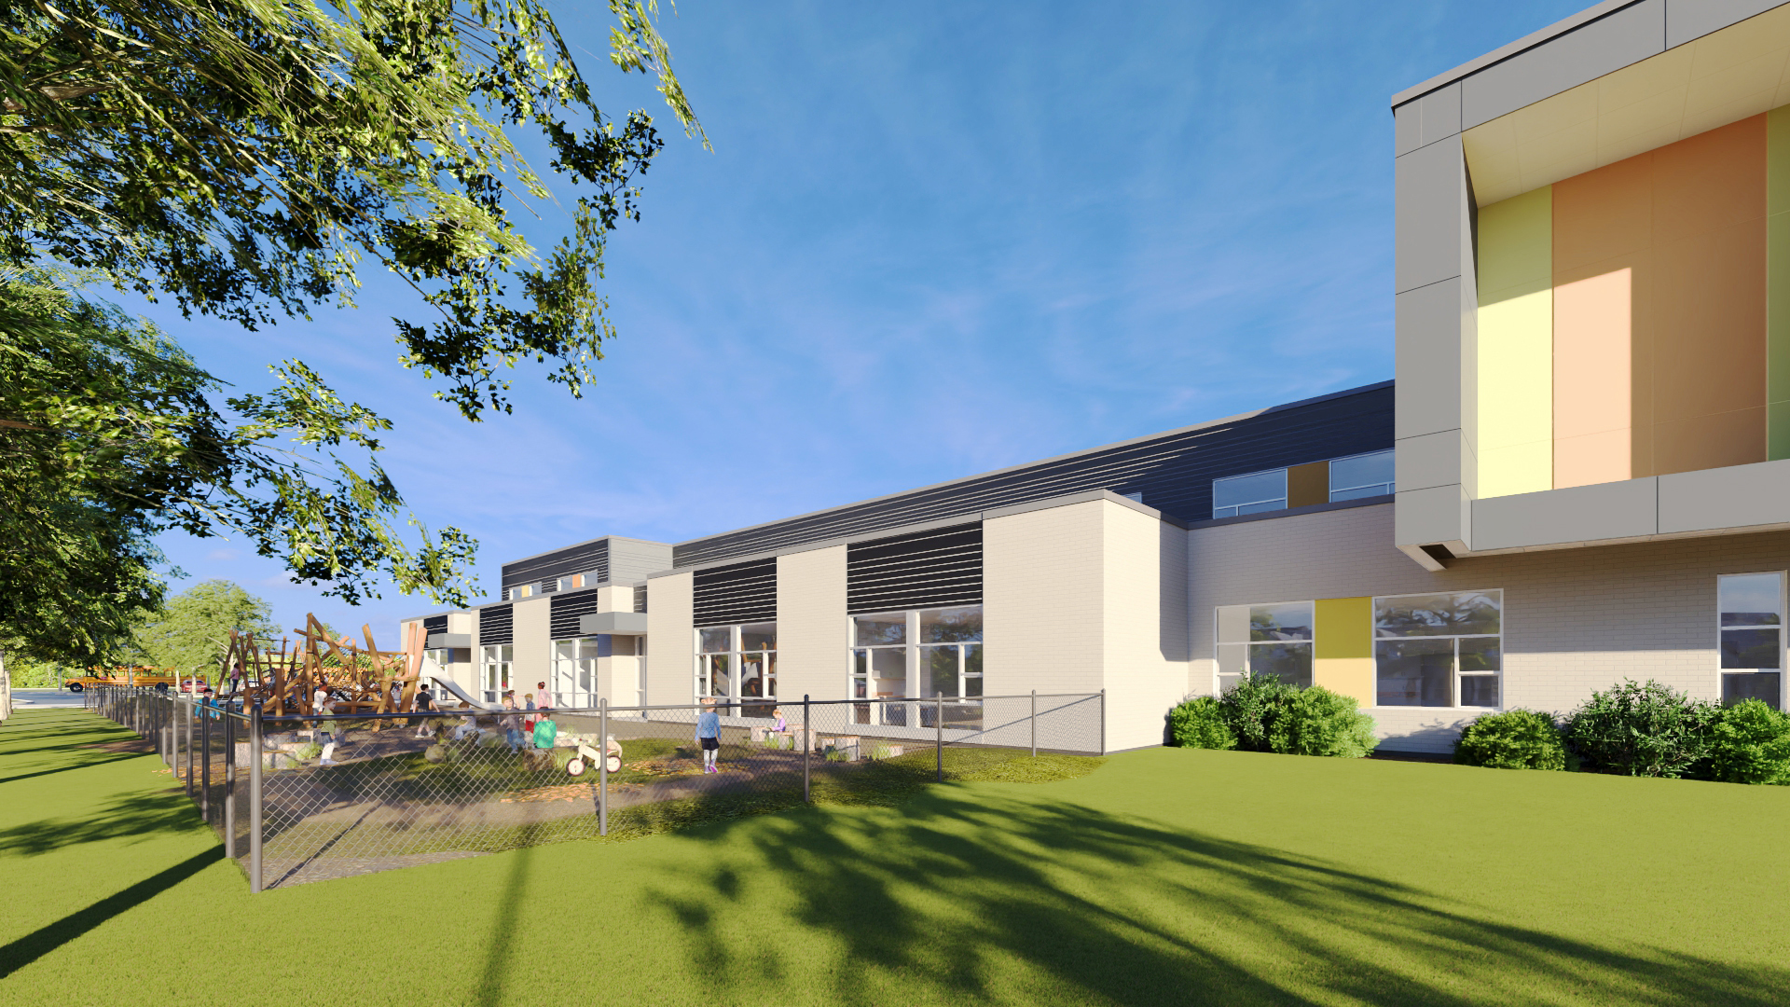

Slide 14
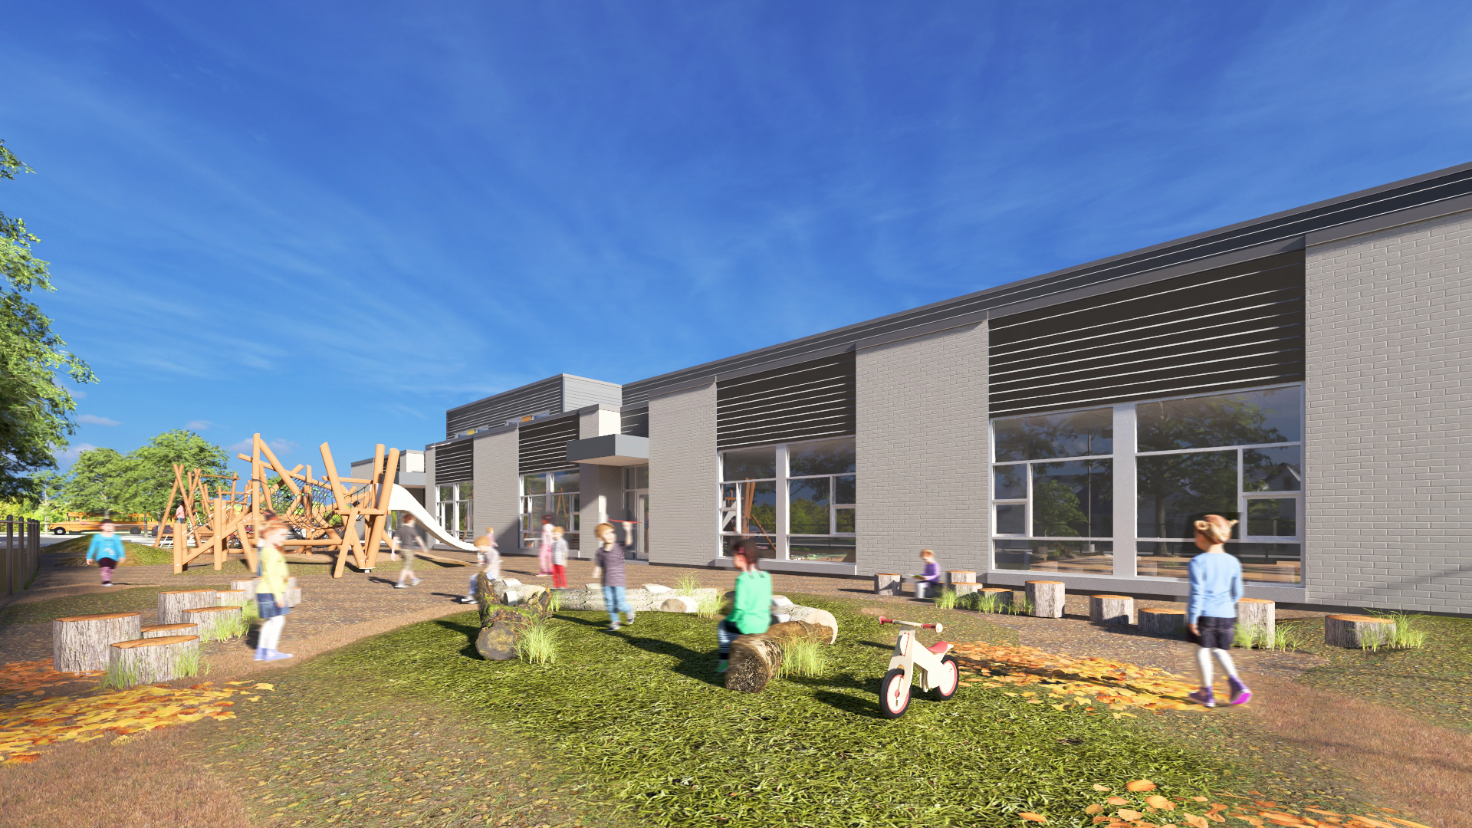

Slide 15
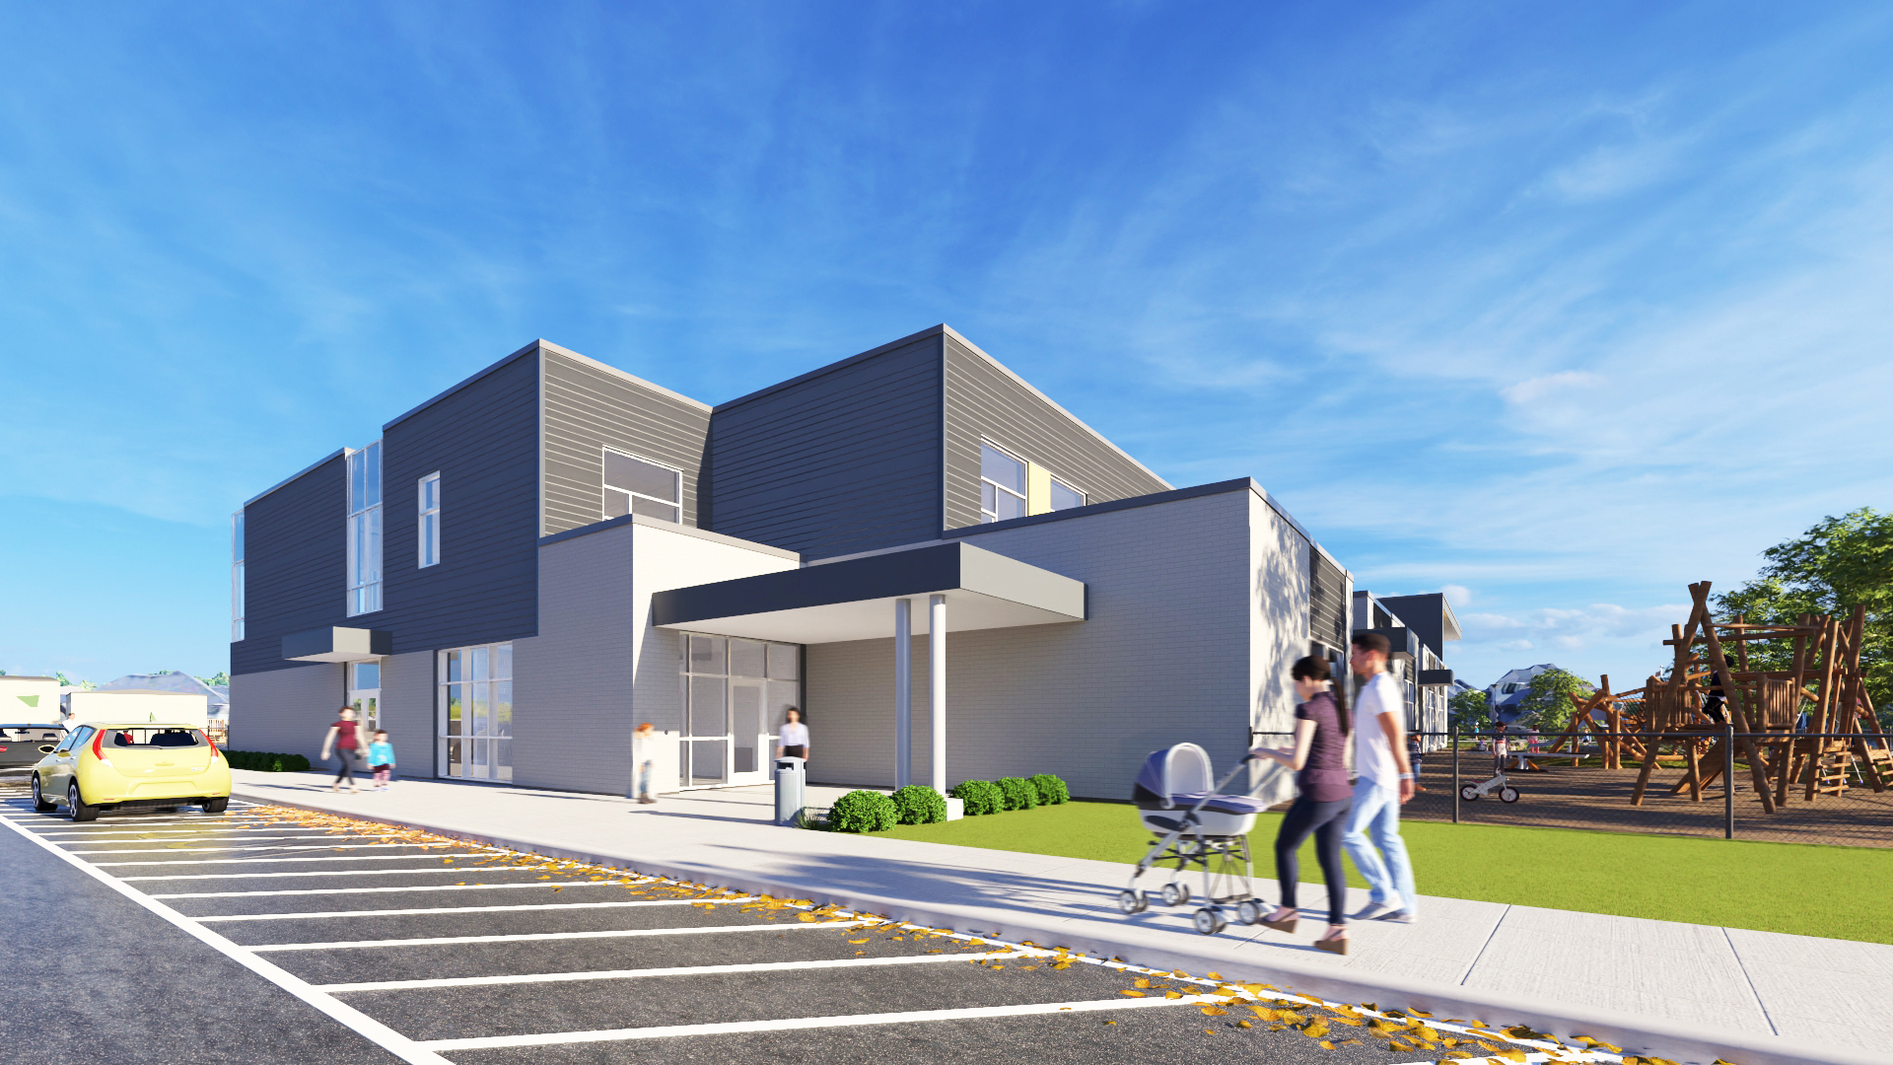

Slide 16
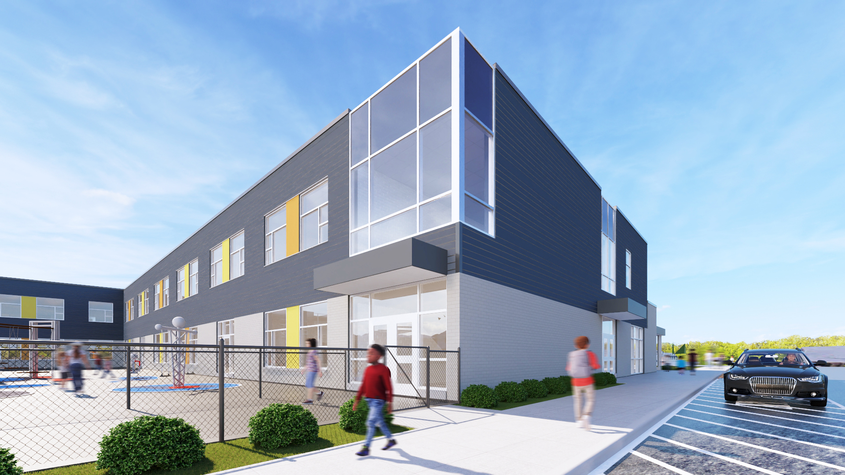

Slide 17
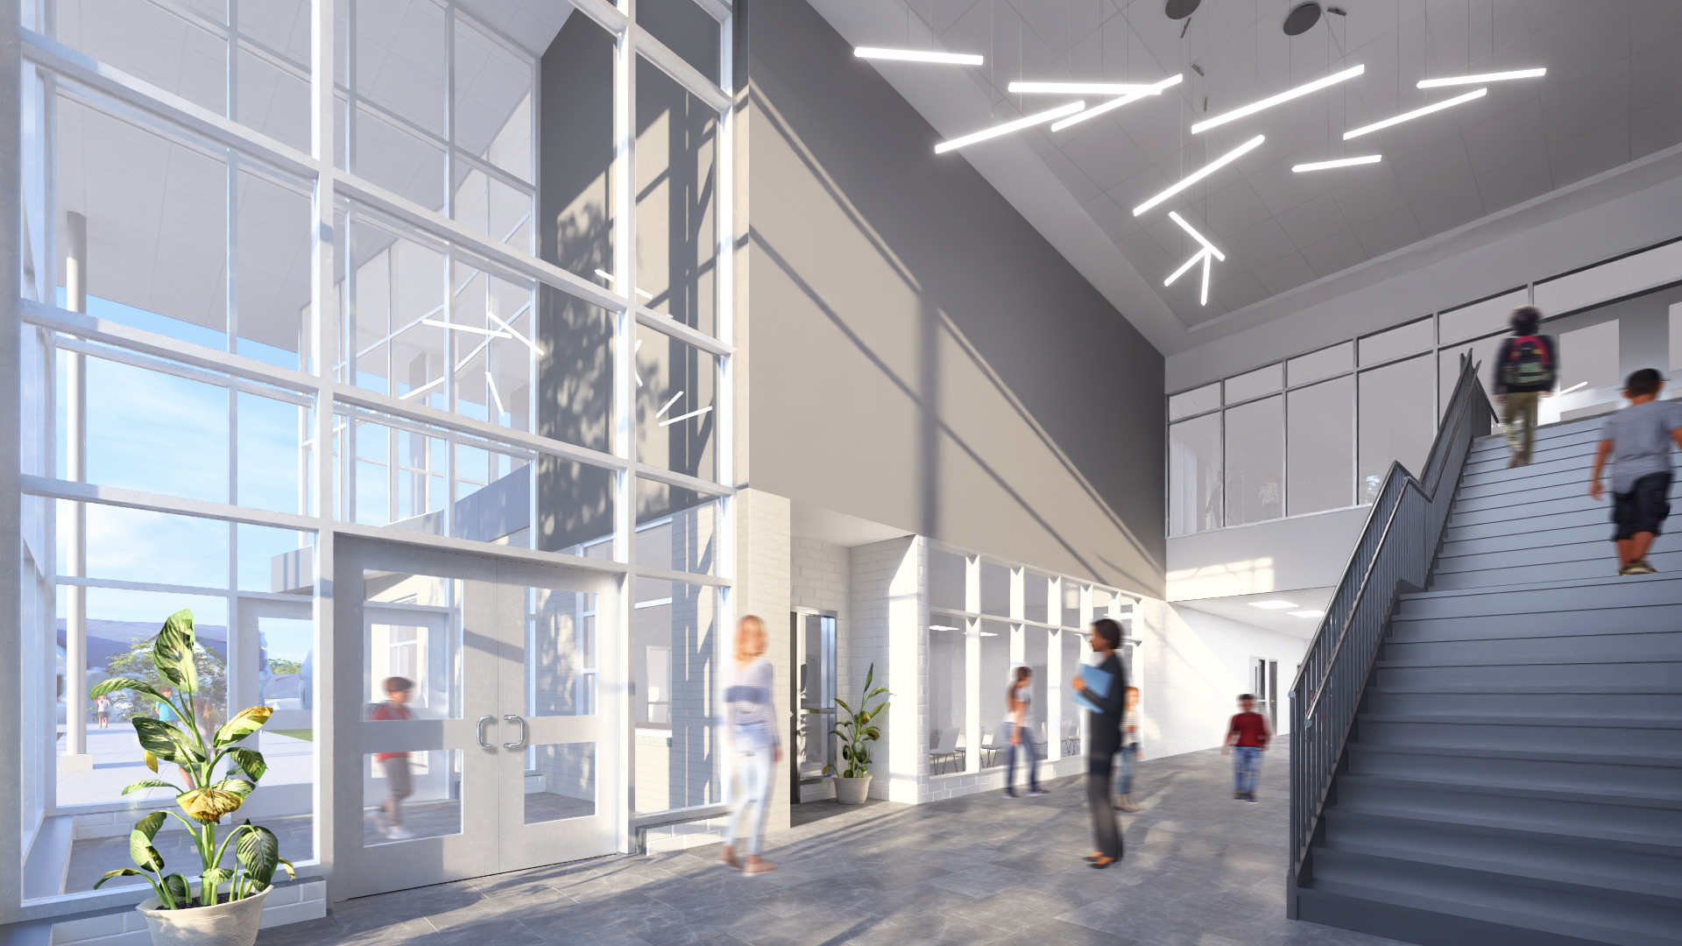

Slide 18
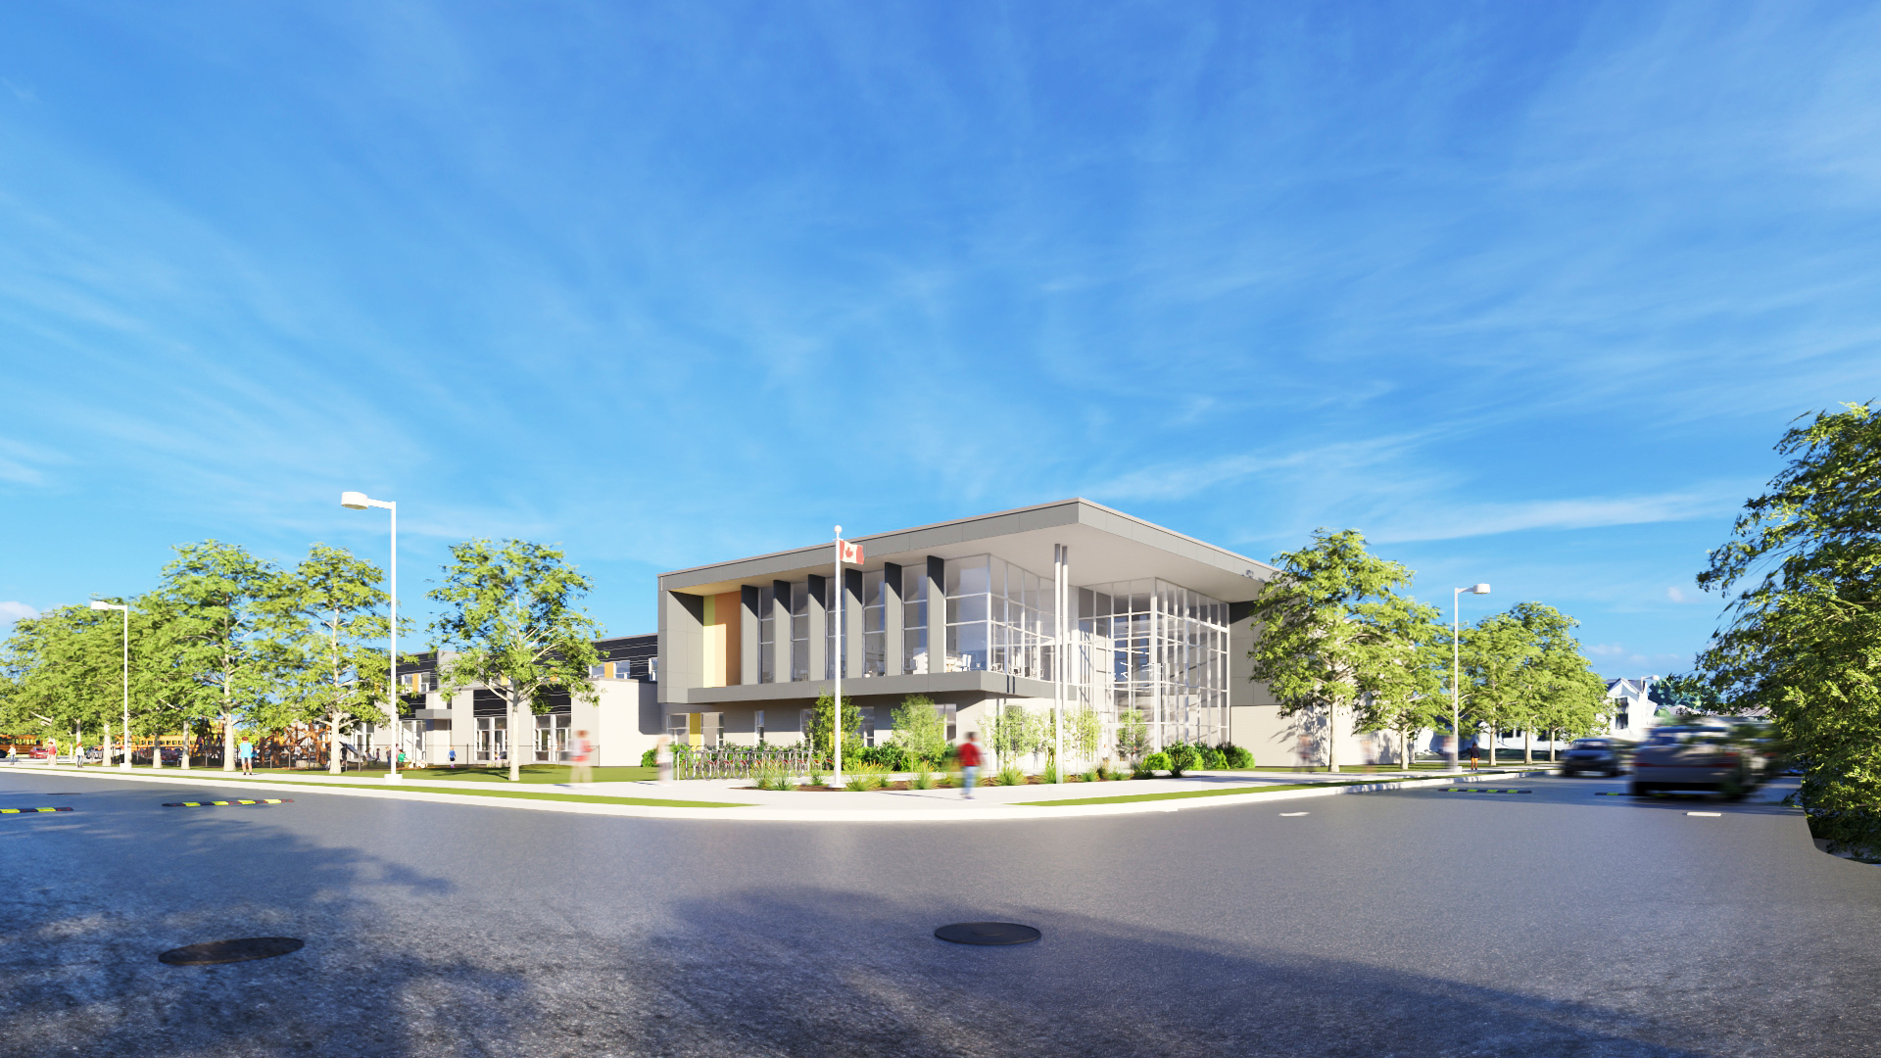
THANK YOU

